Slide 1

Developing a Gold Standard Perinatal Trauma Pathway for Wales
Dr Sarah Douglass, Principal Clinical Psychologist
Dr Matt Lewis, Principal Clinical Psychologist
Megan King, Assistant Psychologist

Slide 2
Workshop context
Part 1
What is trauma?
Why is it important to understand the impact?
What do we mean by perinatal (population)?
Examples of current best practice
Service user experiences
Part 2
Developing a Gold Standard All-Wales Perinatal Pathway

Slide 3
What is trauma...
Psychological trauma has been defined as “an event, series of events, or set of circumstances that is experienced by an individual as physically or emotionally harmful or life threatening and that has lasting adverse effects on the individuals functioning and mental, physical, social, emotional or spiritual wellbeing”
(SAMSHA, 2012)

Slide 4
Why is it important to understand this...
Trauma is not universal; it is different for every person. Please can staff see us as individuals?
(mother with birth trauma)
I told the them that I had been sexually abused and I was scared about the internal, she rubbed my arm and said, "he's a doctor...he isn't looking at you in that way"
(mother reflecting on her experience of services during pregnancy)

Slide 5


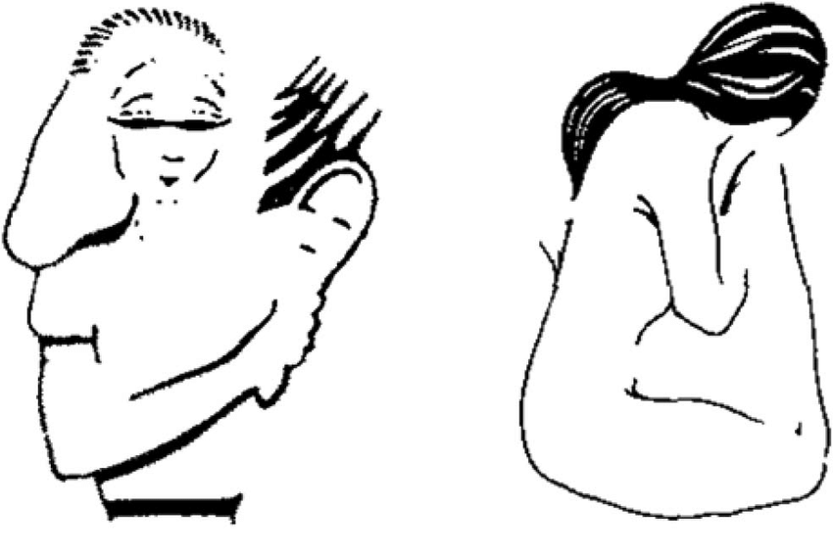

Individual context is everything...

Slide 6
Perinatal defined...
Timeframe:
The perinatal period refers to the period from conception to the infant(s) first birthday
Other home nations have/are moving to 2nd birthday to mirror the first 1000-days literature and evidence
Services:
  GP
  Maternity
  Health visitor
  Sonography
  Obstetrics
  Paediatrician / neonatologist
  Anaesthetics
  Neo-natal Intensive Care Unit (NICU)
  Parent-infant services
  Specialist Mental Health services (community and inpatient)
  Social services

Slide 7
Examples of current best practice

Slide 8
Case Study: Devon Partnership NHS Trust’s perinatal mental health pathway
Devon partnership developed the Sexual Abuse Care Pathway for Women in Pregnancy. This offers routine enquiry to all women about past or current abuse at their first booking with the community midwife. If there is a disclosure, staff complete the ‘Prediction and Detection tool’ and, with consent, they refer to the Perinatal Mental Health Team where the mother is triaged and offered an ‘opt in’ letter. From there, a range of referrals can take place, depending on the level of need. For example, women can be placed on the PMH care pathway or referred to the Obstetric Clinic where they can discuss delivery choices and options.
Additionally, they have developed two information leaflets. One supports expectant women who have experienced abuse in childhood, as a teenager or adult. The other is for staff working with women during pregnancy and childbirth who have experienced sexual abuse. Such tools can encourage meaningful conversation.

Slide 9
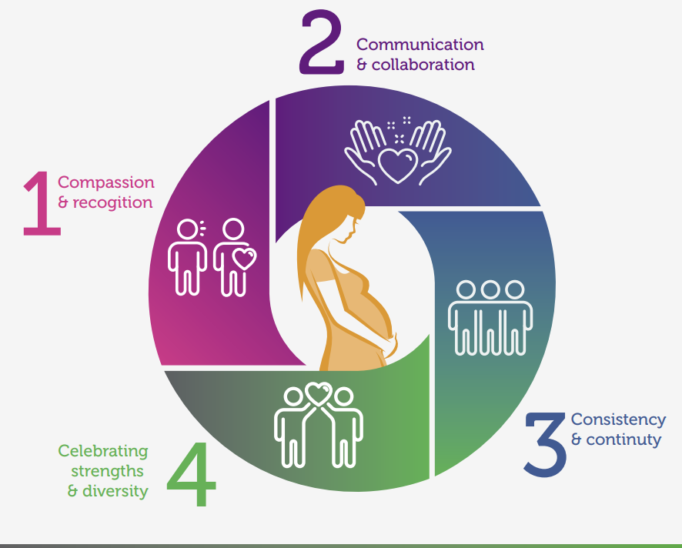
Blackpool Better Start (2021) - A good practice guide to support implementation of trauma-informed care in the perinatal period
This guide aims to help staff and services understand the impact of psychological trauma and respond in a sensitive and compassionate way.
It aims to support staff to ensure they ‘do no harm’ through care delivery that, without thought or intention, could re-traumatise individuals.
This includes examples of how to:
Recognise and understand the impact of psychological trauma and how experiences may present during the perinatal period
Respond to disclosures and tailor care to needs of women and families so that services do not re-traumatise individuals
Best support staff working in maternity and mental health services, acknowledging the effects of vicarious trauma and that staff may have their own experiences of trauma, which could impact on their capacity to deliver trauma-informed care

Slide 10
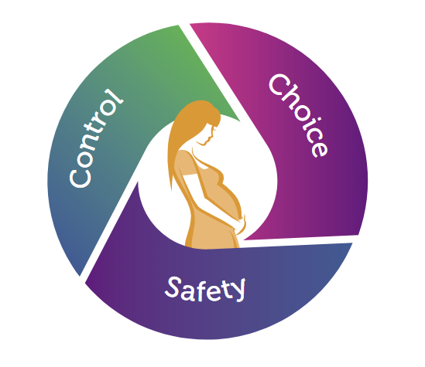
Trauma-informed care
Trauma-informed care aims to promote feelings of psychological safety, choice, and control. Every contact with a woman and her partner matters. It is important that staff put the woman at the centre of her care – this can be done by ensuring all individuals feel seen, heard and cared for

Slide 11
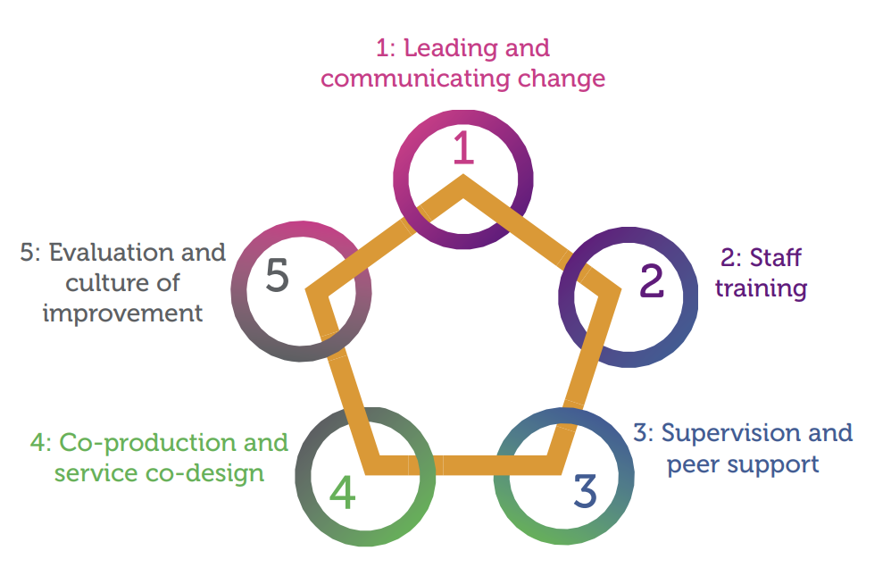
Recommendations for becoming trauma-informed
Creating a trauma-informed system will require a change in culture and practice at multiple levels. This includes support and understanding from those involved in sustainability and transformation partnerships / integrated care systems, commissioners and providers.
The diagram highlights key areas for consideration

Slide 12
Other trauma-informed resources...
Engaging with Complexity. Providing Effective Trauma Informed Care for Women Centre for Mental Health and Mental Health Foundation (2019). Information for public sector providers and commissioners on providing effective trauma informed care for women.
A sense of safety. Trauma-Informed approaches for women Agenda Alliance for Women and Girls at Risk and Centre for Mental Health (2020). Considers barriers to implementing trauma-informed approaches across the health and care context.
A Case for TIC: A Complex Adaptive Systems Enquiry for Trauma Informed Care Thirkle, Kennedy & Sice (2018).
Trauma-Informed Organizational Change Manual Institute on Trauma and Trauma-Informed Care (2019).
Trauma-informed Care and Practice Organisational Toolkit. The Mental Health Coordinating Council (MHCC), Australia (2018).
The Alberta Family Wellness Initiative Brain Story Certificate Free, accredited online trauma training.
Women’s Mental Health Taskforce Department of Health and Social Care and Agenda Alliance for Women and Girls at Risk (2018).
Priorities for improving women’s mental health and experiences of services, including principles of trauma informed care.

Slide 13
Service user experiences

Slide 14
“The paediatric consultant was cold, clinical and rude”
“I was told to only buzz if I was hemorrhaging”
“I was made to feel like I was making a fuss about nothing, because what I had been through was ‘normal’”
We would have liked some recognition that what we had just been through is horrific”
“We felt we couldn’t raise these issues because they were too busy, over stretched”

Slide 15
Perinatal Trauma Workstream

Slide 16
Draft perinatal trauma pathway: aims
To be inclusive of mothers and other people who are pregnant and give birth, as well as their partners.
To be co-owned and co-produced together with people that use services and have experienced trauma and/or tokophobia, to ensure that decisions are collaborative and transparent, and that care and support is offered that empowers the individual where possible.
To improve access to effective evidence-based psychological therapies for people who experience trauma and fear of giving birth resulting from traumatic experiences (secondary tokophobia) in the perinatal period, particularly to communities or individuals who experience barriers to equitable access to services.
To standardise provision across regions to avoid variability in access to provision and improve the sharing of best practice

Slide 17
Draft perinatal trauma pathway: aims
To integrate maternity and mental health services to ensure a lean, person-centred pathway that minimises repeated referrals and assessments and improves transitions between services
To be informed by evidence and clinical guidelines, by practitioner knowledge and by the knowledge of people that use services and have experience of trauma and tokophobia
To identify training and workforce development needs that may be required to deliver the pathway
To interface with other pathways, such as the traumatic bereavement pathway and other perinatal psychological therapies pathways

Slide 18
An All-Wales Perinatal (Gold Standard) pathway

Slide 19
Groups
Group 1
Group 2
Group 3
Group 4
Group 5
Group 6
Group 7
Group 8
Group 9
Group 10

Slide 20
References
Substance Abuse and Mental Health Services Administration Trauma and Justice Strategic Initiative (SAMSHA). (2012). SAMHSA’s working definition of trauma and guidance for trauma-informed approach. Rockville, MD.: Substance Abuse and Mental Health Services Administration.

