Slide 1
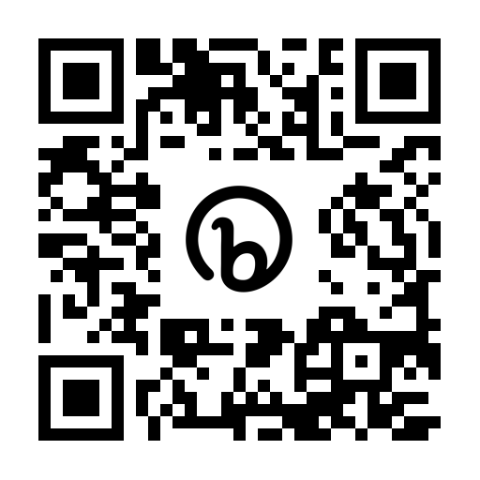


Working with complexity in ptsd
(and how to win at rugby)
TSW Conference 2023
Dr Hannah Murray
Research Clinical Psychologist
Oxford Centre for Anxiety Disorders and Trauma
University of Oxford
Handouts/papers: bit.ly/MurrayTSW
murrayptsd@gmail.com @murrayptsd

Slide 2

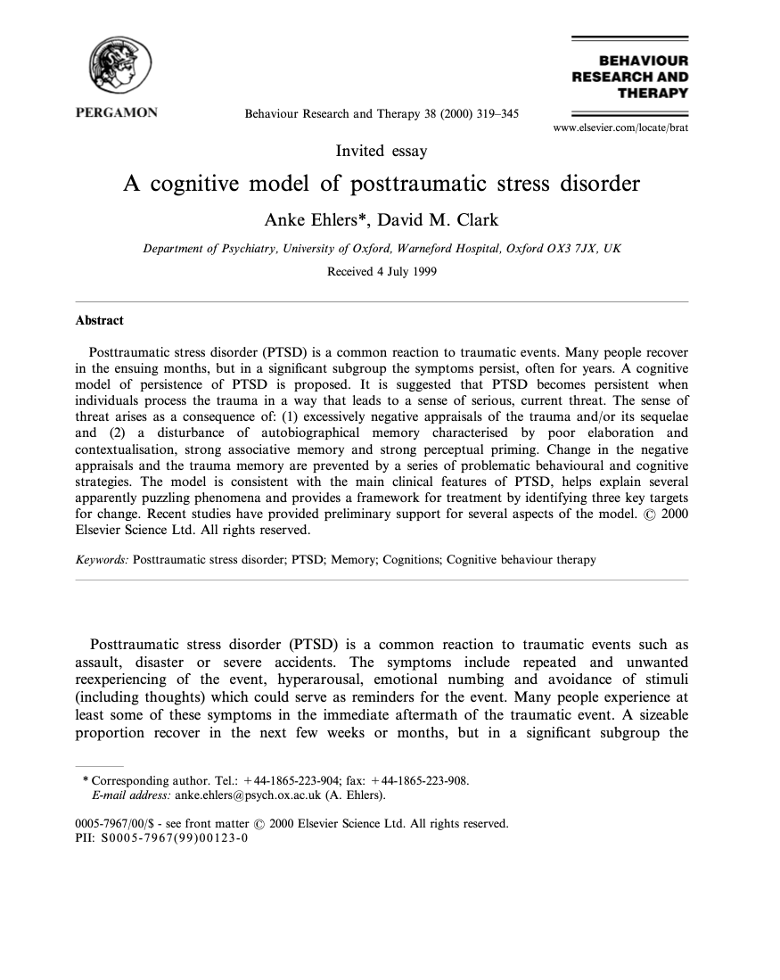
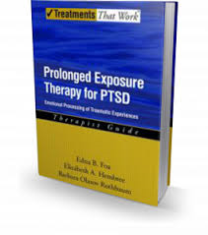
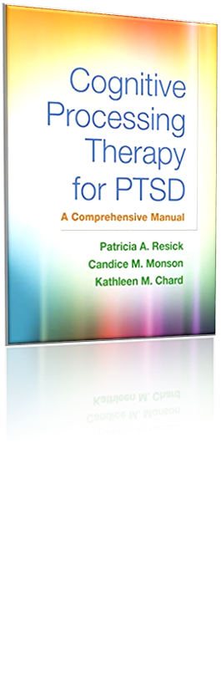

The current state of play
Notes:
Much like the England rugby team, results in the early 2000s were excellent for a number of developing PTSD treatments

Slide 3
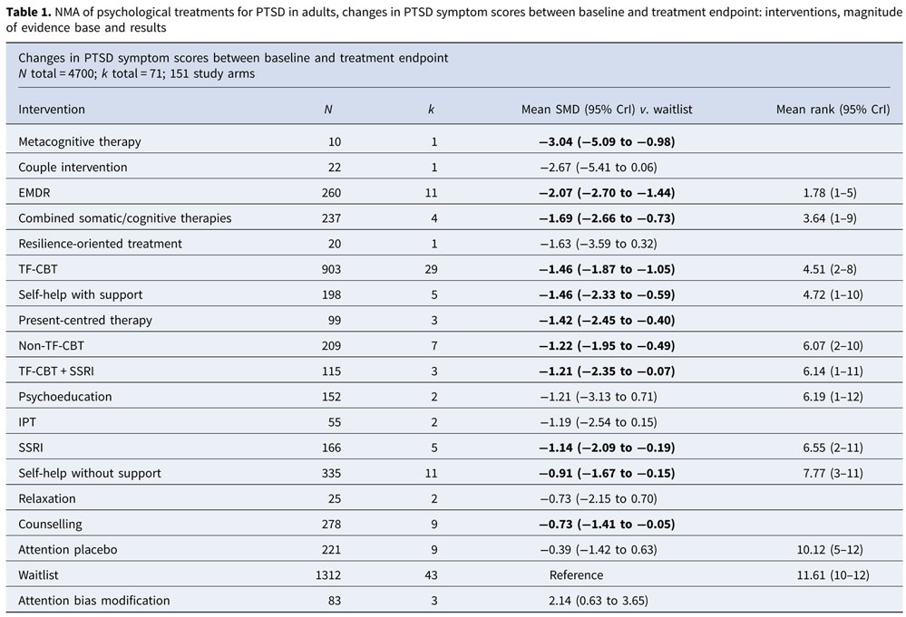

Treatment for adults
Offer an individual trauma-focused CBT intervention to adults with a diagnosis of PTSD or clinically important symptoms of PTSD who have presented more than 1 month after a traumatic event. These interventions include:
  cognitive processing therapy
  cognitive therapy for PTSD
  narrative exposure therapy
  prolonged exposure therapy.
Mavranezouli, I., Megnin-Viggars, O., Daly, C., Dias, S., Welton, N. J., Stockton, S., ... & Katona, C. (2020). Psychological treatments for post-traumatic stress disorder in adults: a network meta-analysis. Psychological Medicine, 1-14.

Slide 4

Away form also improving
Murray, H., El‐Leithy, S., & Billings, J. (2017). Intensive cognitive therapy for post‐traumatic stress disorder in routine clinical practice: A matched comparison audit. British Journal of Clinical Psychology, 56(4), 474-478.

Slide 5
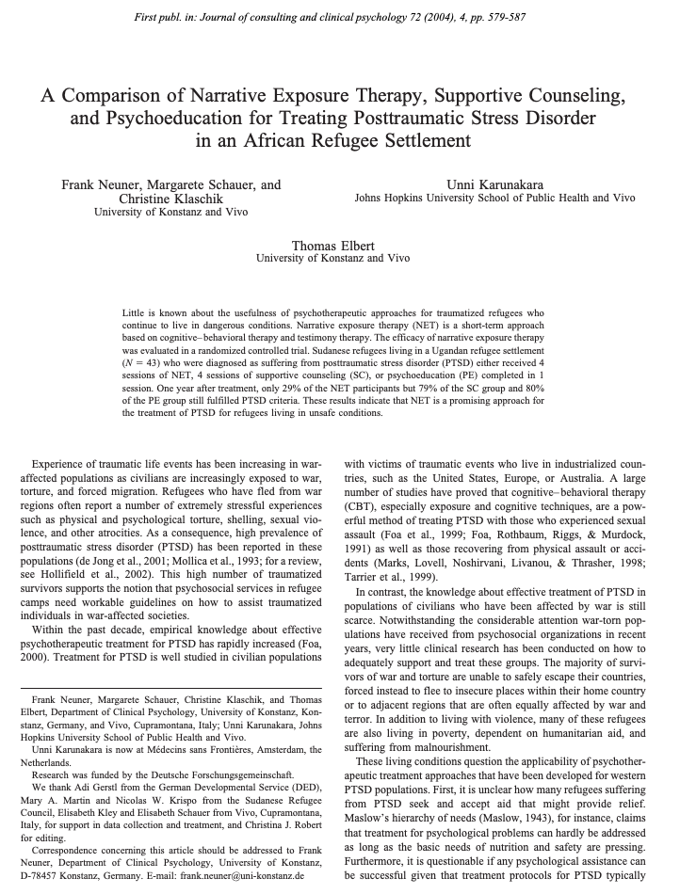
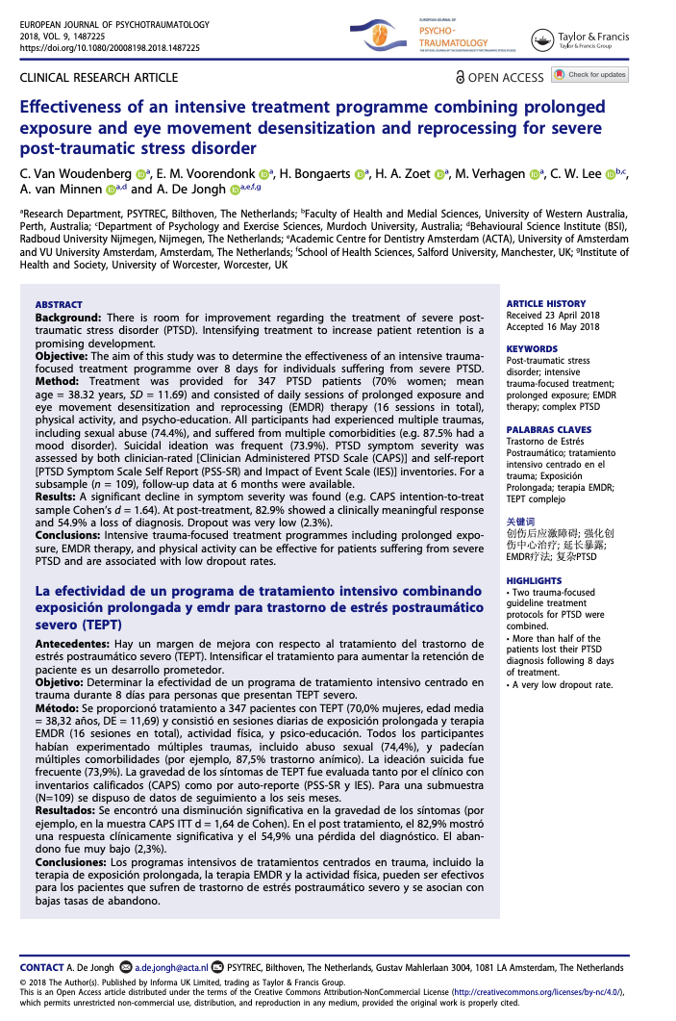
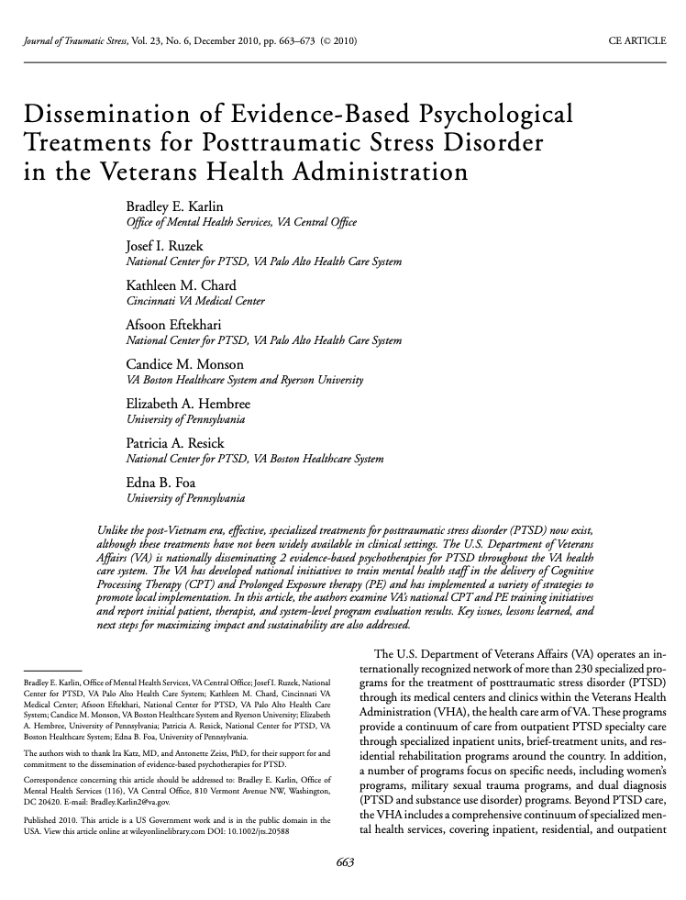

Slide 6
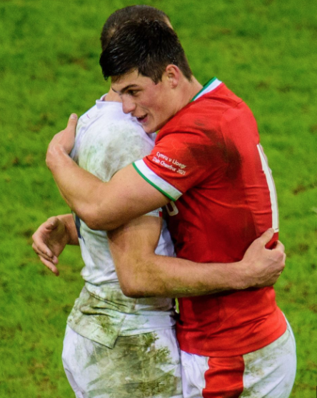
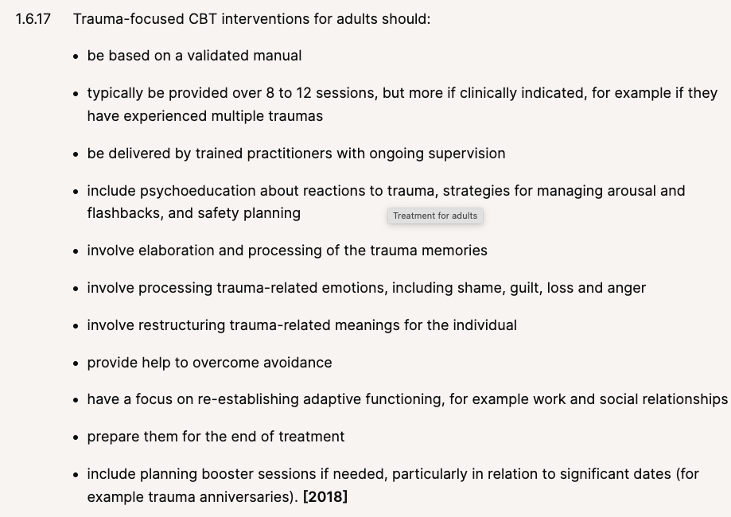
Finding common ground
Notes:
It’s possible we are also starting to identify the common ingredients to successful therapy interventions for PTSD

Slide 7


room for improvement
Non-recovery rates
Drop-outs
Residual symptoms
Research-practice gap

Slide 8
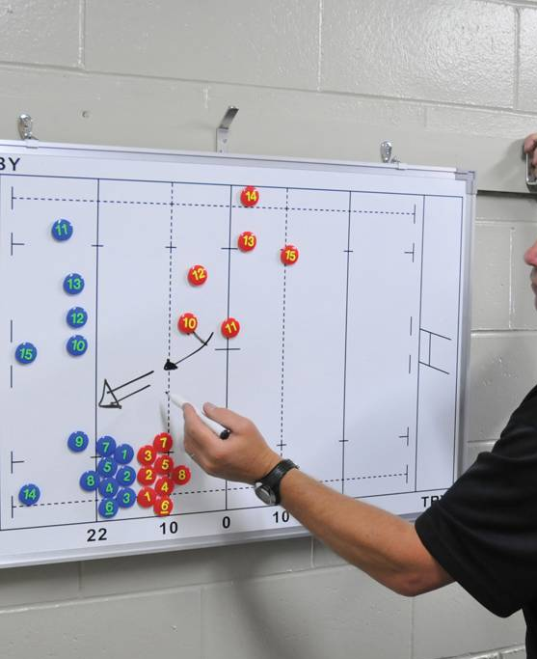
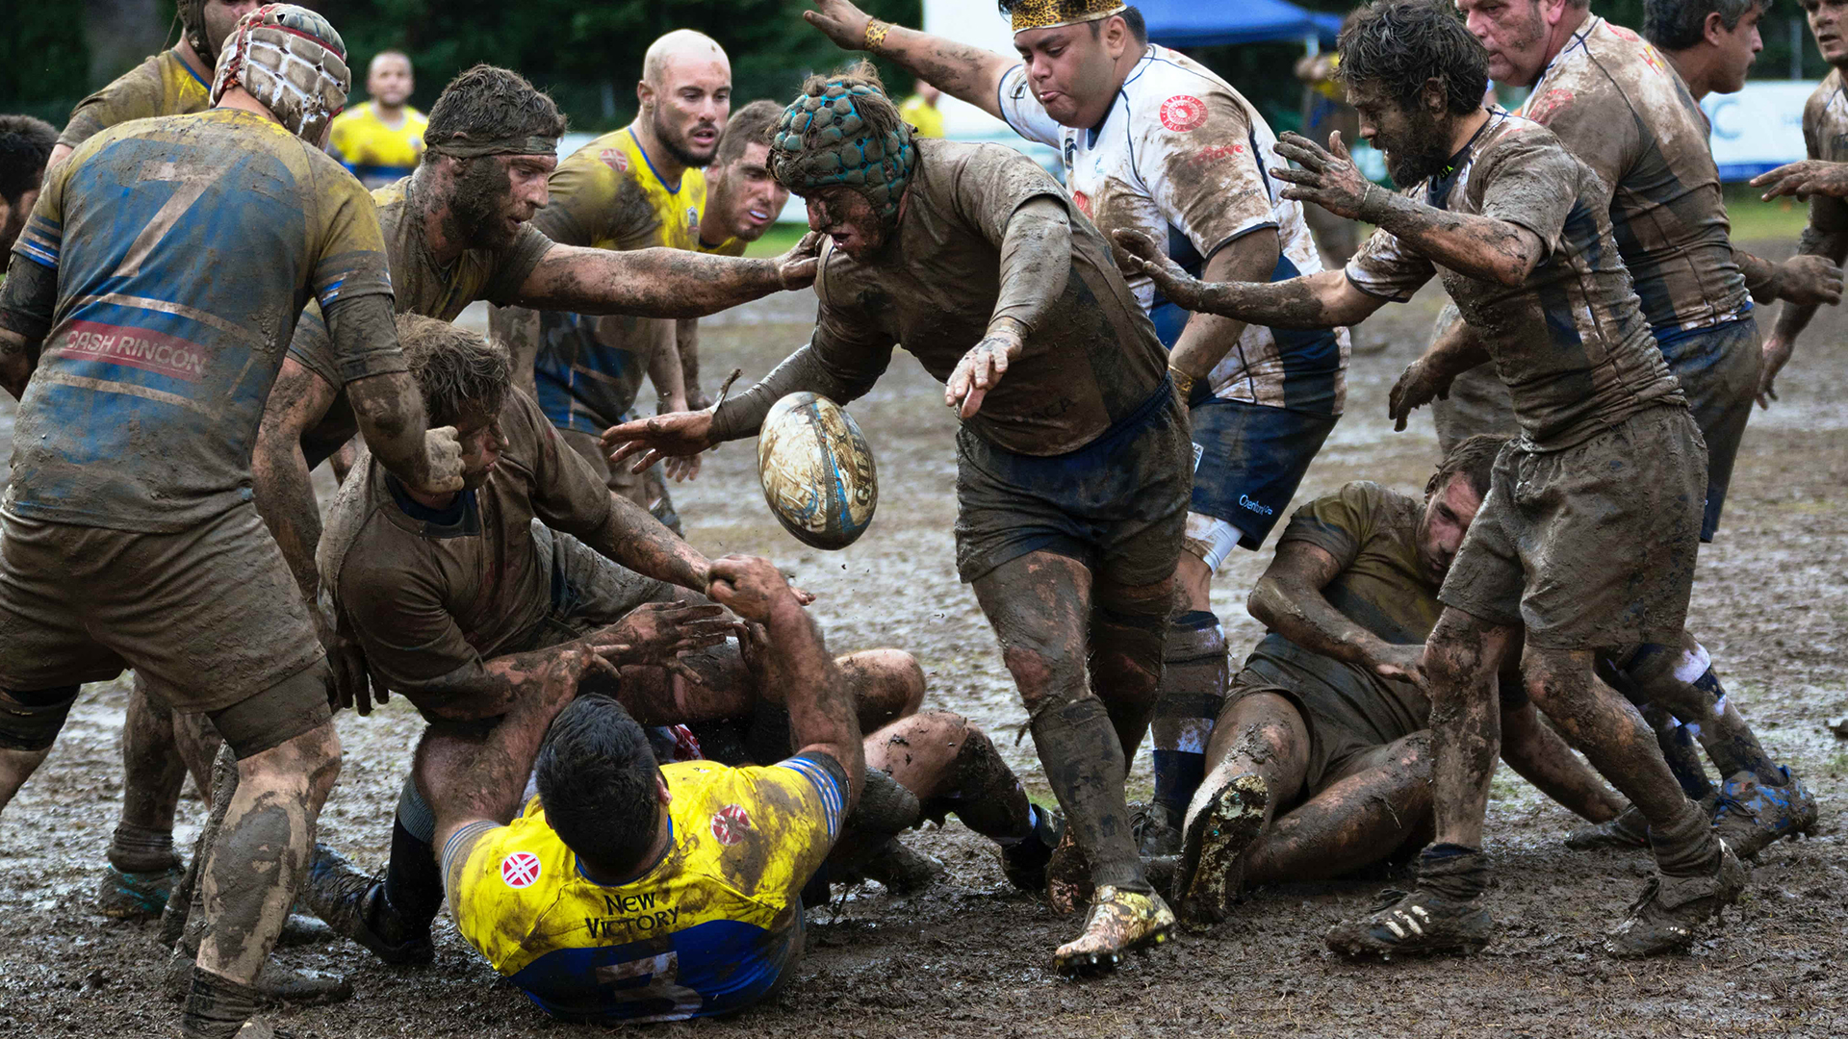
Is the real world a bit messier?

Slide 9
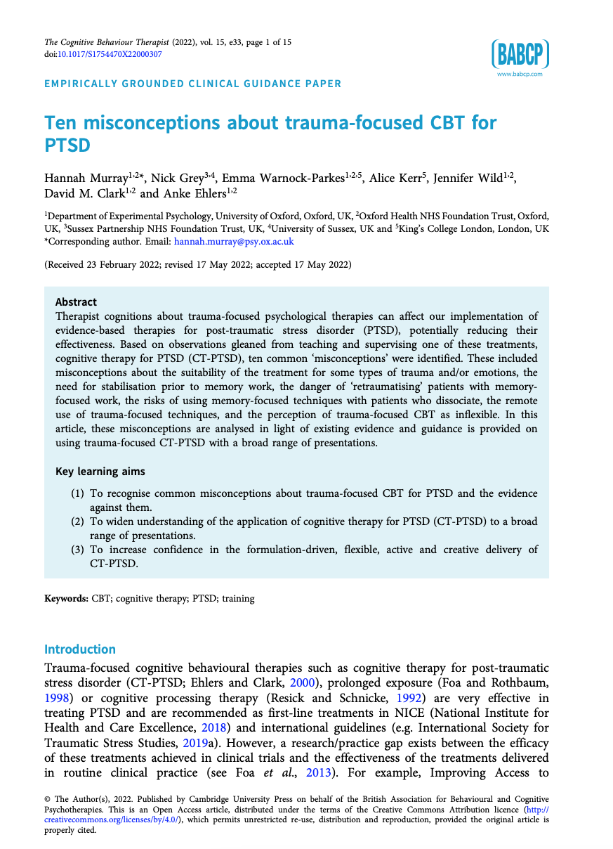
What is the missing link?
System obstacles?
Therapist beliefs?

Slide 10
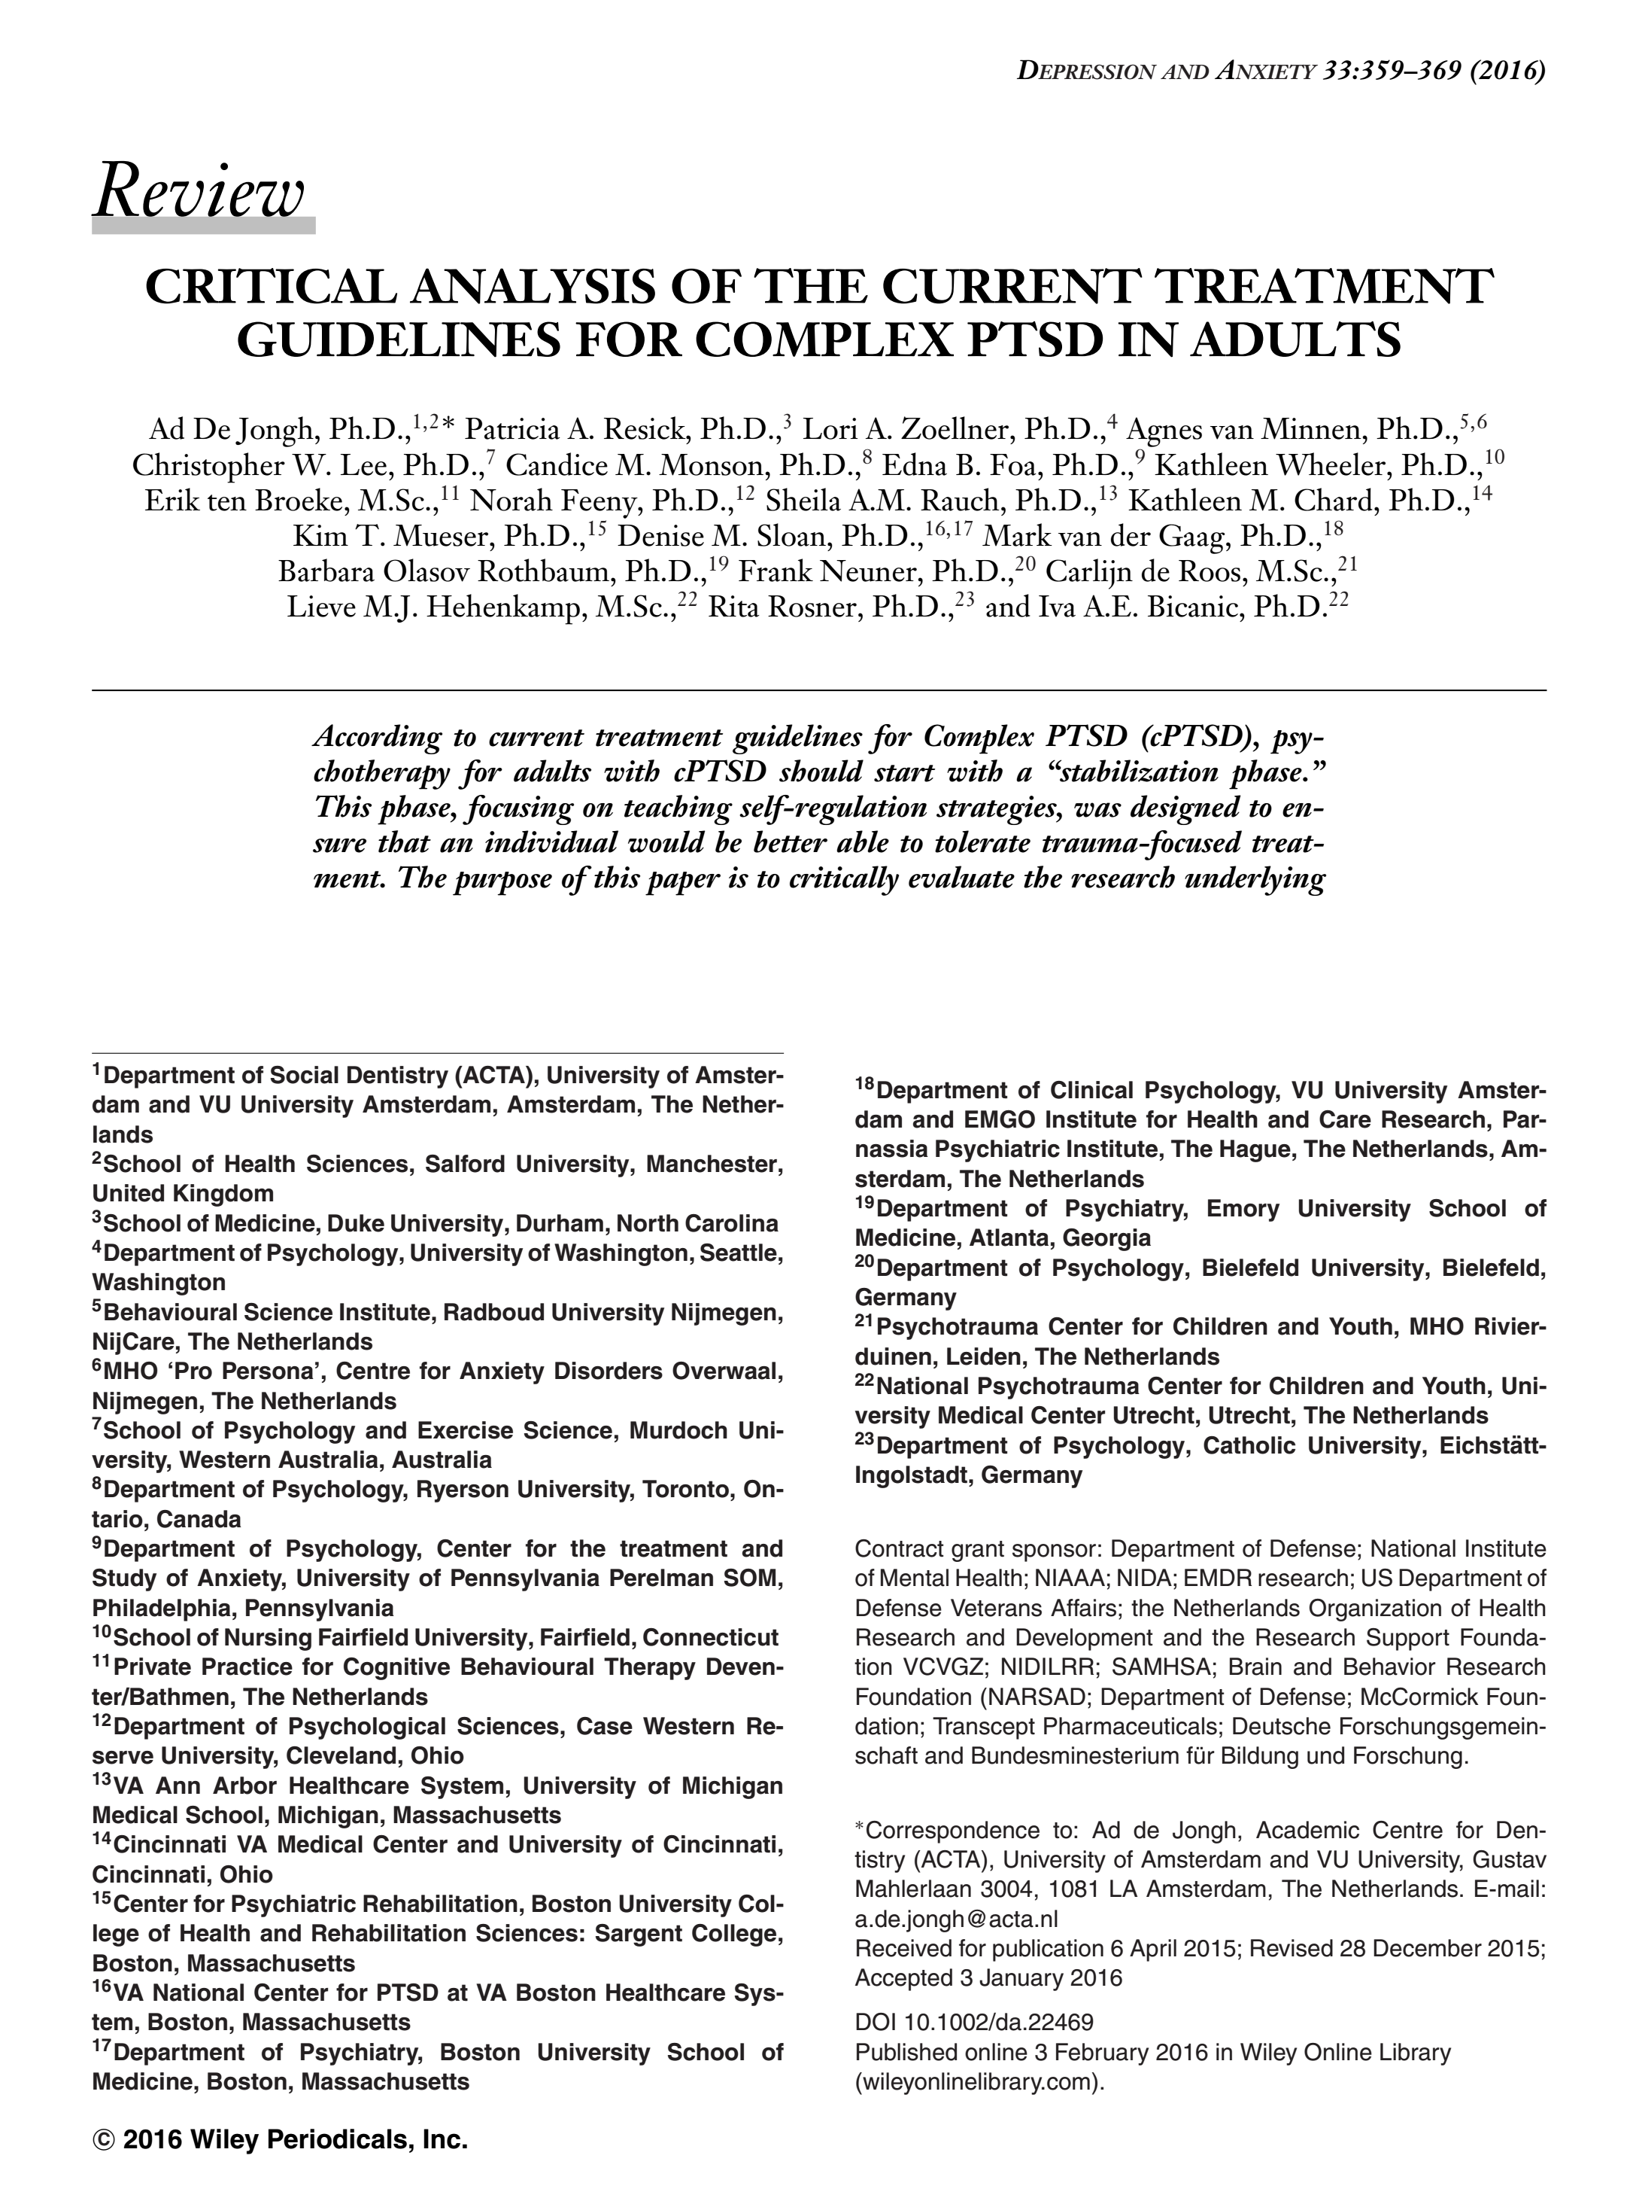
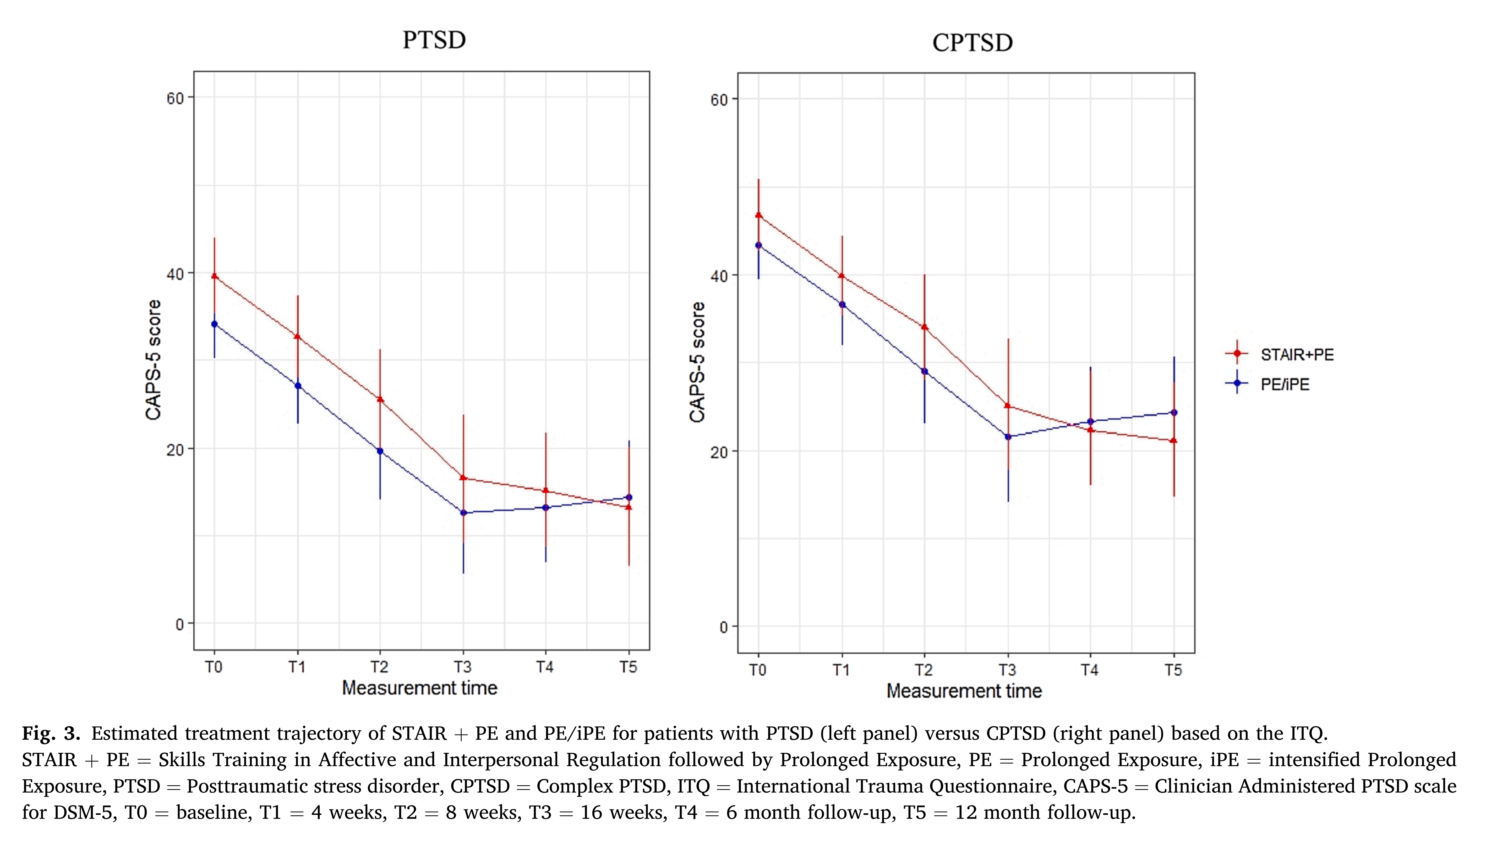

Slide 11
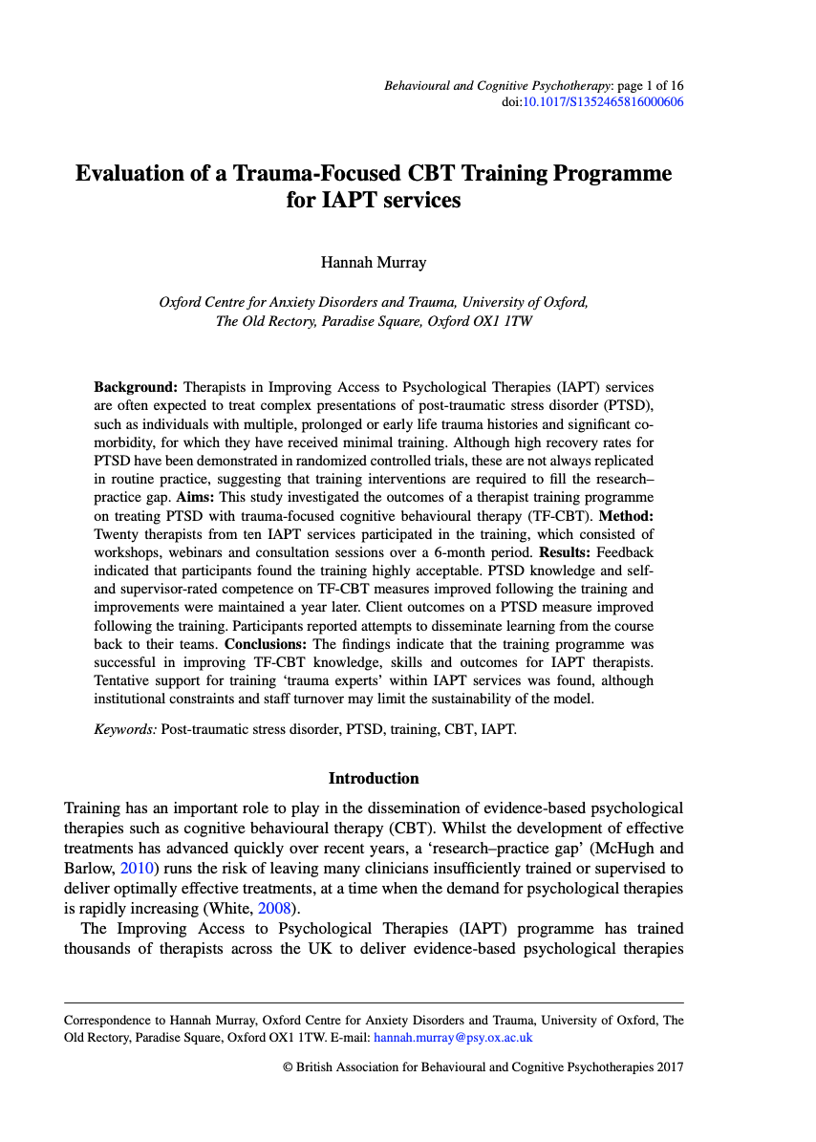
What is the missing link?
System obstacles?
Therapist beliefs?
Training needs?
Different clients?

Slide 12
What is complexity in ptsd?
The type of trauma?
Type 1 vs Type 2 Traumas
    Childhood abuse
    War and combat
    Detention and torture
    Domestic violence
    Trafficking
Emotional abuse and neglect
Captivity traumas and defeat
Traumatic bereavements
Disfigurement and disability
Perpetration and moral injury
Delirium and psychosis
The type of disorder?
Complex PTSD
Personality change following exposure to catastrophic stress
Dissociative disorders
Developmental Trauma Disorder
Conversion disorders
Somatization disorders
Psychotic symptoms
Personality Disorders
The nature of the PTSD?
Multiple/fused trauma memories
Memory gaps and affect without recollection
Moral injury and betrayal trauma
Recovered, constructed and hallucinated memories
Rigid pre existing schema
Shame, disgust, mental defeat
Dissociation and shutdown
Risky coping, substance misuse
Extreme avoidance, withdrawal, rumination etc

Slide 13
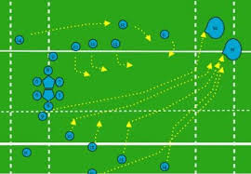
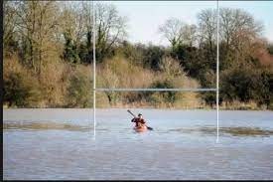
Complex vs complicated

Slide 14
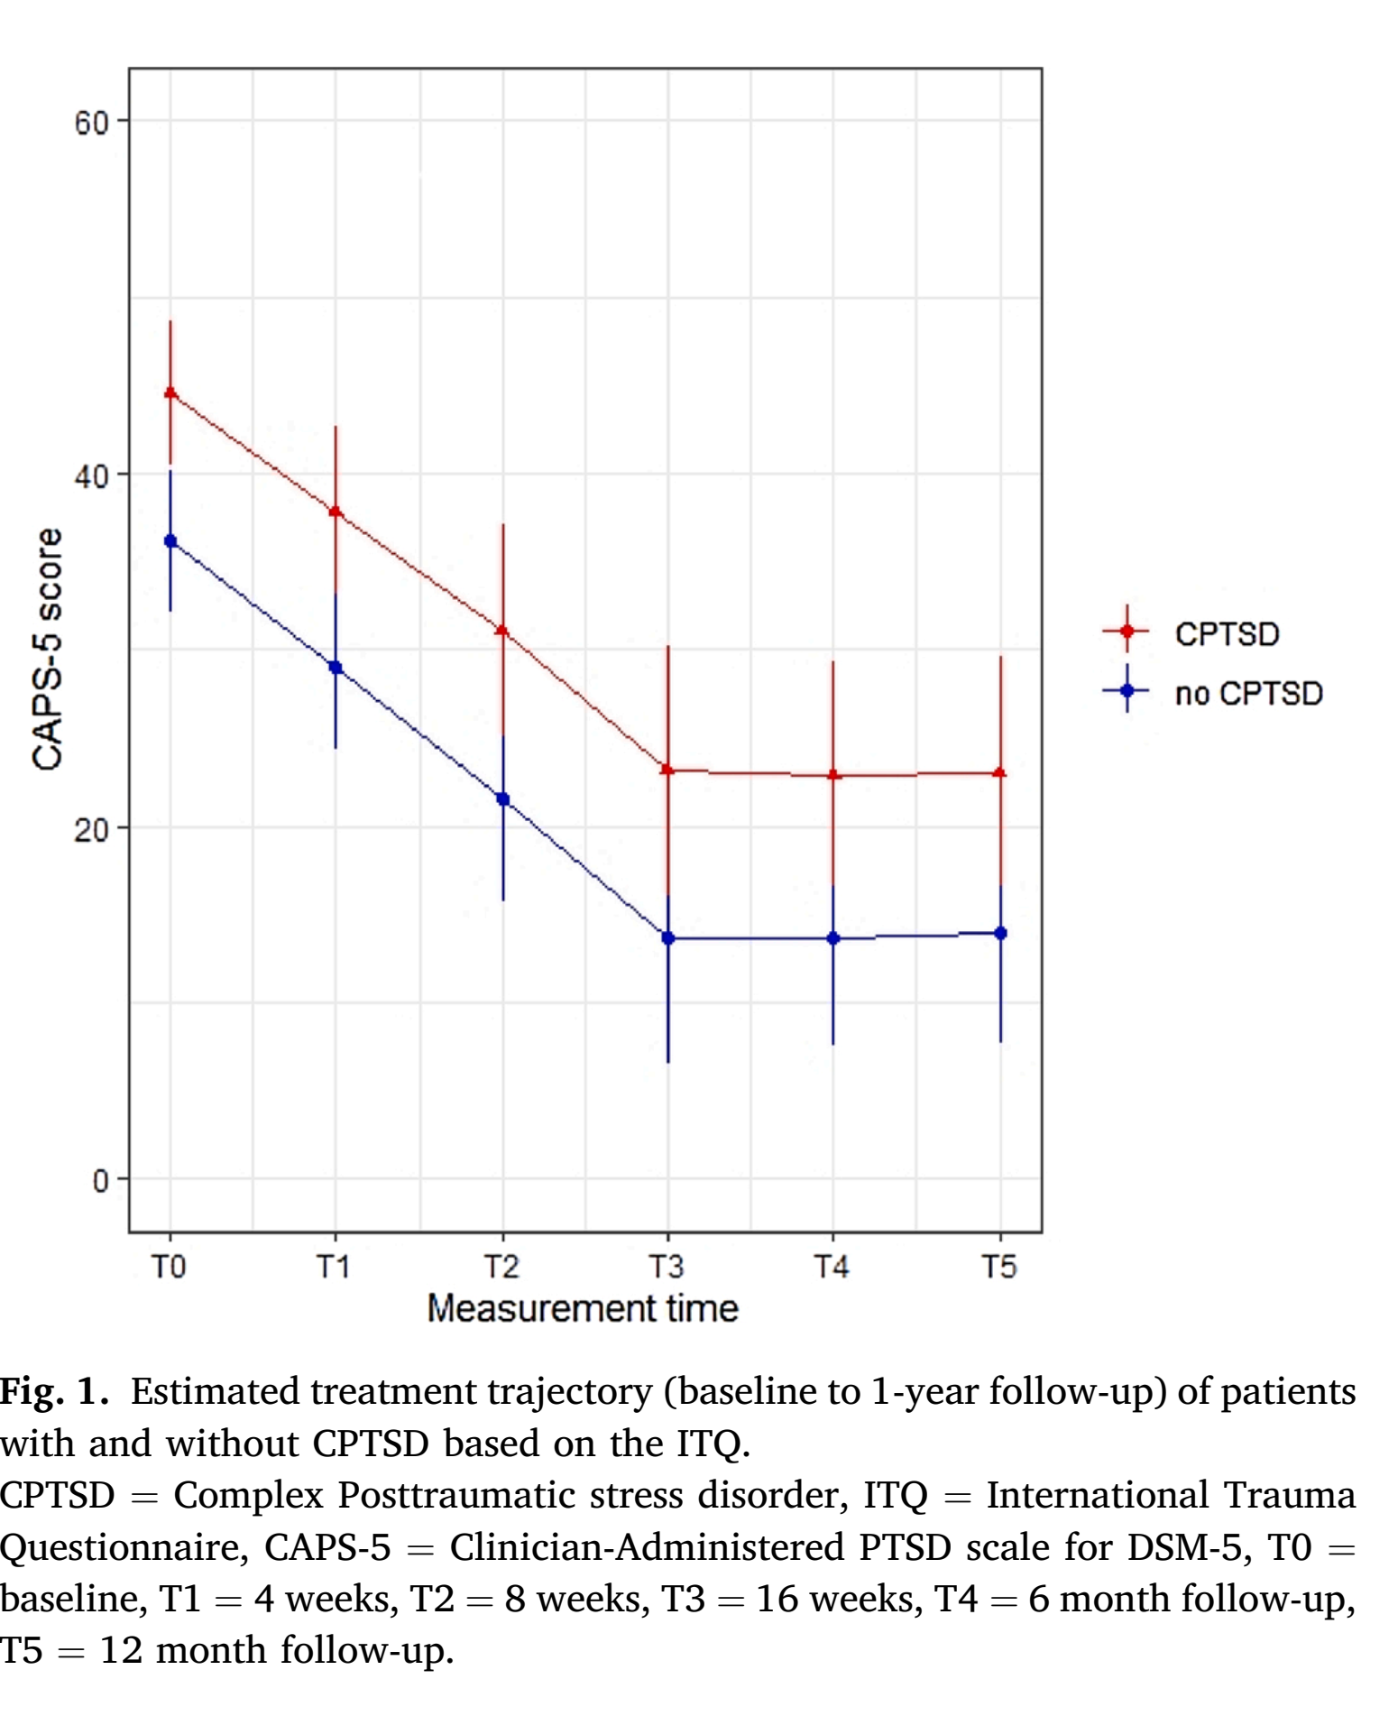
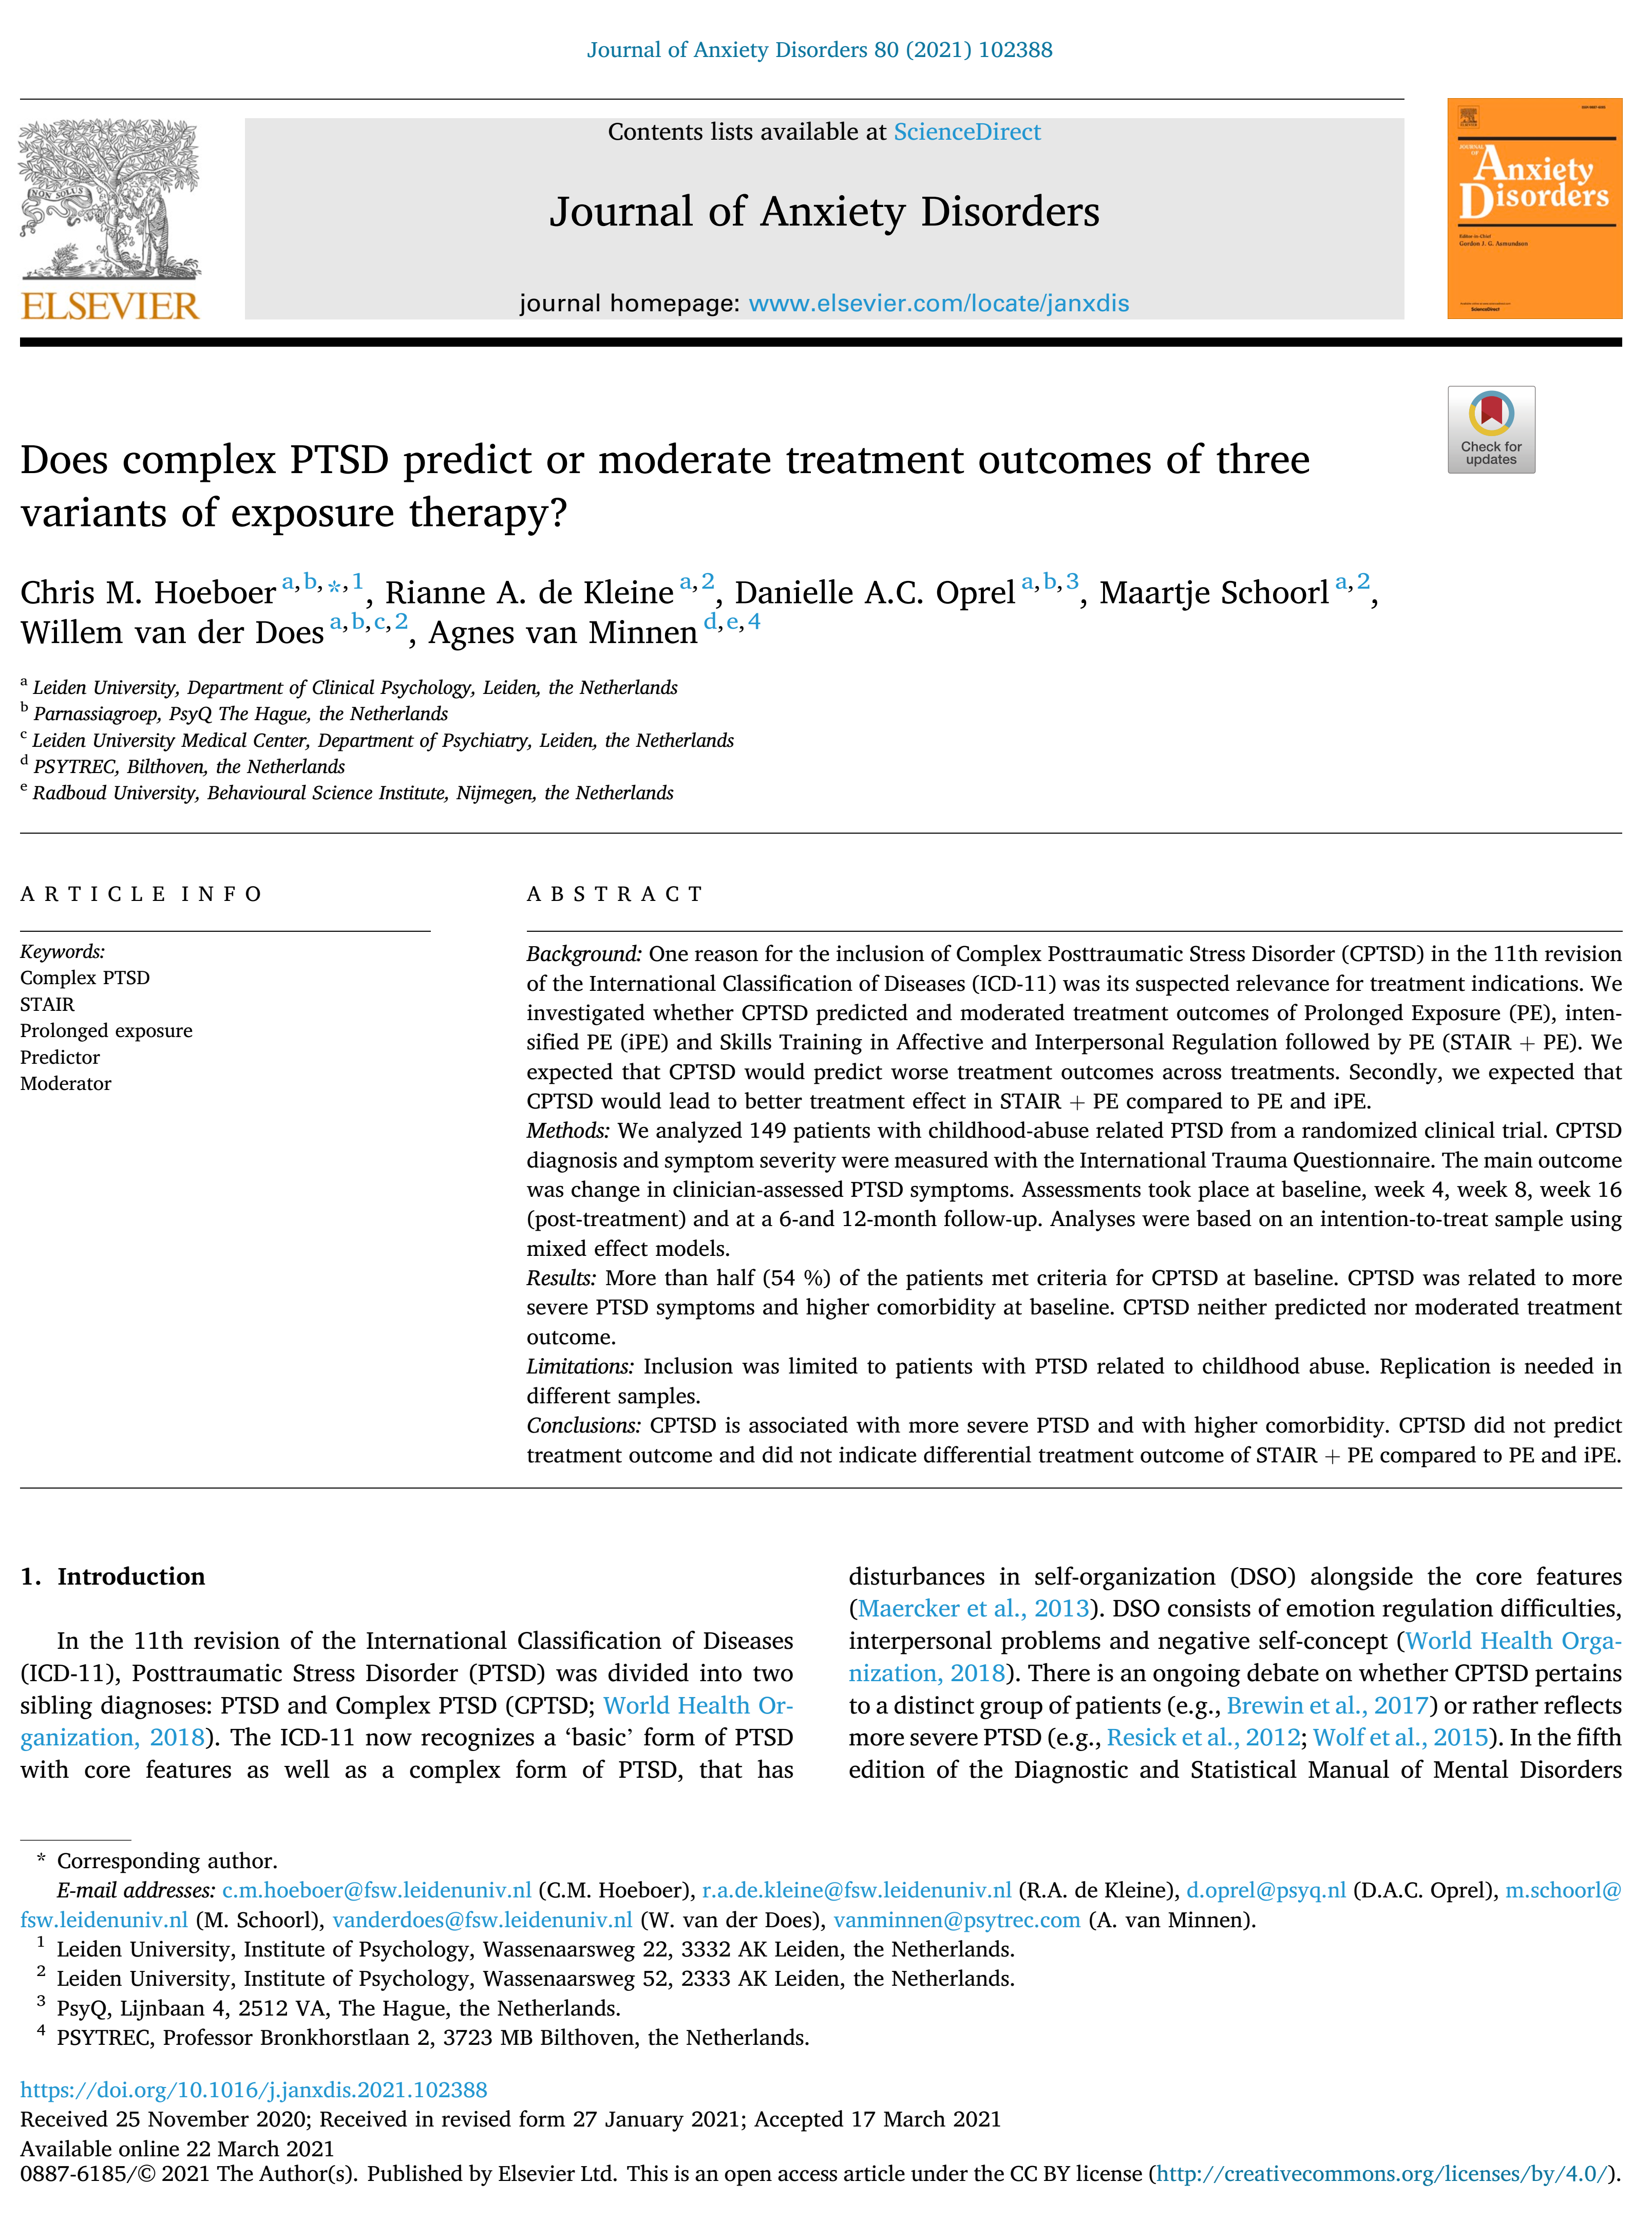
Do our treatments still work with ‘complex’ clients?
Hoeboer, C. M., de Kleine, R. A., Oprel, D. A., Schoorl, M., van der Does, W., & van Minnen, A. (2021). Does complex PTSD predict or moderate treatment outcomes of three variants of exposure therapy?. Journal of Anxiety Disorders, 80, 102388.
Notes:
PE + STAIR trial
Checked whether cPTSD moderated outcome – it didn’t
People with cPTSD started off with more severe PTSD symptoms and more comorbidity and ended higher but did just as well

Slide 15
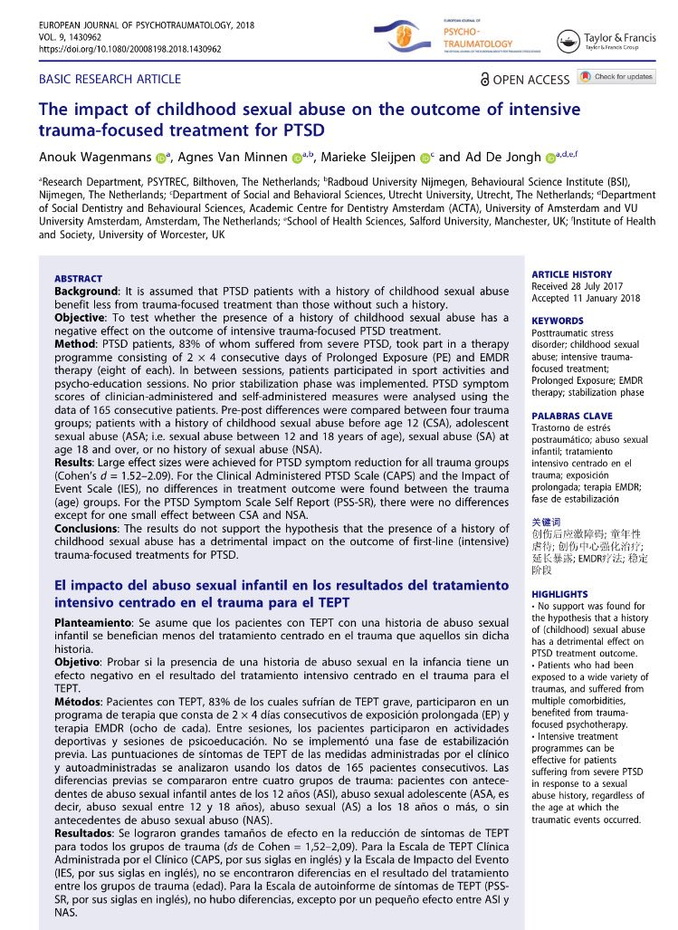
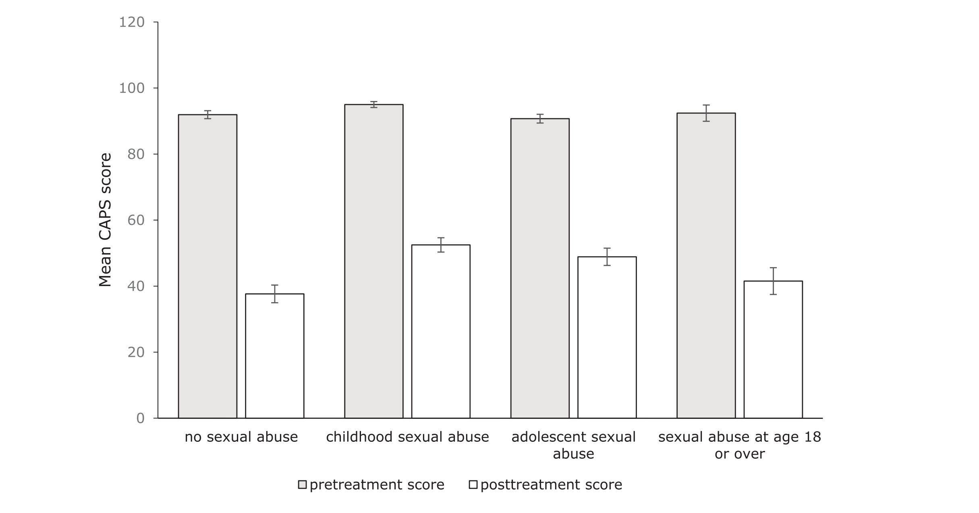
94% severe PTSD
50% mod-high risk
Large effects
d=1.5-2.1
Wagenmans, A., Van Minnen, A., Sleijpen, M., & De Jongh, A. (2018). The impact of childhood sexual abuse on the outcome of intensive trauma-focused treatment for PTSD. European journal of psychotraumatology, 9(1), 1430962.
Notes:
Intensive intervention of PE and EMDR
Sub-analysis to check if childhood abuse affected effectiveness of intervention – no effect

Slide 16
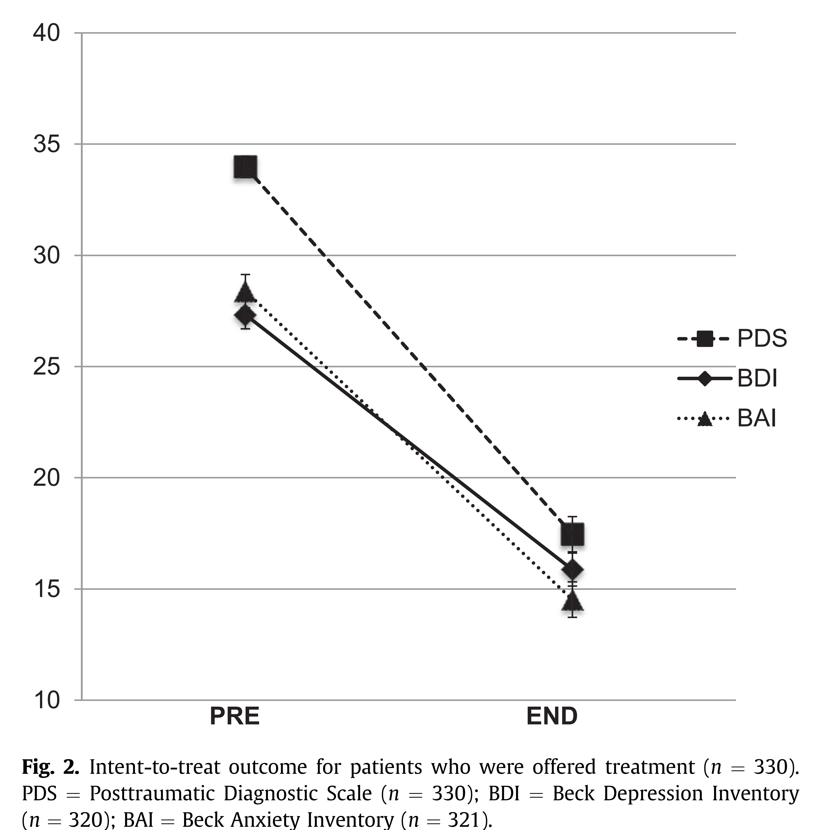
CT-PTSD in routine practice
330 patients and 34 therapists with a wide range of experience
Mean 10.6 sessions (SD=5) + 2 Booster sessions (SD=3)​
43% from minority ethnic backgrounds​
57% interpersonal violence traumas​
78% at least one comorbidity (mean=2)​
Wide range of common “complexity” factors did not predict outcome – including BPD, no trauma memory, previous treatment, childhood abuse or number of traumas.
330 patients and 34 therapists with a wide range of experience, mean 10.6 sessions (SD=5) + 2 Booster sessions (SD=3)
43% from minority ethnic backgrounds
57% interpersonal violence traumas
22.5% involved death of others
78% at least one comorbidity (mean=2)
14% dropout rate / 21% unreliable attenders
1.2% got worse during treatment
Wide range of common “complexity” factors did not predict outcome – including BPD, no trauma memory, previous treatment, childhood abuse or number of traumas.
Ehlers, A., Grey, N., Wild, J., Stott, R., Liness, S., Deale, A., ... & Clark, D. M. (2013). Implementation of cognitive therapy for PTSD in routine clinical care: effectiveness and moderators of outcome in a consecutive sample. Behaviour research and therapy, 51(11), 742-752.

Slide 17
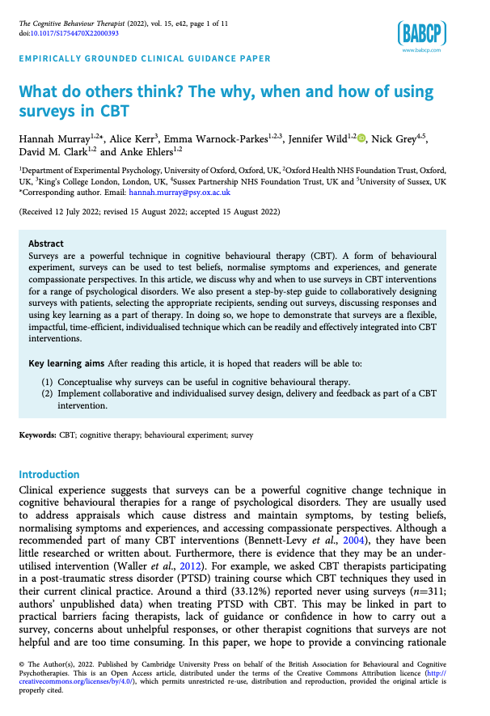
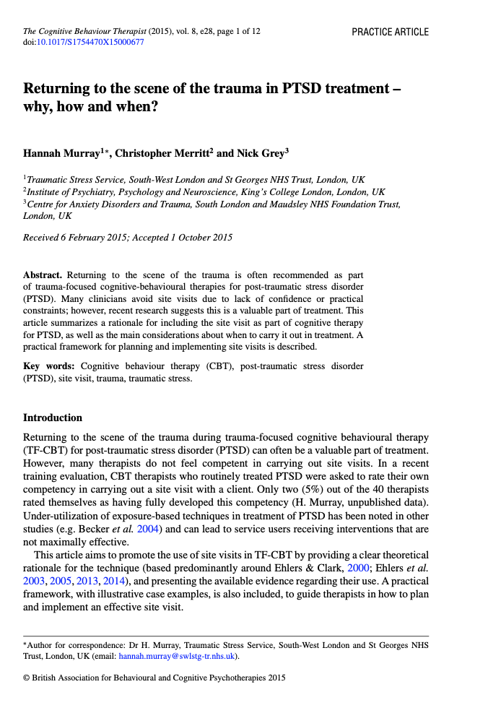
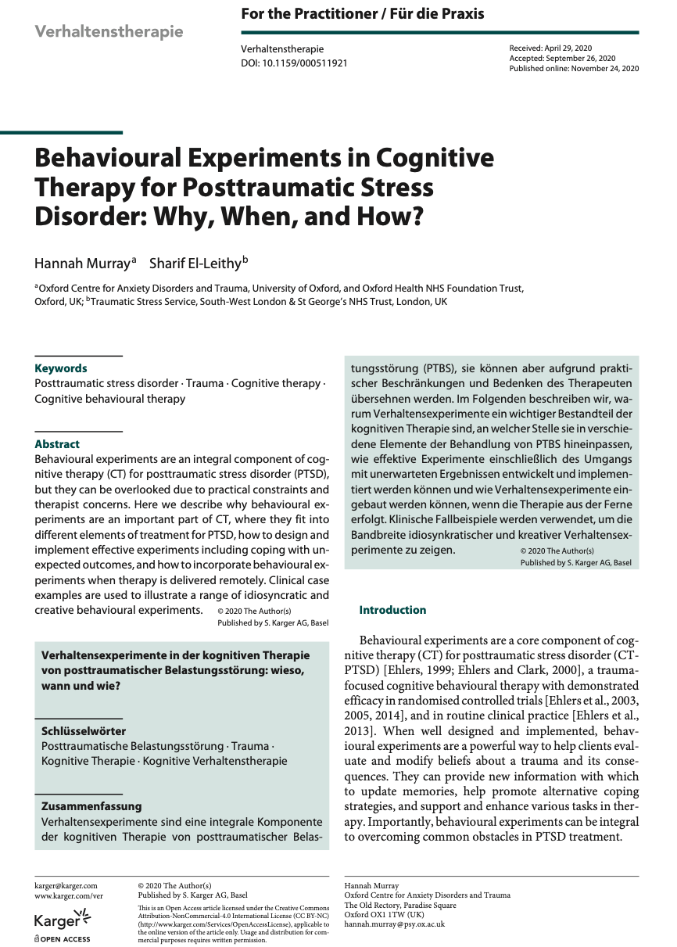

Do we need new treatments or to do existing treatments better?

Slide 18
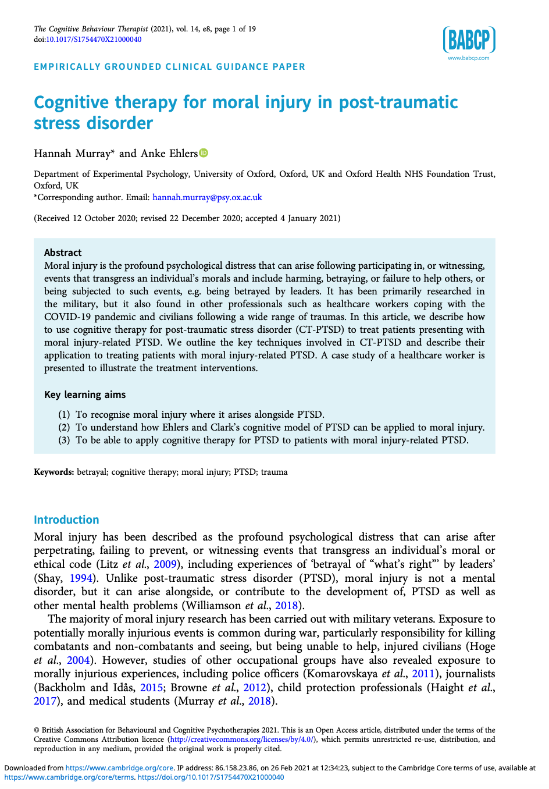
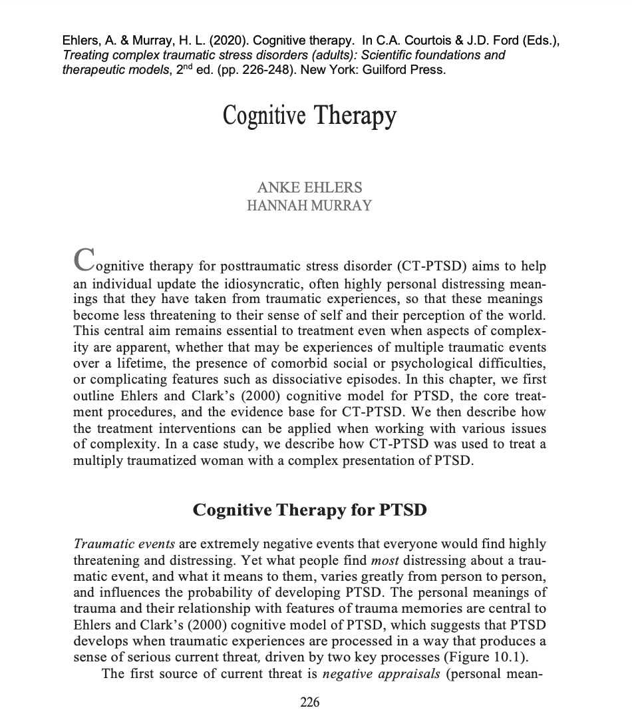
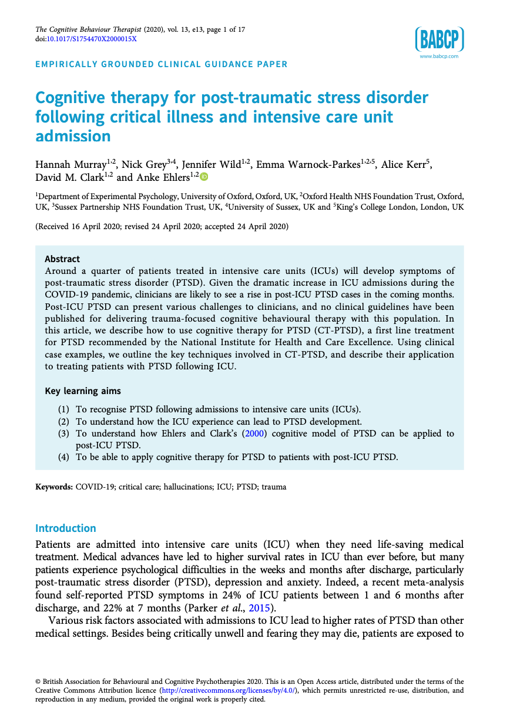
…And adapt them to different populations

Slide 19
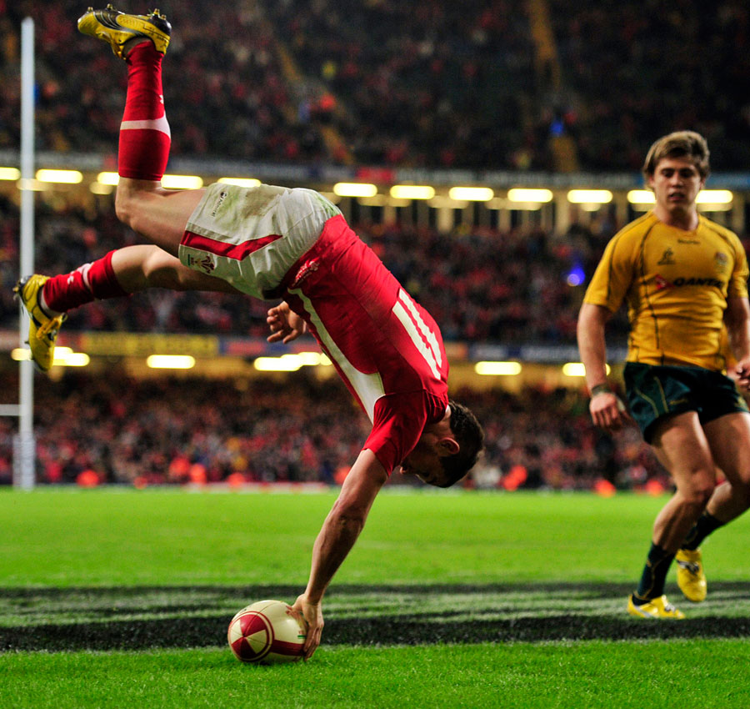
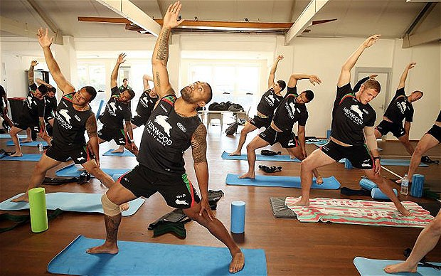
Learn to flex
There’s more than one way to score…

Slide 20

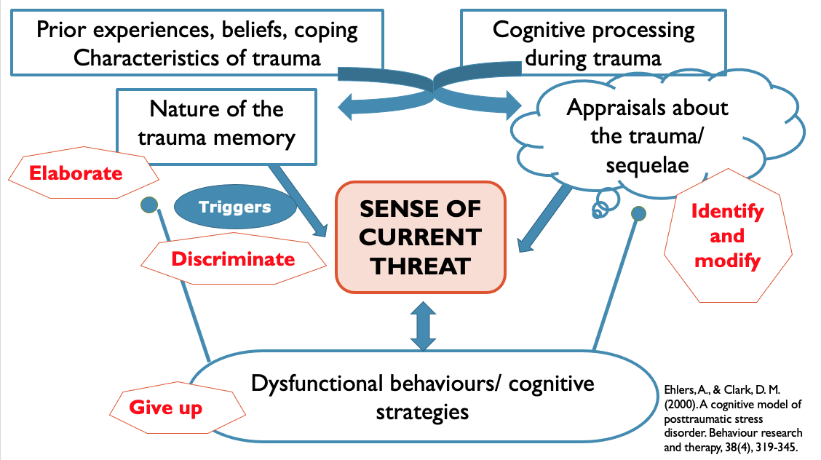


Formulate not formulaic

Slide 21
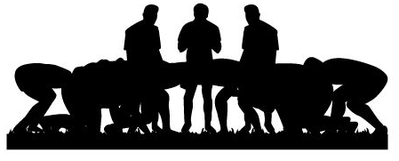
Memory work
Cognitive work
Coping strategies work
Imaginal reliving
Socratic questioning
Responsibility pie charts
Grounding strategies
Updating trauma memories
Surveys
Rumination interventions
Trigger discrimination
Behavioural experiments
Thought suppression exercise
Timelines
Continua methods
Safety planning
Narrative writing
Psychoeducation
Hypervigilance experiments
Imagery rescripting
Reviewing evidence
Shared formulation
Site visits
Reclaiming/building your life
Blueprint

Slide 22

Single incident trauma – accident
Main cognitive themes – fear
No major additional complexities
Elouise
Shared formulation
Imaginal reliving
Updating trauma memories
Trigger discrimination
Behavioural experiments
Blueprint
Psychoeducation
Site visit
Reclaiming your life

Slide 23

Single incident trauma – accident
Main cognitive themes – shame, guilt
Loss of consciousness during accident
Permanent physical injury
Tariq
Shared formulation
Socratic questioning
Responsibility pie charts
Survey
(shame)
Updating trauma memories
Psychoeducation
Timeline
Imaginal reliving
Rebuilding your life
Behavioural experiments (injuries)
Updating trauma memories
Trigger discrimination
Behavioural experiments
Site visit
Blueprint
Rebuilding your life

Slide 24

Multiple child + adult interpersonal trauma
Main cognitive themes – shame, anger
Risky self-harm behaviours
High levels of dissociation
Patience
Shared formulation
Psychoeducation
Safety planning
Grounding strategies
Trigger discrimination
Socratic questioning
Survey
(shame)
Continua methods
Rebuilding your life
(including identity, sexuality)
Updating trauma memories
Imagery rescripting
(shame, anger)
Behavioural experiments (interpersonal)
Narrative writing
Blueprint
Timeline
Rebuilding your life
(including identity, sexuality)

Slide 25
Strongly held beliefs
Long standing beliefs/schema
Self-attack and self-hatred
Head-heart gap
Beliefs related to loss
Moral injury and betrayal
Over-activation
Under-activation
Dissociation
Multiple trauma memories
Gaps in trauma memories
Recovered memories
Constructed imagery
Psychosis-related memories
Memory complexity
Meanings complexity
PTSD
PSD
Coping
complexity
Strenuous efforts to avoid
Substance misuse
Reckless behaviour
Violence and aggression
Non suicidal self injury (NSSI)

Slide 26
Psychological comorbidity
Memory complexity
Meanings complexity
Physical comorbidity
Social comorbidity
PTSD
PSD
PSD
Coping
complexity
Risk and safeguarding

Slide 27

Culture and diversity
Therapeutic relationship
Psychological comorbidity
Memory complexity
Meanings complexity
Physical comorbidity
Social comorbidity
PTSD
PSD
PSD
Coping
complexity
Risk and safeguarding

Slide 28
Neurodevelopmental problems
e.g. learning difficulty, ASD, ADHD
Physical
Addiction/habit problems
e.g. alcohol, drugs, gambling, cyber, sex
Personality problems
e.g. negative affectivity, detachment, dissociality, disinhibition, rigidity
Psychological
Anxiety disorders
panic, phobia, GAD, SAD, HA, OCD
Physical/sensory disability
e.g. disfigurement, sight loss, paralysis
Body/Eating disorders
Binge/purge, BDD anorexia, bulimia
Psychosis
paranoia, delusions
audio-visual hallucinations
Housing problems
e.g. overcrowding, unstable, poor conditions
Psychological comorbidity
Depressive disorders
low mood, hopelessness, anhedonia, withdrawal
Neurological problems
e.g. brain injury, stroke, dementia, epilepsy, dysautomnia
Sleep disorders
e.g. parasomnias, sleep paralysis, insomnia
Work problems
e.g. sickness, tribunals, unemployment
Money problems
e.g. benefits, debt, food poverty
Memory complexity
Meanings complexity
Social comorbidity
Physical comorbidity
Interpersonal problems
e.g. arguments, relationships difficulties
PTSD
Acute illness
e.g. UTIs, TBI, STIs
PSD
PSD
Legal problems
e.g. immigration, court case, compensation claims
Coping
complexity
Chronic illness
e.g. asthma, heart disease, diabetes, reproductive problems, COPD, Long COVID
Persistent physical symptoms
e.g. dissociative seizures, movement disorders, IBS, CFS
Family problems
e.g. issues with children, separation, isolation, rejection, abuse
Risk and safeguarding
Reckless behaviour
e.g. thrill seeking, passive suicidality, NSSI, self-triggering
Social
Social disadvantage
e.g. discrimination, lack of social capital, stigmatisation
Chronic pain
e.g. neuropathic pain, arthritis
Risk to self
e.g. high risk NSSI, strong wish to die, planning, sig. historical risk
Risk to others
e.g. impulsive violence, appetitive aggression, domestic/child abuse
Adapted from: Barton at al. (2017)
Barton, S., Armstrong, P., Wicks, L., Freeman, E., & Meyer, T. D. (2017). Treating complex depression with cognitive behavioural therapy. The Cognitive Behaviour Therapist, 10.
Revictimisation risks
trafficking, gangs, sexual exploitation, domestic abuse
Active risk from others
Threats, stalking, coercive control, revenge
Risk

Slide 29




Neurodevelopmental problems
e.g. learning difficulty, ASD, ADHD
Over-activation
Under-activation
Dissociation
Multiple trauma memories
Gaps in trauma memories
Recovered memories
Constructed imagery
Psychosis related memories
Addiction/habit problems
e.g. alcohol, drugs, gambling, cyber, sex
Personality problems
e.g. negative affectivity, detachment, dissociality, disinhibition, rigidity
Strongly held beliefs
Long standing beliefs/schema
Self-attack and self-hatred
Head-heart gap
Beliefs related to loss
Moral injury and betrayal
Anxiety disorders
panic, phobia, GAD, SAD, HA, OCD
Physical/sensory disability
e.g. disfigurement, sight loss, paralysis
Body/Eating disorders
Binge/purge, BDD anorexia, bulimia
Psychosis
paranoia, delusions
audio-visual hallucinations
Housing problems
e.g. overcrowding, unstable, poor conditions
Depressive disorders
low mood, hopelessness, anhedonia, withdrawal
Neurological problems
e.g. brain injury, stroke, dementia, epilepsy, dysautomnia
Sleep disorders
e.g. parasomnias, sleep paralysis, insomnia
Work problems
e.g. sickness, tribunals, unemployment
Money problems
e.g. benefits, debt, food poverty
Interpersonal problems
e.g. arguments, relationships difficulties
Acute illness
e.g. UTIs, TBI, STIs
Legal problems
e.g. immigration, court case, compensation claims
Strenuous efforts to avoid
Substance misuse
Reckless behaviour
Violence and aggression
Non suicidal self injury (NSSI)
Chronic illness
e.g. asthma, heart disease, diabetes, reproductive problems, COPD, Long COVID
Persistent physical symptoms
e.g. dissociative seizures, movement disorders, IBS, CFS
Family problems
e.g. issues with children, separation, isolation, rejection, abuse
Reckless behaviour
e.g. thrill seeking, passive suicidality, NSSI, self-triggering
Social disadvantage
e.g. discrimination, lack of social capital, stigmatisation
Chronic pain
e.g. neuropathic pain, arthritis
Risk to self
e.g. high risk NSSI, strong wish to die, planning, sig. historical risk
Risk to others
e.g. impulsive violence, appetitive aggression, domestic/child abuse
Stop or prioritise
Adapt or target concurrently
No adaptation needed
Revictimisation risks
trafficking, gangs, sexual exploitation, domestic abuse
Active risk from others
Threats, stalking, coercive control, revenge

Slide 30

Neurodevelopmental problems
e.g. learning difficulty, ASD, ADHD
Over-activation
Under-activation
Dissociation
Multiple trauma memories
Gaps in trauma memories
Recovered memories
Constructed imagery
Psychosis related memories
Addiction/habit problems
e.g. alcohol, drugs, gambling, cyber, sex
Personality problems
e.g. negative affectivity, detachment, dissociality, disinhibition, rigidity
Strongly held beliefs
Long standing beliefs/schema
Self-attack and self-hatred
Head-heart gap
Beliefs related to loss
Moral injury and betrayal
Anxiety disorders
panic, phobia, GAD, SAD, HA, OCD
Physical/sensory disability
e.g. disfigurement, sight loss, paralysis
Body/Eating disorders
Binge/purge, BDD anorexia, bulimia
Psychosis
paranoia, delusions
audio-visual hallucinations
Housing problems
e.g. overcrowding, unstable, poor conditions
Depressive disorders
low mood, hopelessness, anhedonia, withdrawal
Neurological problems
e.g. brain injury, stroke, dementia, epilepsy, dysautomnia
Sleep disorders
e.g. parasomnias, sleep paralysis, insomnia
Work problems
e.g. sickness, tribunals, unemployment
Money problems
e.g. benefits, debt, food poverty
Interpersonal problems
e.g. arguments, relationships difficulties
Acute illness
e.g. UTIs, TBI, STIs
Legal problems
e.g. immigration, court case, compensation claims
Strenuous efforts to avoid
Substance misuse
Reckless behaviour
Violence and aggression
Non suicidal self injury (NSSI)
Chronic illness
e.g. asthma, heart disease, diabetes, reproductive problems, COPD, Long COVID
Persistent physical symptoms
e.g. dissociative seizures, movement disorders, IBS, CFS
Family problems
e.g. issues with children, separation, isolation, rejection, abuse
Reckless behaviour
e.g. thrill seeking, passive suicidality, NSSI, self-triggering
Social disadvantage
e.g. discrimination, lack of social capital, stigmatisation
Chronic pain
e.g. neuropathic pain, arthritis
Risk to self
e.g. high risk NSSI, strong wish to die, planning, sig. historical risk
Risk to others
e.g. impulsive violence, appetitive aggression, domestic/child abuse
Stop or prioritise
Adapt or target concurrently
No adaptation needed
Revictimisation risks
trafficking, gangs, sexual exploitation, domestic abuse
Active risk from others
Threats, stalking, coercive control, revenge
Patience

Slide 31

How to treat ptsd
(and win at rugby)
Train thoroughly and develop your team depth
Believe in yourself and support your team mates
Do the basics well
Stick to your game plan, but flex your tactics as needed

Slide 32
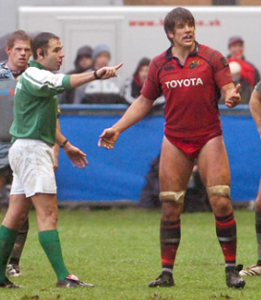
And finally…
Play on even if you’ve lost your shorts

Slide 33
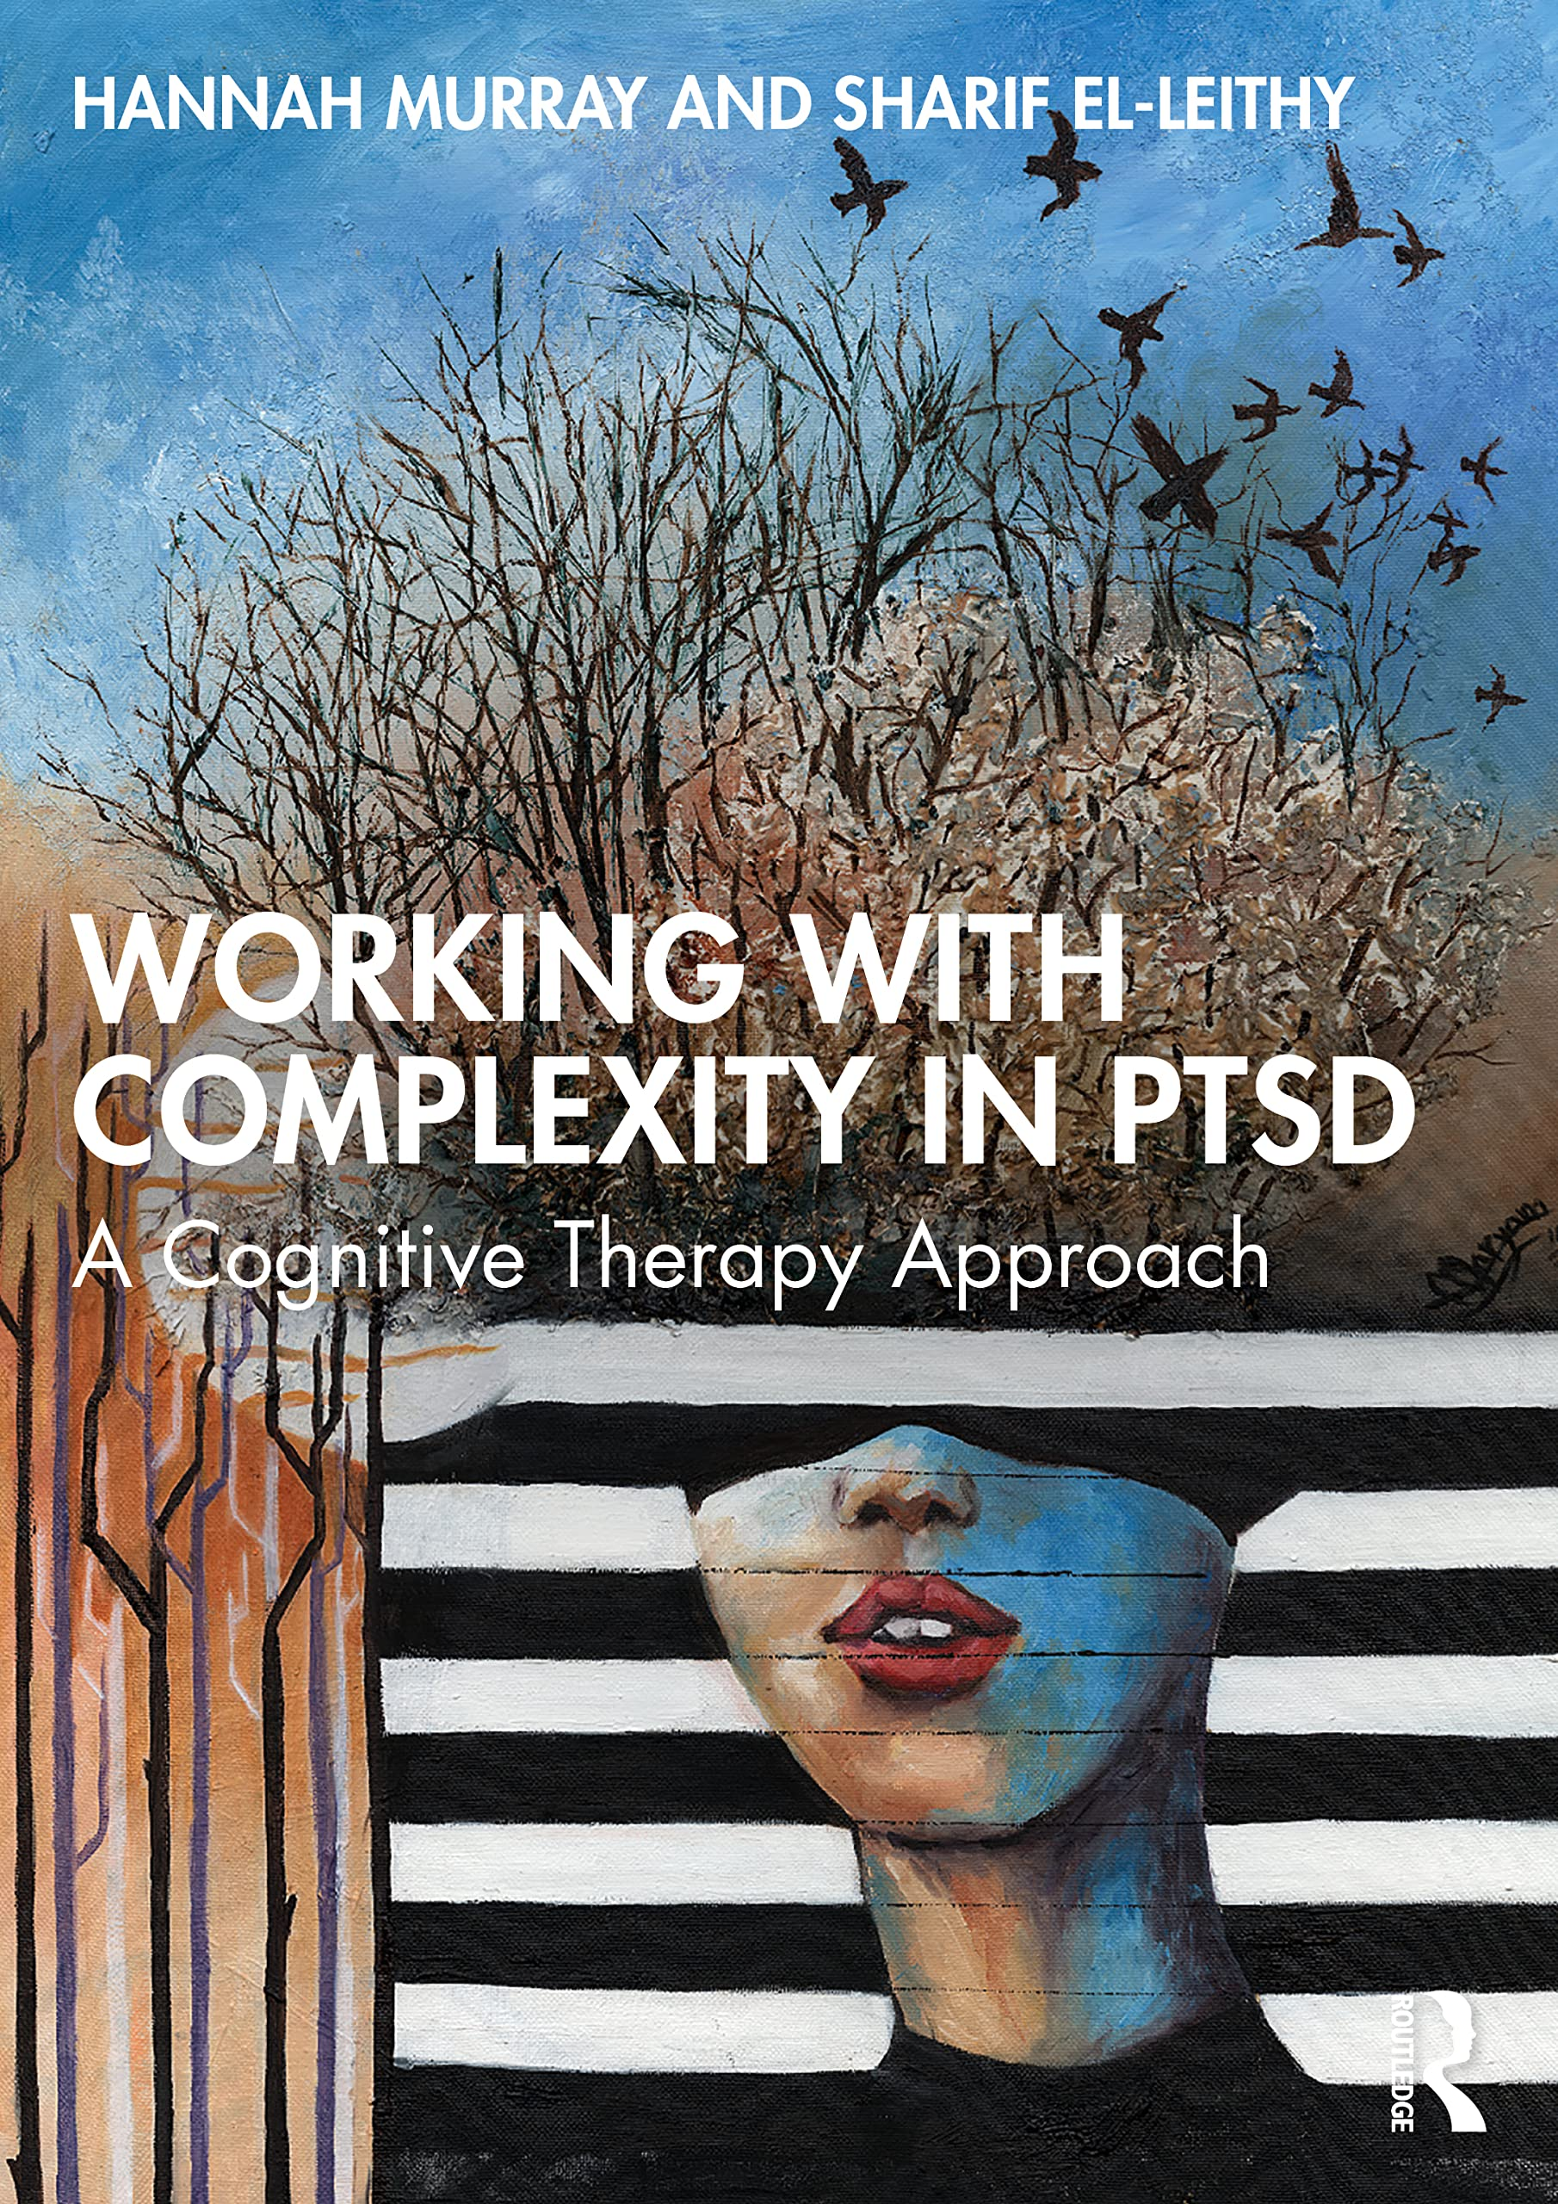
Thank you
for listening
Handouts: bit.ly/MurrayTSW
murrayptsd@gmail.com @murrayptsd
Resources/FAQs: www.workingwithcomplexity.com
Training videos/resources: www.oxcadatresources.com

