Slide 1
What do we know (and don’t know) about Trauma and people with an intellectual disability:
Acknowledgement, Validation and Intervention
Dr Caley Hill & Dr Victoria Tozer – Clinical Psychologists
Aneurin Bevan University Health Board
Learning Disability Directorate
TSW conference 15 February 2023
Notes:
Say this is a journey for me. I haven’t recognised PTSD and we receive very few referrals for individuals suffering from PTSD. We have worked with trauma for years and I have my own model of thinking about this from an attachment and developmental perspective but have never written about this – I wonder why! It seems important now to harness the energy invested in producing Matric Cymru and The Trauma Framework to highlight the needs of people with a learning disability and advocate and support equality in raising awareness and developing evidence-based interventions.
My context.
The plan for today: Going to talk for 20 minutes about some of the key information and recommendations and then have time to think together about moving forward with this agenda.

Slide 2
Definitions of trauma
‘An event, a series of events, or a set or circumstances that is experienced by an individual as physically or emotionally harmful or life-threatening’ SAMHSA, 2014
‘Events or circumstances experienced by an individual as physically or emotionally harmful, or life-threatening, which result in adverse effects on the individual’s functioning and well being’ Learning Disability Professional Senate (2021)
Adverse Childhood Experiences (ACES) are: experience of abuse and neglect (physical, sexual, emotional) and household dysfunction (alcohol or substance abuse, mental health problems, domestic violence and parent incarceration, parental divorce).
Notes:
Key points threats to life, emotionally harmful.

Slide 3
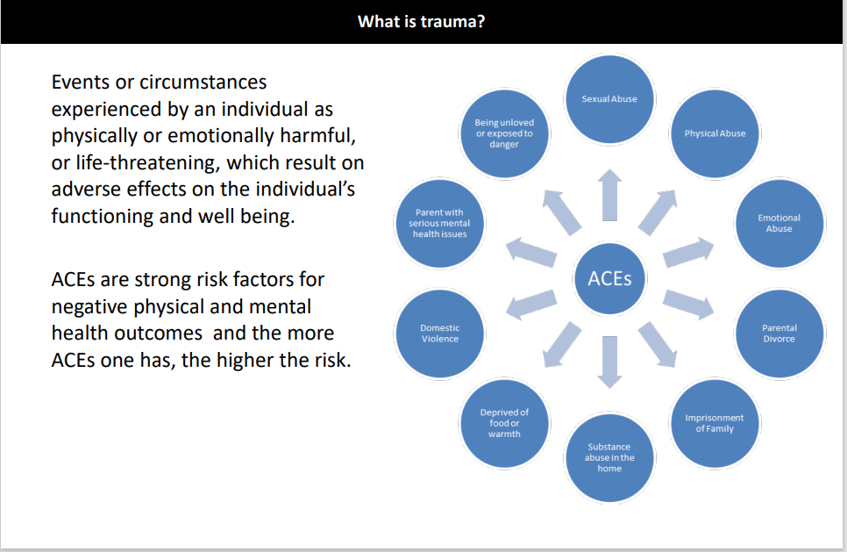
Learning disability professional senate (2021)

Slide 4
A different summary…
‘Trauma imposes an abusive long-term relationship with the event upon us, without our consent. It violates us, removing our agency. It … leads to toxic stress, affecting our responses to socially ambiguous situations. It disturbs our ability to make friends, to trust, to ever relax, sleep, or eat to satisfaction. It distorts our view of ourselves, like a hateful mirror. Our memories fragment. Our bodies flood us with anxiety and stress hormones. Our heart often pounds, and we may have attacks of anxiety without anything threatening us. We have lost basic rust in the safety of the world and our mind. The psyche is ripped.’
They go on to say that services compound this by offering self-help and brief strategies, and medication ‘long before we are asked what happened to us. We are told we should not overwhelm the NHS and the trauma whispers that we are undeserving of help. Somehow, we are worth less than those carefree ones out there, self-actualising themselves, living with their confident, celebrator and fulfilling lives.
‘The Body Keeps the Score as Bessel Van der Kolk famously said – but so does the mind, the psyche. Where we cannot find the words, it will be embodied.’
Allan Skelly & Louisa Shirley writing in Clinical Psychology Forum No 350 February 2022

Slide 5
The context and the task…
That people with an intellectual disability experience trauma is clear, and
This has been historically overlooked, and
Health systems have created trauma, and
People with an intellectual disability often have less robust support systems, and
Systems continue to be invalidating and traumatising, and
People often don’t have agency in their systems, and
People with an intellectual disability are underrepresented in international ACES and PTSD research and, in evidence-based interventions
It can only get better (we hope)

Slide 6
Trauma and its impact
It is now universally accepted that trauma during early childhood has a detrimental effect on a child’s development. The persistent fear response from early experiences alters the development of the child’s brain and extends to reductions in brain volume (Bremner, 2006).
      self-regulation
      cognitive skills and IQ
      language skills
      social skills
International research also indicates that ACES play a key role in child development and subsequent adult mental and physical health. Exposure to 3-5 ACES is considered to have strong associations with a broad range of severe health problems (e.g. Fellitti et al, 1998)
And so, trauma alters the very essence of who one is, and how one acts.
Notes:
Developmentally:
Below the age of 6, most rapid brain development takes place and ACEs can have a profound lifelong negative effect on this development and is associated with a negative impact on IQ
Reference Fellitti and colleagues in 1998 (Need reference) conclusively demonstrated a strong relationship between childhood adversity and mental and physical health in adulthood using the adult retrospective assessment.
Trauma impacts on our sense of who we are, our identity, our sense of agency and ourselves in the world.
Question: What else might it impact on in terms of development? Our relationships, our desire to play, creativity, our confidence to try new things to fail, our emotions

Slide 7
Traumatic events & ACES for people with an intellectual disability
It has taken a long time for professionals and service providers that accept that abuse, adverse life events and childhood experiences is traumatic for people with a intellectual disability.
People with an intellectual disability are at risk of experience more adverse life experiences (Emerson & Brigham, 2014)
Children with ID are more likely to experience ACE’s compared to children in the general population
Research by Reichman & colleagues showed having a disabling health condition (including ID) was associated with 83% higher odds or the child experiencing 2 or more ACEs and 73% higher odds of experiencing 3 or more ACES at age 5 years.
Notes:
Present study reviewed 69 case files of children with ID between ages of 2yrs – 16 yrs. between April – June 2018 using the original ACEs framework and, additional variables such as economic hardship, no of placements see pg. 6-7
Results 82.6% experienced at least 1 ACE: 49.3% experience 2 ACES or more. Most common ACEs were parental separation / divorce, parental MH probs, witness of violence ag a parent.
28.6% had parents with ACEs. There was a strong correlation between ACEs in parents and ACEs in their children supporting transgenerational relationship patterns

Slide 8
Vulnerability to trauma cont.
People with ID are much more vulnerable to sexual abuse / assault, physical and verbal abuse compared to other members of society
Systems perpetuate trauma: For example, people are often moved suddenly without thought for their need for attachment being considered important.
People often don’t have agency in their context
Restraint occurs in systems
Notes:
Paid carers often leave suddenly
Needs being knowingly or unknowingly neglected
Can lead to a small ‘window of tolerance’ resources for coping is reduced, risk of developing difficulties is increased
Also carers might be traumatised

Slide 9
PTSD
PTSD occurs in 20–30% of people exposed to traumatic events and the prevalence in the general population is 1% (Helzer et al, 1987), with life-time prevalence of 9.2%.
The psychological understanding of PTSD is that it represents a failure to process the experience of fear, reflecting either a previous vulnerability to fear or exposure to extremes of fear (Foa & Kozak, 1986). Others suffer sadness, guilt and shame (Andrews, 1998), that is, fear shatters an inner, rather than an external, sense of security.
Resilient individuals see themselves as neither omnipotent nor helpless in the face of stress, and are not ashamed to seek help and use what is offered. In contrast, vulnerable individuals tend to see care-seeking as shameful and anxiety inducing.
How these emotions and coping strategies are understood in those with intellectual disability is largely unknown.
Notes:
Starting to build a picture of adults with an intellectual disability more vulnerable to trauma, impact on sense of self and impacting on relating to others and then seeing care-seeking as shameful – which services can reinforce – see Roger’s story.

Slide 10
PTSD and intellectual disability
There is very limited literature on the subject of PTSD in people with intellectual disability. Why:
Complex PTSD is associated with prolonged exposure to trauma , interpersonal victimisation and early life abuse. McDonnell et al (2019) reported that children with an intellectual disability are 2.4 times more likely to experience maltreatment compared to a population control group
Natural disasters and accidents have less serious sequelae than those where deliberate actions cause harm. Acts of deliberate violence, particularly physical and sexual abuse, may have the worst outcome.
Those with intellectual disability may be at risk of worse outcome if they are diagnosed to have PTSD, as abuse is the commonest aetiological factor in the onset of the disorder
Notes:
Prolonged exposure – impacts on all areas of development as discussed earlier
Why limited literature?
In part because PTSD was recognised as a separate concept only in the past 20 years.
It is only in this time-scale that there has been a full acknowledgement that PwID suffer from serious mental illness.
But as we will see later there are also much more complex reasons
Stavrakaki, (1997) study
I called it distress – he called it symptoms which are on next page
TRAUMA THAT HAPPENS IN THE CONTEXT OF RELATIONSHIPS HAS THE WORSE OUTCOMES
MOST TRAUMA IS RELATIONAL TRAUMA
PTSD was introduced as a separate diagnosis in DSM–III. The defining criteria for PTSD in DSM–IV (American Psychiatric Association, 1994) is the experiencing of a traumatic stressor as opposed to an ordinarily unpleasant stressor, which is a threat to life or severe injury to self or others.

Slide 11
PTSD and intellectual disability cont.
Scotti et al (2012) suggests 79% of people with an intellectual disability have experienced at least one traumatic event with an average of 2.8 events per person
Only one major study of PTSD (51 adults). (Ryan, 1994) showed adults with ID develop PTSD at rates comparable to adult population
(Stavrakaki, 1997) Of 70 patients presenting with anxiety , 63 had experienced one or more of the following events in the previous 3–6 months: rape/ sexual assault, physical assault, accident, illness, a move, bereavement or change in care.

Slide 12
Presentation of PTSD
Ryan (1994) Almost all those with PTSD were referred for violent or disruptive behaviour
Most common diagnosis was none or schizophrenia
Most common comorbid condition (when PTSD recognised) was major depression
Chronic PTSD in young people can present with symptoms such as dissociation, self-injurious behaviours, substance misuse, conduct problems that can obscure the traumatic origin of the problem
From a developmental perspective, pre-school children show more regressive and aggressive behaviour
One study of anxiety disorders (Stavrakaki, 1997) showed the prevailing symptoms to be aggression, agitation, self-injurious behaviour, obsessive fears and insomnia, with specific symptoms of panic attacks, agoraphobia, sexual dysfunction, mood changes, depersonalisation and derealisation.
Notes:
Stavrakaki, 1997 study was with PwID

Slide 13
Why people are more vulnerable to trauma and ACES
It’s unquestionable that people with an intellectual disability are more vulnerable to trauma (Frankish, 2019)
Children with a learning disability are vulnerable to inadequate care giving
  Separations
  Parents sense of loss
  Child less responsive, harder to meet needs leading to increased helplessness
  Parents unable to move on from maternal preoccupation stage
Consequences
  Child uses behaviour to get needs met
  Or gives up trying to communicate it’s needs and becomes passive or retreats
Notes:
As noted previously: Inadequate care =
arrests emotional development,
impacting on intellectual development
and in extreme cases physical development
Giving up – expressing self via behaviour = can lead to increase in traumatic events (neglect, restraint)

Slide 14
Under-recognition and representation in adults with an intellectual disability - society
Valarie Sinason
Society also prefers not to acknowledge difference because it is very difficult to think about someone being in so much emotional pain.
Until the 1980’s it was usually thought that people with an intellectual disability couldn’t understand upsetting things and were not affected by emotional events.
If a person did show distress or difficult behaviours it was seen as being part of their condition or learning disability.
The most common treatments were either medication or behavioural approaches. Before Valarie Sinason it was generally felt PwLD were not intelligent enough benefit from psychotherapy.
Notes:
Why, given a significantly increased vulnerability to experiencing ACES and Trauma is there:
under-recognition
Invalidation
(and, lack of investment)?
Medication was usually anti-psychotics known as the ‘chemical ‘cosh’.

Slide 15
Under-recognition and representation in adults with an intellectual disability - society
‘It’s as though people think that they have enough to deal with just with the very presence of a disabled person, without having to deal with any kind of distress or unhappiness as well’ Sinason
Diagnostic overshadowing Attributing the emotional and behavioural problems to the disability instead of diagnosing a comorbid disorder which can lead to underdiagnosis and inadequate interventions.

Slide 16
Ongoing problems recognising and validating trauma – individuals coping
The pain of difference Sinason: Sense of difference creates emotional pain. Disability may be exaggerated to avoid coming to terms with the difference.
Secondary handicap is very common. People find it easier to try and ignore their abuse and traumatic experiences without help and hide behind a pretence of misunderstanding or retreat and in a sense ‘stupidity’ to avoid pain and distress.
Attacks on linking Bion: Severe trauma can lead to personality disintegration as a way of coping with awful trauma by maintaining chaos in person’s internal world
If surviving means cutting your head off, your intellect is destroyed. If knowing and seeing involves knowing and seeing terrible things, it is not surprising that knowing, becoming stupid, becomes a defence’ Sinason
Notes:
The pain of difference: Sinason said emotional pain that people with disabilities often feel by being different. She pointed out that it may be easier for the person to exaggerate the handicap rather than come to terms with the difference which results in the person’s intelligence being masked. Society prefers not to acknowledge the difference because it is very difficult to think about someone being in so much emotional pain. Society has dealt with this previously by thinking that learning disabled people are unfeeling beings.
Secondary handicap
Bion –American psychologist worked with Veterans
During work could find himself becoming sleepy or mesmerised – transference from the person.
The person’s trauma is so overwhelming it is too much to see the links and connections
So the mind works to maintain the chaos in the person’s internal world

Slide 17
Ongoing problems recognising and validating trauma – individuals coping
Common indications of trauma:
the person’s intellectual skills being poorer than would be expected from the disability they were born with
self-injury, or violence towards themselves, aggression to others or inappropriate sexual behaviours It often indicates trauma
Putting on a front, pleasing carers and not upset people caring for them The person may do this unconsciously ( see also Winnicott’s False Self ) which develops when children fit in with what the carer wants and suppresses their own true needs and feelings. This requires energy so the person uses their capacity becomes more disabled
Denial as a defence against trauma

Slide 18
Moving forward
It is crucial for clinicians to be aware of PTSD and
That it should be considered in the context of the persons intellectual disability and developmental stage
Presenting symptoms of post-traumatic stress disorder in people with intellectual disability:
Aggression Disruptive / defiant behaviour
Disruptive/defiant behaviour Self-harm
Agitation/jumpiness Sleep problems
Distractibility Withdrawn behaviour
Depressed mood
The presentation of symptoms over a prolonged periods may lead clinicians to overlook the experience of traumatic events as aetiological factors
Notes:
It is crucial to explore symptoms of PTSD in the context of the developmental level of the individual and particularly their cognitive and emotional capacity.
And this also will inform intervention.

Slide 19
‘I can tell you the way we shouldn’t be treated. This is from experience.’
Roger Wilczek writing in Clinical Psychology Forum No 350 February 2022.
‘Don’t be abrupt with people who have disabilities. Listen to them and take extra time if they aren’t sure how to answer you or can’t get their words out. Respond to their approaches for support by getting the full picture. Let them say everything that is troubling them. Don’t break your promises. Take responsibility for mistakes if you are a professional, like if you double book them or forget to tell them about you being off.’ Independence is good up to a point. But not if it means sitting alone in your flat. Not if it means taking the axe to my care. If I end up in hospital because I am so lonely and desperate you won’t have saved any money. ‘
‘Give children good beliefs. don’t let children think that they aren’t worth anything’.
Notes:
Roger Wilczek (Adult with an intellectual disability -Expert by experience) writing in Clinical Psychology Forum No 350 February 2022. He experienced at least 5 of 10 ACES. (Illness as a child, locked in a dark place, physical assault, bullied at school, dismissal of distress, victim of robbery, loss) significant mental health difficulties.

Slide 20
Summary
People with ID experience trauma. It impacts on:
  Cognitive development
  Identity
  Self-esteem
  It presents in different ways
As a society and as professionals we struggle to validate this and, that services are traumatising
Trauma occurs in the context of relationships. Development and healing also occurs in the context of relationships
National / international: Trials are thus needed to evaluate the validity of current PTSD criteria for persons with intellectual disability at different levels of functioning (Skelly, A & Shirley, L., 2022).

Slide 21
ABUHB Learning Disability Psychological Services
We acknowledged the gaps in knowledge and evidence base
Our psychological interventions are based on relational safety as well as drawing on evidence based interventions
However, all 3 elements are not currently integrated into a formal evidence base
As a first step we are looking to understand and validate the prevalence of PTSD and C-PTSD in our population
From this we would like to pilot interventions to contribute to the evidence base

Slide 22
Prevalence of PTSD/CPTSD in Individuals Accessing Community Learning Disability Services

Slide 23
Rationale
How many people in our services may have PTSD or CPTSD?
The answer will help us to ensure that services can provide evidence-based treatment for PTSD/CPTSD
Focus is on the experience of "big T" trauma that may lead to the development of PTSD/CPTSD rather than developmental trauma alone
Notes:
People with ID often overlooked (forgotten?), lack of an evidence base.
For us sense that we need to start at the very beginning establish prevalence first
People with LD experience Trauma too – we consider developmental trauma are we as good at recognising PTSD?

Slide 24
Study
Establish prevalence rates of PTSD/CPTSD for individuals with an Intellectual Disability who access Community Learning Disability Services within ABUHB
File audit to gather information about; experience of traumatic events, indicators of psychological distress (e.g. behaviours that challenge), treatment received, diagnosis and demographics
In a proportion of cases data from clinical assessments that have been completed (where appropriate) e.g. diagnostic questionnaires, Life Event Checklists will be triangulated against data obtained from the file audit

Slide 25
Results will help to identify if people accessing our services are experiencing PTSD/CPTSD and from this the need for treatment.
Will inform training needs to ensure that people with Intellectual Disabilities are able to access evidence based interventions in line with the national strategy for the treatment of PTSD/CPTSD

Slide 26
Developing the Matrix
Looking at:
Experience of "big T" trauma
What diagnoses people have – do they already have a diagnosis of PTSD/CPTSD?
Interventions – what interventions have been offered to people
Medication – data collection for an evaluation being conducted by Dr Sarah Argent
Diagnostic criteria for PTSD, tools such as LEC used to identify types of traumatic event to look for. Also included some others that may not normally be asked about e.g. restraint

Slide 27
Where are we now?
Literature review - a work in process
Audit – Initial iteration of a data collection matrix has been developed & tested.
Ready to pilot

Slide 28
The Future
The first stage of a longer-term piece of work. Ideas for development:
How does this link in with reducing restrictive practice agenda?
Attachment/relational and developmental trauma
ASD and trauma (trauma response for events differs according to diagnosis of ASD?
Staff and carers experience of PTSD

Slide 29
Idea: working model to improve trauma services for people
What are the themes of evidence based psychological trauma / PTSD ints?
Relational Safety Emotional Stability Exposure / Processing
Who I am regulation skills
Self, others, world and strategies
Notes:
People act out their feelings….

Slide 30
A Model – psychological / relational safety
Is essential
Trauma happens in the context of relationships or between people
Development happens in the context of relationships *
People with ID are vulnerable to neglect re relational safety and emotional stability
What happens to people when they experience this?
In moving forward with developing the evidence base for trauma interventions for adults with ID, and the systems who support them, relational safety and attachment will need to be taken into account.
‘Research unswervingly shows that relationship is the strongest predictor of therapeutic success’
Collins et al, 2022)
Notes:
Leading to pathologizing and managing people behaviourally and diagnostic overshadowing
We are all aware:
Trauma has a negative impact on development and
can contribute to global developmental delay.
Child development happens in the context of relationships (attachment and relational security).
The safety of relationship impacts on all areas of development including identity and emotional regulation and stability in the context of co-regulation.
Relational safety – relationship focussed practice. Carers are reliable, predictable, consistent, present (physically and emotionally) and aware of inequalities and power imbalances. I would add validating, curious, non-judgemental, able to hold boundaries

Slide 31
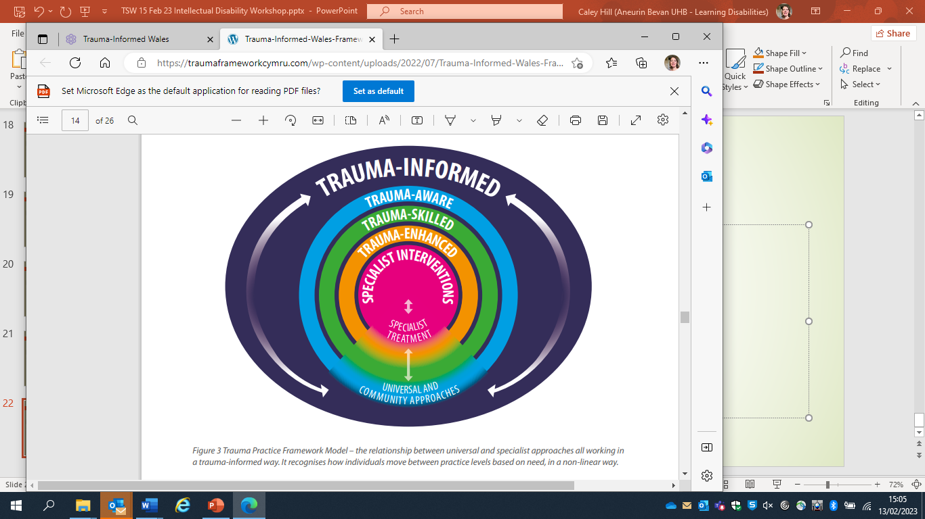
The National (Wales) Context
National Trauma Practice Framework 2022
Our focus today is Trauma Enhanced and Trauma Specialist
Notes:
A trauma-enhanced approach is used by frontline workers who are providing direct or intensive support to people who are known to have experienced traumatic events within their role, and encompasses ways of working to help people to cope with the impact of their trauma.
Specialist interventions may be formal personalised and co-produced interventions that are offered within a range of settings, or specialist input to support organisations and systems to be trauma-informed.
Trauma-aware is a universal approach that emphasises the role that we all have as members of Welsh society, providing community-led responses to the impact of ACEs and trauma, and supporting resilience through connection, inclusion and compassion.
A trauma-skilled approach is embedded within the practice of everyone who provides care or support to people who may have experienced trauma, whether or not the trauma is known about. This applies to most organisations and services in Wales, and many working in and with the community.

Slide 32
Workshop
 | Current practice | Next steps | Aspirations
National Strategy
How to develop an evidence base? What is the evidence base? Adaptation of current generic models / practice
Working with Systems around the individual
Working with individuals
Notes:
We want to think together and
harness your knowledge, skills, expertise and experience
To name :
current good practice,
next steps and
aspirations at all levels of the system of which we are a part
to share good practice and continue a journey to provide high quality practice based / evidence-based care for services for adults with a learning disability who experience Big T trauma
In your groups….. Please consider the table above
Add in:
Lessons learned to date (inviting anybody’s response for example individuals from other specialities
Resources required
Prompts: restraint, over-medication,

Slide 33
References
Frankish, P (2019) Trauma Informed Care in Intellectual Disability
Helzer, J. E., Robins, L. N. & McEvoy, L. (1987) posttraumatic stress disorder in the general population. New England Journal of Medicine, 317, 1630–1634.
McCarthy, J (2018) Post-traumatic stress disorder in people with learning disability. Advances in Psychiatric Treatment (2001), vol. 7, pp. 163–169
Adshead, G. (2000) Psychological therapies for post-traumatic stress disorder. British Journal of Psychiatry, 177, 144–148.
Emerson & Brigham (2014) Exposure of children with developmental delay to social determinants of poor health: cross sectional case record review study. Child: Care, Health and Development 41 (2), 249-257.
Foa, E. & Kozak, M. (1986) Emotional processing of fear: exposure to corrective information. Psychological Bulletin, 99, 20–35.
Freedman, S. A., Brandes, D., Peri, T., et al (1999) Predictors of chronic post-traumatic stress disorder. A prospective study. British Journal of Psychiatry, 174, 353–359.
Gath, A. (1992) A visit to Romania in October 1990 and Leros in May 1991. Journal of Intellectual Disability Research, 36, 3–5.
Hardan, A. & Sahl, R. (1997) Psychopathology in children and adolescents with development disorders. Research in Developmental Disabilities, 18, 369–382. ––– & Sahl, R. (1999) Suicidal behaviour in children and adolescents with developmental disorders. Research in Developmental Disabilities, 20, 287–296.

Slide 34
References
Helzer, J. E., Robins, L. N. & McEvoy, L. (1987) Post traumatic stress disorder in the general population. New England Journal of Medicine, 317, 1630–1634.
Herman, J. (1992) Complex PTSD: a syndrome in survivors of prolonged and repeated trauma. Journal of Traumatic Stress, 5, 377–391.
Hollins, S. & Esterhuyzen, A. (1997) Bereavement and grief in adults with learning disabilities. British Journal of Psychiatry, 170, 497–501. ––– & Sinason, V. (2000) Psychotherapy, learning disabilities and trauma: new perspectives. British Journal of Psychiatry, 176, 32–36.
Howlin, P. & Clements, J. (1995) Is it possible to assess the impact of abuse on children with pervasive developmental disorders. Journal of Autism and Developmental Disorders, 25, 337–354.
Learning Disability Professional Senate (2021) Top ten Tips: Trauma Informed Approaches for people with a learning disability.
Ryan, R. (1994) Post-traumatic stress disorder in persons with developmental disabilities. Community Mental Health Journal, 30, 45–53.
Sovner, R. & Hurley, D. A. (1983). Do the mentally retarded suffer from affective illness? Archives of General Psychiatry, 40, 61–67.
Stavrakaki, C. (1997) Anxiety disorders in persons with mental retardation: diagnostic, clinical and treatment issues. Psychiatric Annals, 27, 182–189. World Health Organization (1992)
Trauma and Intellectual Disability. Acknowledgement, identification& intervention. (2021). Eds Nigel Beail, Pat Frankish & Allan Skelly. Pavilion.

