Slide 1
Parameters and Legalities of Information Governance Issues with 3rd Sector Organisations
Dave Parsons
Information Sharing and Integration Governance Manager, Digital Health & Care Wales
Julian Willett
Transformation & Innovation Lead, Mental Health Clinical Board, Cardiff & Vale UHB

Slide 2
“The Assessment & Core Dataset Workstream will develop, implement and monitor a national minimum dataset and consider minimum standards for assessment, across the age range including infant mental health and across both Mental Health and Learning Disability services, in conjunction with local Health Board Leads and partners, and with oversight from the Traumatic Stress Wales (TSW) National Steering Group.”
(From Traumatic Stress Wales’ Assessment & Core Dataset Workstream Terms of Reference)

Slide 3
Examples of Third Sector providers
Sexual Assault Referral Centres (SARC)
  Eight in Wales:
    Two are hosted by NHS:
      C&VUHB
      BCUHB
    Six are hosted by New Pathways:
      SBUHB
      PTHB
      ABUHB
      CTMUHB
      HDUHB x 2

Slide 5


Dave Parsons
Information Sharing & Integration Governance Manager
Digital Health & Care Wales

Slide 6

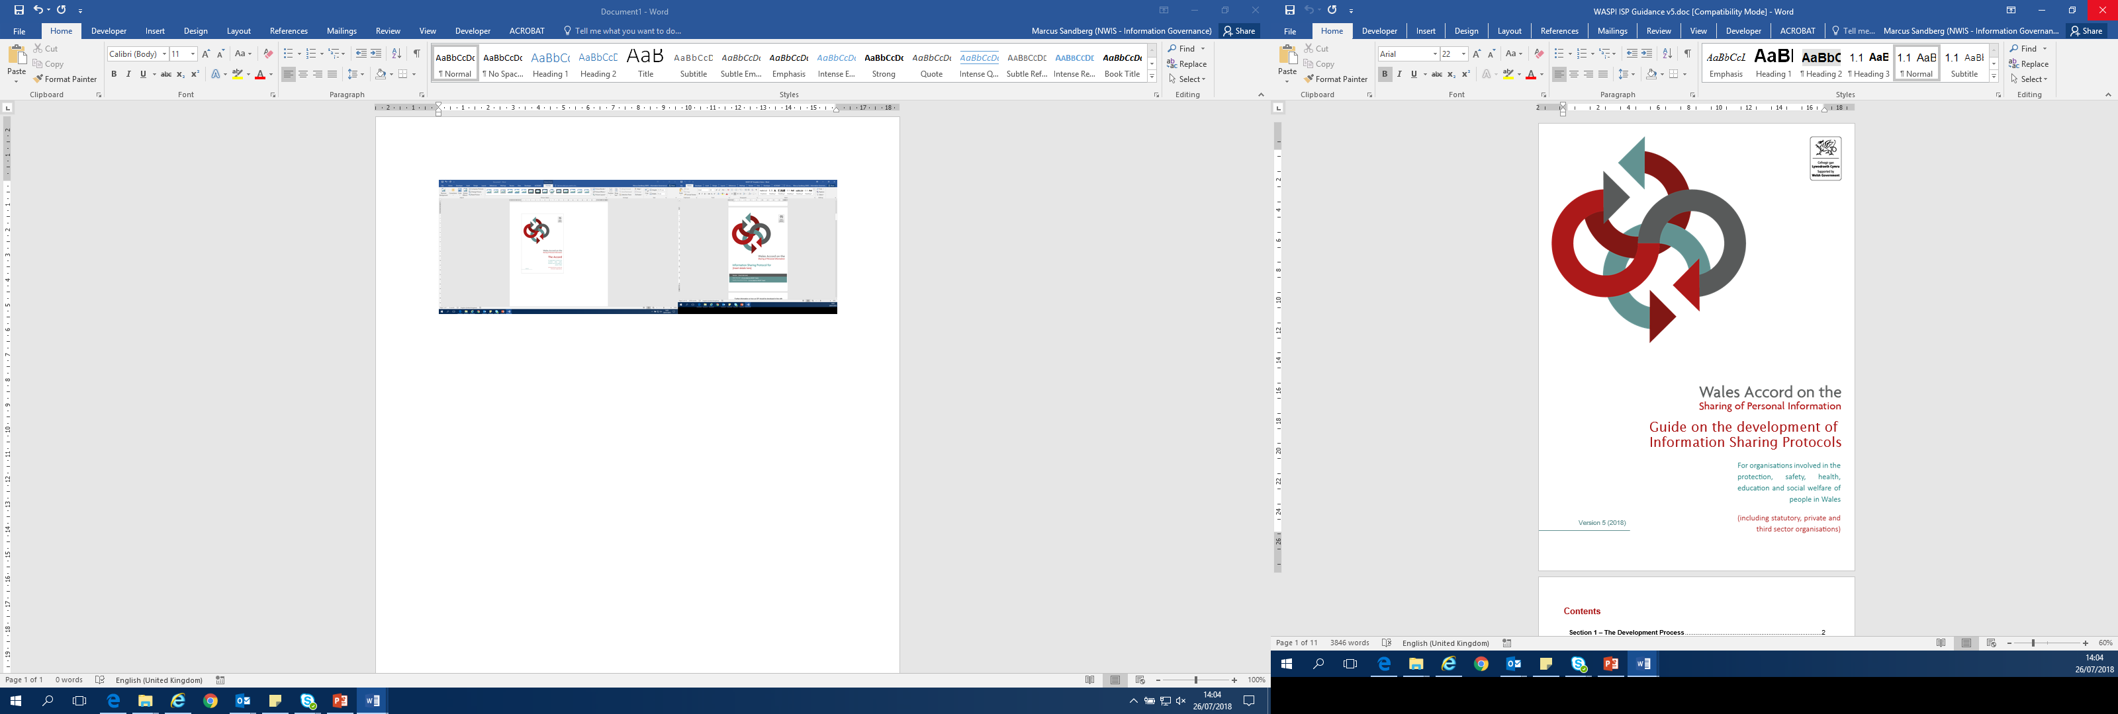
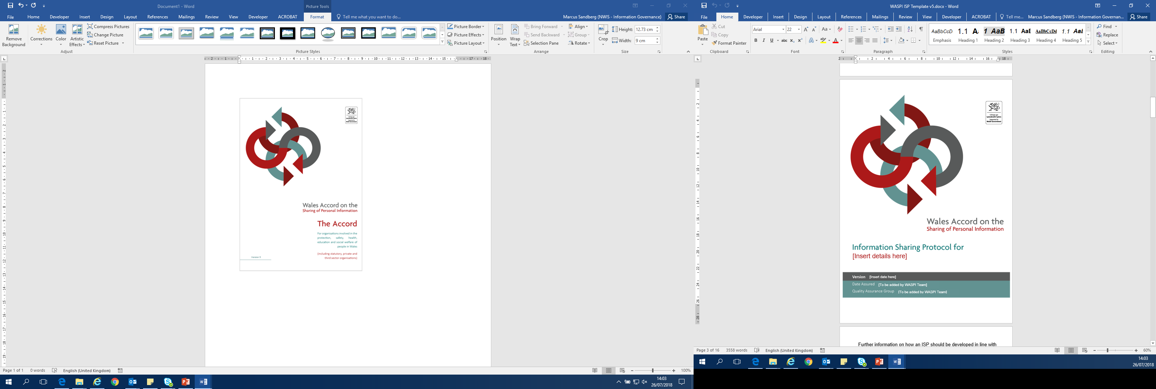

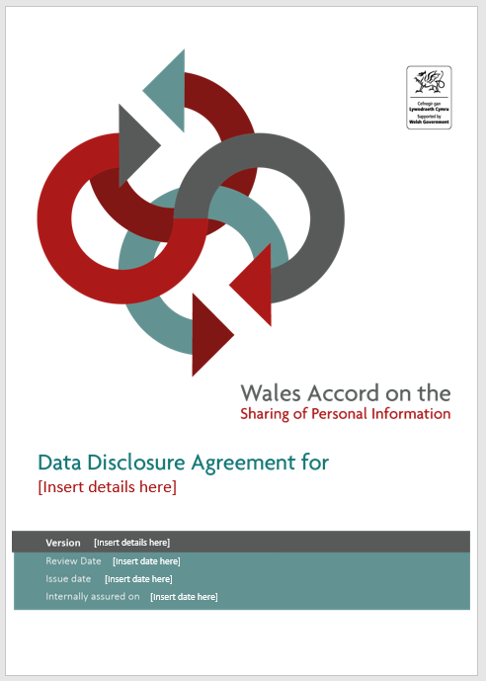
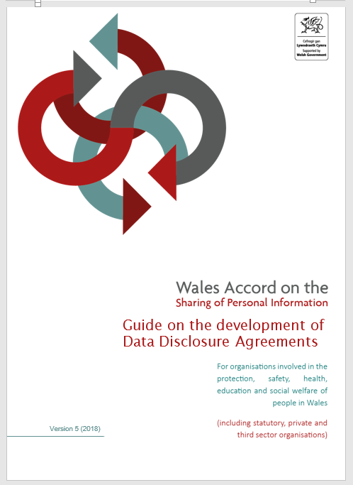
Wales has wide-ranging support for an information sharing framework, the Wales Accord on the Sharing of Personal Information (WASPI). Funded by Welsh Government, recognised as good practice by the Information Commissioner and with input from service providers WASPI has, over the last decade, made significant progress in embedding WASPI across service providers in Wales and helped to break down the perceived barrier to information sharing.
WASPI Vision | Organisations will confidently, effectively and lawfully share personal data, as necessary, for the benefit of people in Wales.

Slide 7
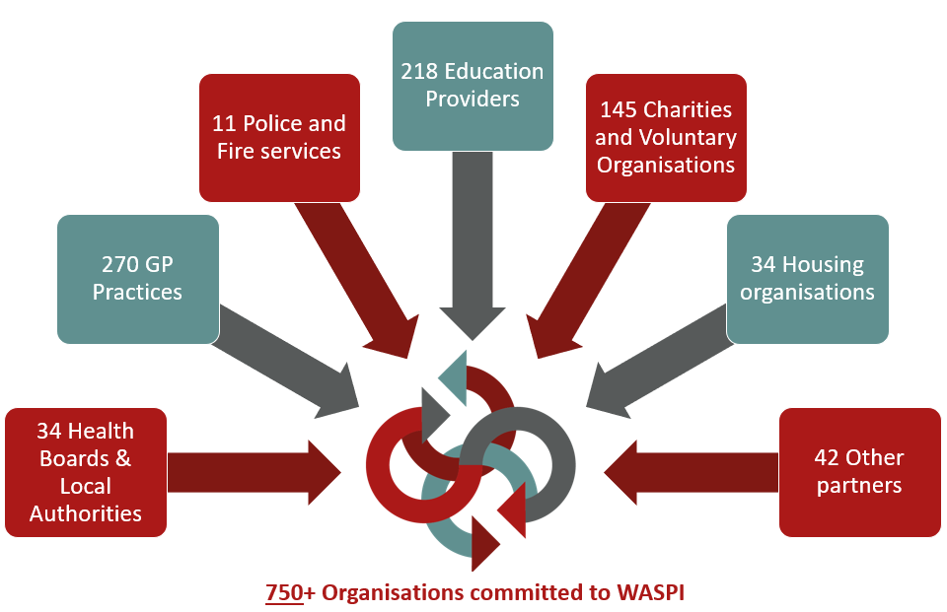
WASPI National Position
WASPI Growth since last funding review
750 organisations now signed up to the Accord
250+ Approved Information Sharing Protocols are now published on the WASPI website
Introduction of 5 regional quality assurance groups, which are all now supported by the WASPI Team and have their own Chair appointed
WASPI’s importance as the information sharing framework in Wales, recognised by Welsh Government and other stakeholders, following work and support in particular areas including during pandemic and as part of the Ukrainian Refugee Scheme
No equivalent framework in UK

Slide 8
Governance
LEADERSHIP & GOVERNANCE
-Scrutiny
Strategy
-Priorities
-Opportunities
LOCAL IMPLEMENTATION
SUPPORT
Central WASPI Team (DHCW)
-Website
-Promotion
-Advice
-Liaison
REGIONAL OWNERSHIP
-WASPI Management Board
-Wales Information Governance Board (WIGB)
-Welsh Government
-750+ participating organisations
-Local Information Governance Leads
-ISP Development
Quality Assurance Groups
Mid & West
South Wales
Cwm Taf
South East
North Wales

Slide 9
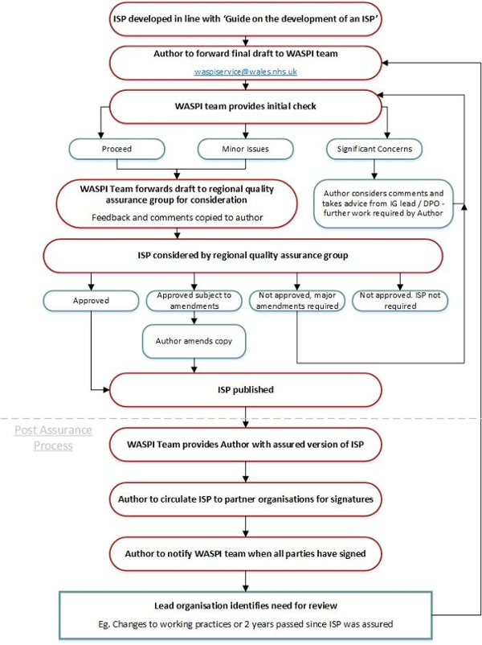
The WASPI process
Health Board/Trust Information Governance Contacts:
Name | Organisation
Carol Johnson | Betsi Cadwaladr University Health Board
Patrycja Duszynska | Hywel Dda University Health Board
Darren Lloyd | Digital Health and Care Wales
Becs Wadley | Swansea Bay University Health Board
Jonathan Meredith | Aneurin Bevan University Health Board
James Webb | Cardiff and Vale University Health Board
Vacant | Cwm Taf University Health Board
Amanda Smart | Powys Teaching Health Board
John Lawson | Public Health Wales Trust
Kelly Holding | Welsh Ambulance Service NHS Trust
Tim Knifton | NHS Wales Shared Services Partnership
Martin Harris | Health and Care Research Wales
Helen Tyler | Welsh Health Specialised Services Committee
Kelly James | Health Education and Improvement Wales
Ian Bevan | Velindre NHS Trust

Slide 10
WASPI – Its added value
Supported priority areas such as NEET, Flying Start, MARAC, Teams around the family programmes – ISP’s across all areas of Wales
WASPI Framework pivotal in supporting data sharing arrangements supporting TTP and sharing initiatives supporting citizens during the covid-19 pandemic and is now supporting data sharing for the Ukrainian resettlement programme, with data flows from WG, through to enabling all LA’s and Health Boards to confidently share personal information for the programme.
Wales recognised through the national local data sharing during the pandemic Institute of Government ongoing report, as being the only nation able to achieve documented data sharing effectively due to its WASPI framework

Slide 11

Development of WASPI as a Code of Conduct
The WASPI Code of Conduct offers code members and their stakeholders, including the public, additional assurances on organisational practices of data sharing
What
Article 40 of the UK GDPR makes provision for the preparation of codes of conduct, the ICO have requirements organisations need to meet to be approved as a Code. This includes the requirement of having a Code Owner and Monitoring Body, responsible for monitoring signatories to ensure they meet the requirements and maintain the Code itself
Creating an enhanced WASPI framework will provide confidence to organisations, this is likely to result in less risk averse approaches to sharing of personal data about Welsh citizens
Why
Build upon the existing Wales Accord on the Sharing of Personal Information (WASPI) framework, through an additional tier of assurance
Provide confidence to organisations, with less risk averse approaches to sharing of personal data about Welsh citizens
Introduce assurance and accountability controls, which will significantly improve data sharing standards
Aims
Provides an approved assurance model for organisations to confidently document the lawful sharing of personal and sensitive data across multiple sectors
The code ensures consistent application of principles for sharing of data through governance and accountability aligned to the ICO data sharing code of practice.
Provides a monitoring mechanism, carried out by an ICO approved monitoring body, to ensure organisations meet information sharing best practice
The code is approved by the Information Commissioner’s Office under the provisions of article 40 of the UK General Data Protection Regulation (UK GDPR)
Outcomes
Being a Member of an approved ICO Code of Conduct can provide protection for an organisation in the event of regulatory action being considered for a breach of data protection

Slide 12
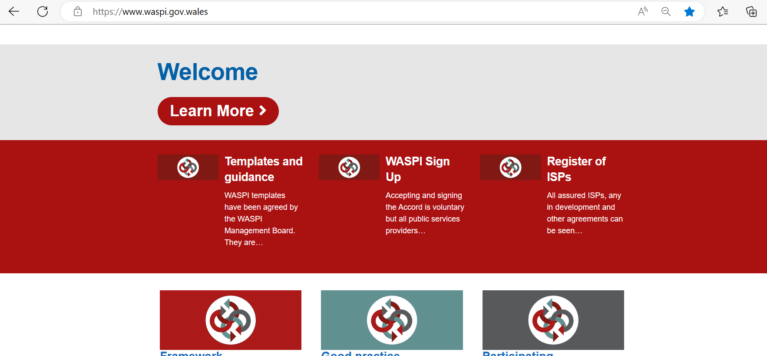
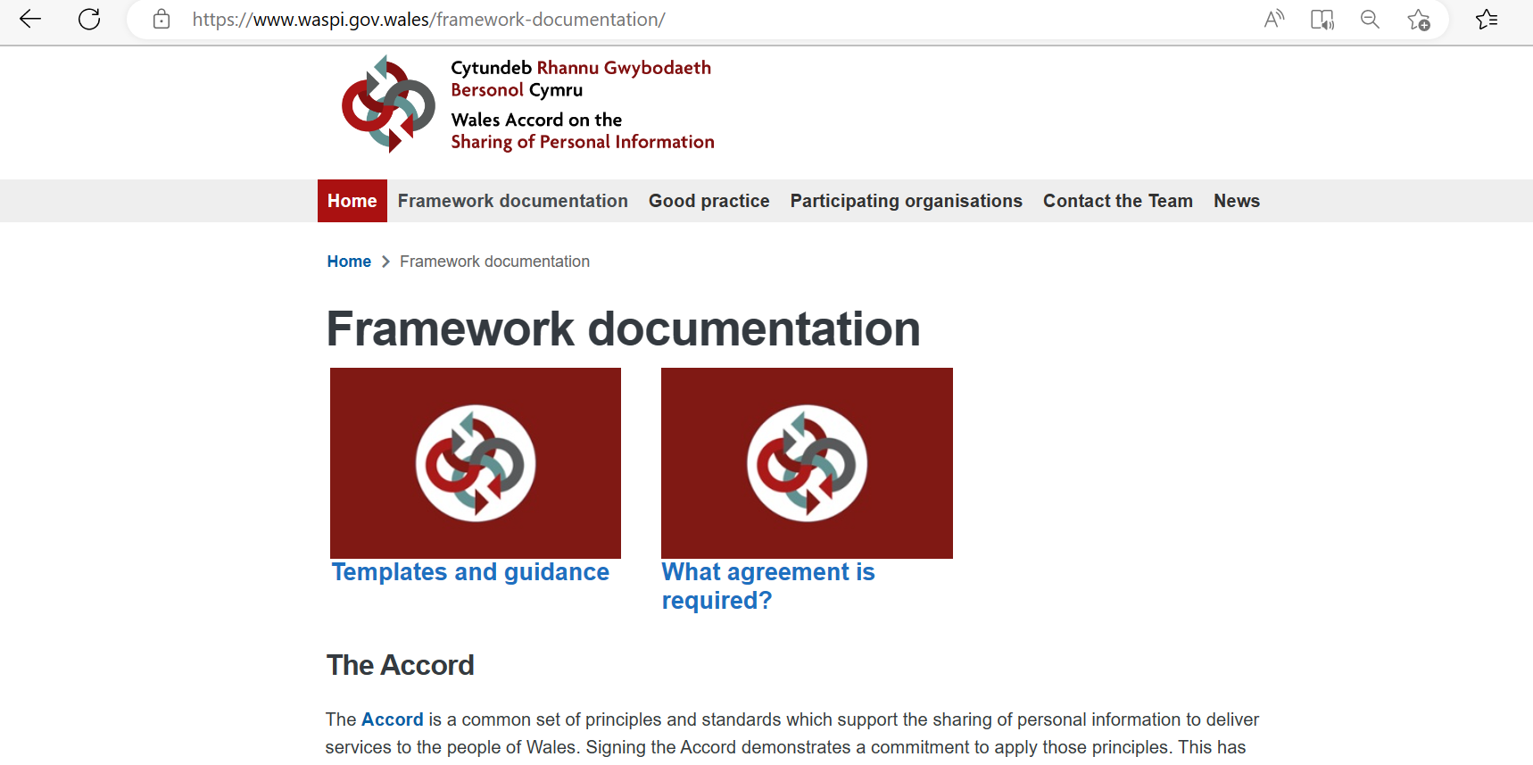


Sign up to WASPI & more information
www.waspi.org
waspiservice@wales.nhs.uk

Slide 13
Thank you

