Slide 1

Therapies of the future
Dr Mat Hoskins MBBCh MSc MRCPsych
Lead Adult Consultant Psychiatrist,
Traumatic Stress Wales
Psychiatric Intensive Care Consultant,
Cardiff and Vale University Health Board
(he/him)
Notes:
Hi I’m Mat and I’m the lead adult consultant for TSW, with my work largely focussing on the drug treatment algorithm we’ve developed. I also look after a psych intensive care unit in Cardiff, and I’m currently the PI for a phase 2 MDMA study that’s just started in Cardiff, and that’s exactly what I’ll be talking to you today about in this workshop

Slide 2
Conflicts of interest
PI for MAPS sponsored clinical trial; received training in-kind and travel expenses.
Co-founded private cannabis clinic; receive payment for consultations.
Notes:
So here are my conflicts of interest, the trial I’m involved in is sponsored by MAPS and I’m also involved in setting up a small medical cannabis clinic in Cardiff.

Slide 3
What we’ll cover – drug-assisted therapies
The challenge of treatment resistant PTSD
  Create your own drug
Psychedelics and MDMA: history, risk and current evidence
  Dispel misconceptions
Cardiff MP18 study
  Future implications for research and Welsh NHS
Notes:
What we’ll cover today, and I’ll try to make this interactive with some tasks we’ll break out to do
We’ll talk about the challenges of treatment resistant PTSD and what that means for us and patients.
We’ll wave a magic wand and design our own drug to help with therapy
We’ll talk about psychedelic compounds in general and MDMA in particular, it’s history and how it came to be used in clinical trials today
I’ll go over the current evidence base for MDMA in PTSD and tell you about our current study in Cardiff, MP18
And we’ll

Slide 4
Treatment resistance in trauma
Trauma-focussed psychological therapies (TFPT)
  Optimal window of arousal
  Strong therapeutic alliance predicts better outcome
Up to 50% cannot tolerate it
Higher Sx severity predicts poor outcome
Notes:
While TFPT is effective for over 50% of PTSD sufferers, it is not effective for everyone, resulting in some individuals having to live with a severe and enduring untreated mental health condition. One reason for treatment resistance is that some PTSD sufferers are so overwhelmed by the negative feelings that accompany memories of their trauma that they cannot fully engage in a therapy that focuses on it. There are high levels of drop-outs from treatment and many sufferers self-harm, attempt suicide or mask their symptoms by using illicit drugs or alcohol to block out their feelings (Brady et al 2004).

Slide 5
Two-minute task
Turn to the people either side of you
Discuss why people might struggle to tolerate or engage with trauma-focussed therapy of any kind.
Try to think about specific symptoms and responses you’d need to overcome.

Slide 6
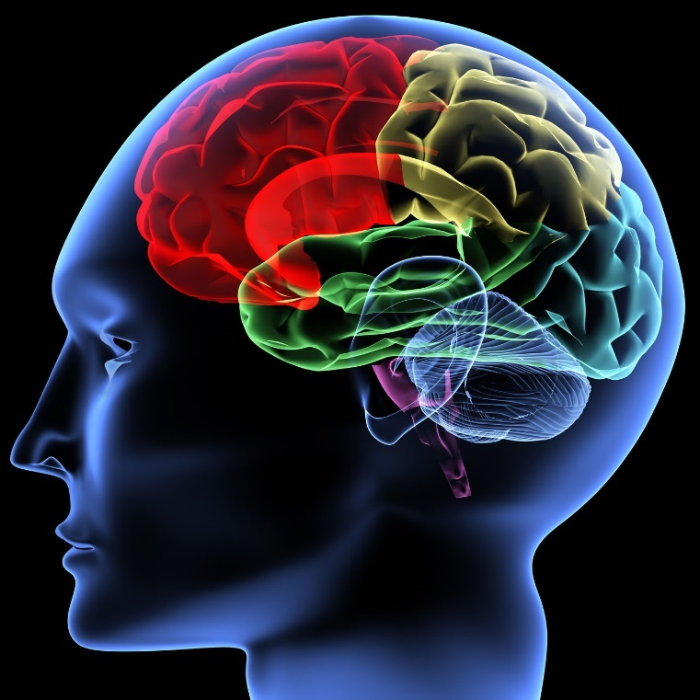
The neurocircuitry of PTSD
Structural and functional abnormalities
  Amygdala
  Insula
  Medial prefrontal cortex
  Rostral anterior cingulate
  Hippocampus
Areas associated with fear conditioning, fear extinction, and emotional regulation
Notes:
Neuroimaging of PTSD sufferers has demonstrated structural and functional abnormalities in brain regions such as the amygdala, insula, medial prefrontal cortex (mPFC), including the rostral anterior cingulate cortex (rACC), and hippocampus (Hughes & Shin 2011). These regions are associated with fear conditioning, fear extinction and the regulation of emotions (Shin & Handwerger 2009). Some brain abnormalities may predispose to the development of PTSD, whilst others are a sequela of PTSD (Robinson & Shurgill 2011). For instance, non-trauma exposed twins of sufferers may show smaller hippocampal volumes (Gilbertson et al 2002) and increased resting metabolic activity in the anterior cingulate cortex (Shin et al 2009), whilst PTSD sufferers acquire further secondary loss of hippocampal volumes (Felmingham et al 2009) and lower grey matter density of the pregenual ACC (Kasai et al 2007). A meta-analysis of fMRI studies suggests a pattern of amygdala and insula hyperactivity in response to emotional stimuli with a corresponding hypoactivation of ventromedial prefrontal cortex and rACC (Etkin & Wager 2007).

Slide 7
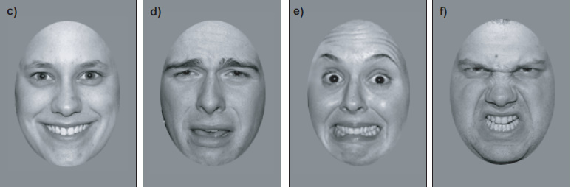
The amygdala and insula
Hyperactive in response to trauma script provocation and when processing fearful vs happy faces
Positive correlation between activation and PTSD Sx severity
Successful exposure therapy associated with decreased amygdala activation
Notes:
The insula is structurally interconnected with the amygdala and specifically sensitive to salient environmental stimuli, marking such stimuli for further processing (Menon & Uddin 2010). Several studies have reported hyperactivity of the insula in PTSD using trauma script symptom provocation (Lindauer et al 2008, Lanius et al 2007) as well as increased activity when processing fearful versus happy facial expressions (Fonzo et al 2010). A positive correlation has been reported between insula activation and PTSD severity (Hughes & Shin 2011) as well as in other anxiety disorders (Etkin & Wager 2007, Stein et al 2007, Shin & Liberzon 2010).

Slide 8
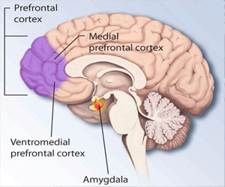
The ACC, mPFC
Reduced activation of mPFC in PTSD Sx provocation
Diminished mPFC and ACC activation in response to fearful faces
Negative correlation between mPFC, ACC activation and PTSD Sx severity
Successful exposure therapy associated with increased ACC activation
Notes:
Individuals with PTSD show reduced activation or greater deactivation in regions of the medial prefrontal cortex in response to traumatic-script driven imagery (Bremner et al 1999, Lanius et al 2001, Shin et al 1999). Diminished rACC and mPFC activation was also seen in response to fearful versus happy facial expressions, with rACC activation being negatively correlated with PTSD severity (Shin et al 2005). Likewise, there is diminished rACC activity in response to trauma-related and unrelated emotional interference (Kim et al 2008, Offringa 2013) with a negative correlation between rACC activation and PTSD symptom severity. Poor response to cognitive behavioural therapy has been predicted by deficient pre-treatment rACC activation (Bryant et al 2008), whilst successful exposure therapy has been associated with increased rACC activation and decreased amygdala activation during fear processing (Felmingham et al 2007).

Slide 9
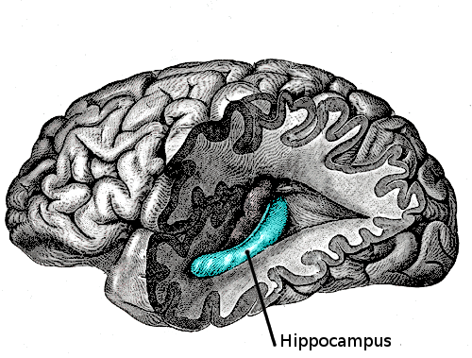
The hippocampus
Disturbances in memory in PTSD
  Intrusive recollections, flashbacks
Hippocampus modulates memories according to context during fear conditioning
Conflicting reports
  Meta-analysis suggests overall reduced activity
  In particular, reduced activity in traumatic script provocation
Successful Rx (sub-threshold PTSD) found increased hippocampal activation
Notes:
PTSD sufferers experience disturbances in memory with symptoms such as intrusive recollections, dissociative flashbacks and psychogenic amnesia (Dickie et al 2008). The hippocampus is involved in consolidating the memories of emotionally arousing experiences and modulating memories according to context during fear conditioning (McGaugh 2004, Corcoran & Maren 2001). There have been conflicting reports as to whether the hippocampus is hyperactive or hypoactive in PTSD but a meta-analysis suggested that overall there is reduced activity in PTSD (Etkin & Wager 2007). In particular, individuals with PTSD have demonstrated reduced hippocampal activation in response to traumatic script provocation (Bremner et al 1999). Reduced hippocampal activation in a virtual Morris water task (designed to test learning, memory and spatial navigation) predicted symptom severity in subjects with PTSD (Astur et al 2006). Successful treatment with psychotherapy in patients with subthreshold PTSD has found increased hippocampal activation in response to traumatic scripts (Peres et al 2007).

Slide 10
Resting state functional connectivity (RSFC)
Increased RSFC between amygdala and insula
Reduced positive connectivity between amygdala and hippocampus
Negative correlations between amygdala and mPFC and between rostral ACC and dorsal ACC
Supports hypothesis of inhibitory role of mPFC on the amygdala
Notes:
Individuals with PTSD have been found to have increased positive RSFC between the amygdala and insula (Rabinak et al 2011) and reduced positive connectivity between the amygdala and hippocampus (Sriprada et al 2012). Additionally, there are negative correlations between the amygdala and the mPFC, rACC and dorsal ACC, supporting the hypothesis of an inhibitory role of the mPFC in relation to the amygdala (Sriprada et al 2012).

Slide 11
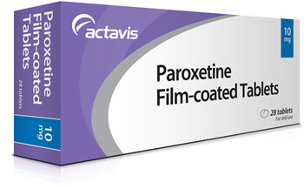
What’s the evidence for conventional pharmacotherapy?
Second-line intervention
Monotherapy – small +ve effect on PTSD Sx
  Paroxetine, venlafaxine, sertraline, fluoxetine
Augmentation – likewise
  Prazosin, quetiapine
(Hoskins et al 2021)

Slide 12
So what does that leave us with?
Not much, unfortunately
  Antidepressants
  Anticonvulsants
  Antipsychotics
  Anxiolytics
Evidence for conventional meds + TFPT sparse
  Clinical experience
  Still not overcoming resistance
Newer psychotherapies?
  3MDR, VR assisted, internet based etc
  Still trauma-focussed

Slide 13
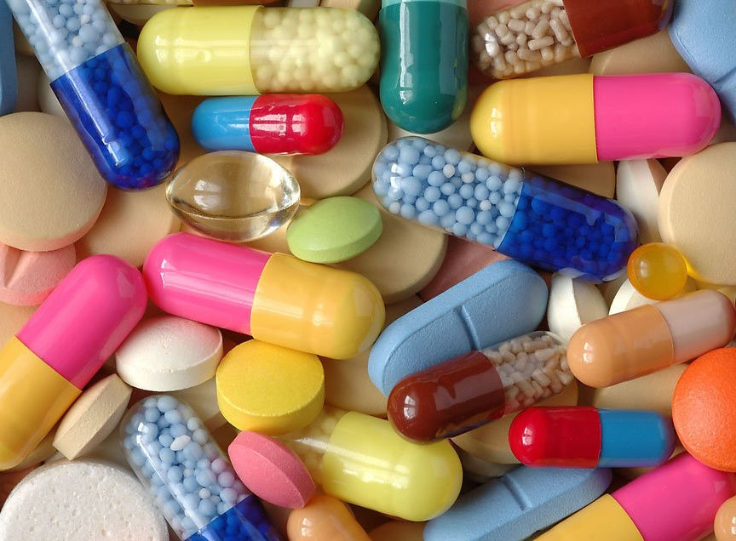
Two minute task - design a new type of short acting drug, taken just before a therapy session
Consider effects on:
  Arousal
  Relaxation
  Level of consciousness
  Memory consolidation
  Fear circuitry
  Therapeutic alliance
  Duration
  Addiction

Slide 14
Are drug-assisted therapies the future?
Paradigm shift
New models of working with pts
Novel, mind altering compounds

Slide 15
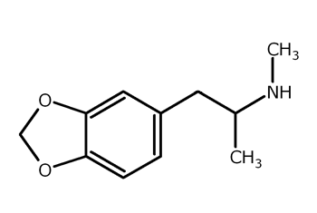
MDMA
3,4-methylenedioxymethamphetamine
  A psychedelic compound
First used as psychotherapeutic tool in late 1970s
  Recreational use as ecstasy ≠ clinical MDMA
Class A illegal drug
  “no recognised medical benefit”
  Stringent UK Home Office restrictions on research

Slide 16
What are psychedelics?
Compounds that cause non-ordinary states of consciousness
  Mind-revealing, entheogenic, empathogenic etc
  Not psychotomimetic nor hallucinogen
Classical – mostly 5HT2a agonism
  LSD, psilocybin, DMT
  Range from 6-72 hours
non-classical
  MDMA, ketamine, numerous synthetic
  Range from 40mins-6 hours
  more manageable for most
Notes:
Entheogens are psychoactive substances that induce alterations in perception, mood, consciousness, cognition, or behavior for the purposes of engendering spiritual development or otherwise in sacred contexts

Slide 17
But what are psychedelics like?
Ineffable, unfortunately.
  Changes in mood, perception, consciousness, cognition, and behaviour
Different substance, different types of experience
  LSD – waves of intensity, clear up, plateau, come-down
  Psilocybin more unpredictable, more “revealing”
Alterations to perception common
  Fractals, breathing, pulsing, melting
Closed eye visuals more intense
  Other-wordly, eidetic memories,

Slide 18
But what are they really like?
Things imbued with meaning and beauty
  Esp music and nature
Peak experiences
  Oceanic boundlessness
  Infinity
  Mystical experiences
  Ego-dissolution, ego-death
  Usually incredibly meaningful and transformative
    Griffiths 2010
You always come down from a peak

Slide 19
Historical and cultural contexts
Evidence of psychedelic plant medicine consumption in most ancient cultures
  Our relationship with this plant-technology goes back thousands of years
Shamanistic
  Community religious healer, used to treat ailments
Entheogenic
  To commune with spirits, rights of passage
Modern
  Ayahuasca retreats
  Native American Church - peyote

Slide 20
Historical and cultural contexts
1950s-70s the first N.American and European psychedelic wave
Mostly LSD psychedelic therapy model
  Preparation sessions
  Hours long drug sessions with attention paid to comfort, music, sitters
  Integration
Extensive research, publications, intl. conferences
  Appeared safe and effective for alcohol dependence, stuck psychotherapy patients
  But then….
Notes:
How do we use them
Historical and cultural context
Modern applications
Prep, drug, integration
Set, setting, music
How do they work
Non-ordinary states
Research in depression
Research in mood
Research in PTSD

Slide 21
Historical and cultural context
Recreational use exploded
  Challenged status quo
  Asked questions about societal structures
  State power, civil rights, puritanism, capitalism, imperialism,
Anhedonic cultural norms
  Pleasure is bad, unless it’s tobacco or alcohol
Used as political tool, banned, designated no medical use
  40 years of no medical research

Slide 22
Two minute task
Put these drugs in order of harm
When considering harm, think of harm to the person, society and addictive potential
Alcohol
Cannabis
Crack Cocaine
Heroin
Ketamine
LSD
MDMA
Nicotine
Psilocybin

Slide 23
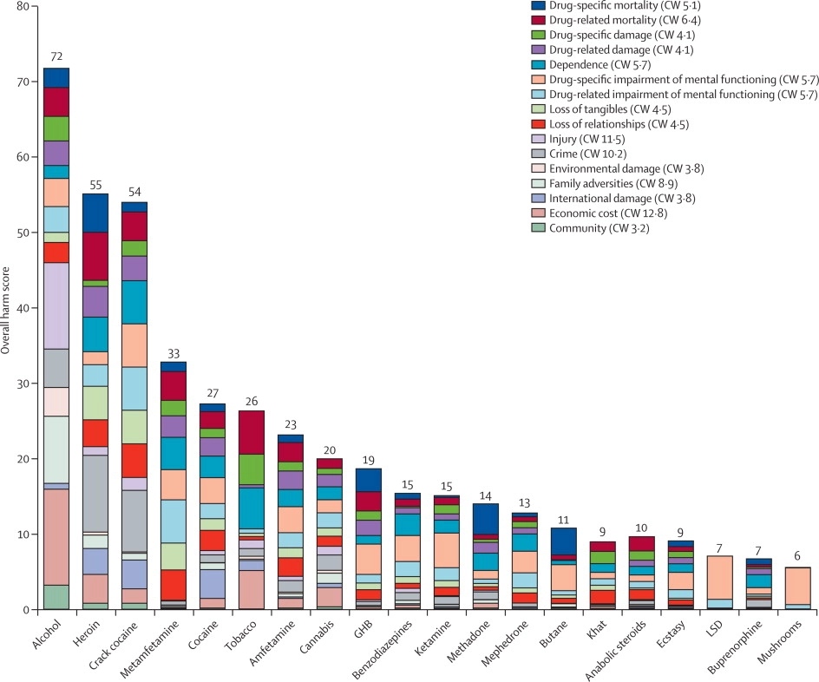

Slide 24
MDMA neurobiological effects
Unique psychopharmacological profile
  Exerts main effect through release of pre-synaptic serotonin (5HT^{1a,1b, 2a})
  To a lesser extent dopamine, noradrenaline, cortisol
  Rapid and robust release of oxytocin
    The love hormone

Slide 25
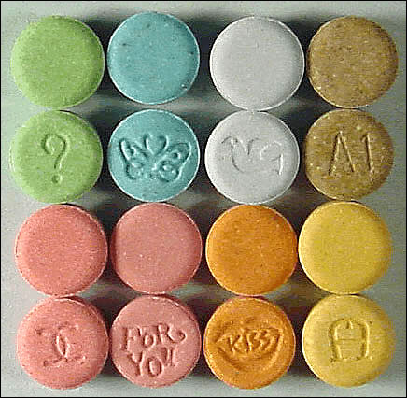
MDMA acute effects
Effects last 2-5 hours
Positive mood and creative thinking
  New insights
Stimulation and paroxysmal relaxation
  Optimal window of arousal
Empathy and Bonding
  Therapeutic alliance
Relatively short duration, well tolerated
  <8 hours
  Mildly raised temperature, HR and BP
There’s a reason they call it “ecstasy”

Slide 26
MAPS
Multidisciplinary association of psychedelic studies
  Founded 1985
  Rick Doblin
Express intention of exploring evidence of MDMA-therapy
Very successful at raising capital to fund high quality RCTS
Developed MAPS model of MDMA-AP with Dr Michael Mithoefer

Slide 27
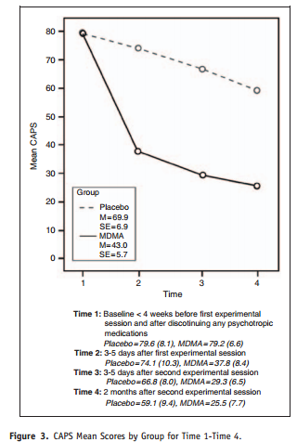
Mithoefer et al 2010
Chronic, treatment resistant
12 therapy sessions
  2 were 8hr long drug assisted
Average duration of symptoms
19.5 years
Clinical response
  85% MDMA
  15% placebo
No adverse events
Longterm FU data (2 years) stat+clin sig Sx gains maintained

Slide 28
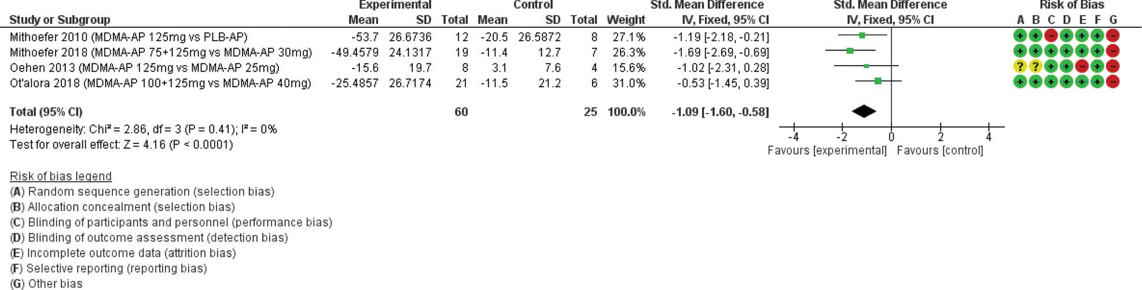
MDMA-AP vs placebo/active placebo

Slide 29
MAPP1 – phase3 2021
Multicentre parallel arm RCT
Severe PTSD
MDMA (n=46) vs placebo (n=44)
3 x drug/placebo sessions (80-180mg)
CAPS5 endpoint

Slide 30
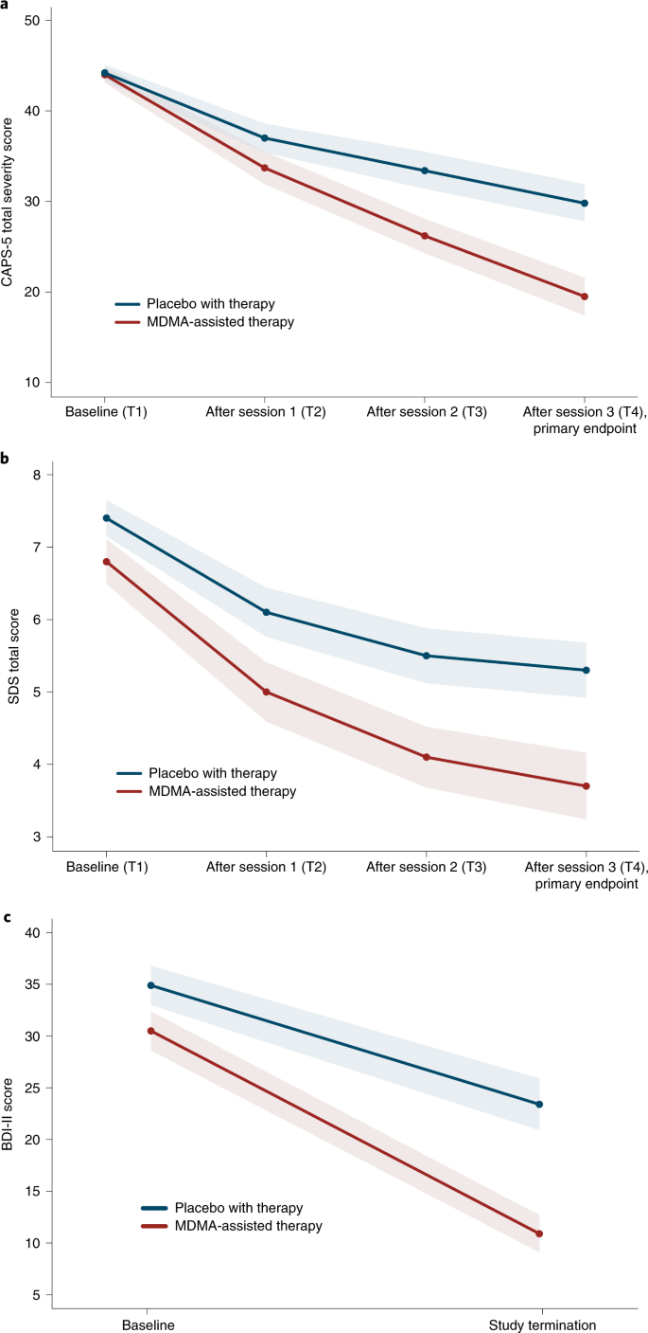
At the primary endpoint, 67% of participants in the MDMA group no longer met diagnostic criteria for PTSD, compared with 32% of participants in the placebo group.
Three sessions of MDMA-assisted therapy significantly reduced PTSD symptoms and functional impairment, compared to placebo.

Slide 31
MAPP2 – phase 3
Multicentre parallel arm RCT
Severe PTSD
Total n=100
3 x drug/placebo sessions (80-180mg)
CAPS5 endpoint
Study completed – to be published 2023

Slide 32
Basic principles of MDMA-AP
First hurdle has been to overcome 40 years of misinformation and demonisation
  RCTs generally very rigorous safety measures
  Strict, expensive regulatory approvals required
Model developed from legitimate 1970’s psychedelic LSD therapy
  Preparation
  Non-directive drug session
  Integration
  Set and setting

Slide 33
Structure and personnel
Female + male therapist dyad throughout
  Chaperone safety measure
  Someone always present
Preparation
  2-3 sessions, 90 mins
Drug session
  2+, several hours
Integration session
  at least one after each drug session

Slide 34
Preparation sessions
  Build therapeutic alliance
  Set intentions for psychedelic experience
    Manage expectations
  Introduce concepts
    Innate healing ability/intelligence
    Non-ordinary states as therapeutic, even if uncomfortable
  For trauma, depression, end of life anxiety
    Spontaneous experiences
    Reliving, prolonged exposure, cognitive restructuring, new insights on old ingrained problems

Slide 35
Preparation; dealing with non-ordinary states
Acceptance with open arms
  “let the medicine do what it needs to do”
  “if something difficult comes up, walk into it, give it a hug and see what it wants to show you”
Innate healing ability
  “trust your body”
  “don’t get ahead of the medicine”
Compassionate curiosity, restorative experiences
  “let the music be a guide”
  “you’re allowed to just have fun”

Slide 36
Set and setting
  Crucial, nuanced and sometimes subtle details
  Set
    Mindset of the pt going into experience
    Preparation, intention, expectations, resistance
  Setting
    Physical environment
    Temperature, light, disturbances, comfort, safety
    Therapists – physical touch
    Access to nature/beautiful objects

Slide 37
Music
“music is the hidden therapist”
  Instrumental, novel, emotionally engaging
  Longer experiences, longer playlists
LSD/MDMA
  Calming, energetic, emotional buildup, emotional release, calming
Ketamine
  Much shorter experience
  Cue example Home – Native

Slide 38
Drug session
Welcome, set intention and plan
Talk through any anxieties
Agree on staying in the room
Agree on consent for physical touch
Pt lying on a bed, eye mask, headphones with emotionally salient music
Main issues for the therapists
  Keep quiet! Lip read and hand signals
  Stay present, meditate, read, etc.

Slide 39
Drug session
Non-directive
  Encourage to focus attention inwards
  Can remind what options there are to modulate intensity
  Change music, music off, eye mask off, talk, hug, move
Physical touch – check consent
Often overnight stay
  Trained night sitter
  Respond to requests, listen but don’t guide

Slide 40
Integration sessions
Always occur the following day
Usually in the same room
90 mins
An open, compassionate and curious space to discuss experiences
Validate feelings
Facilitate new meanings as they emerge

Slide 41
The non-directive approach
Relies upon the innate healing ability of a person affected by trauma
  Pts think about, relive, reprocess, restructure
  Spontaneously, non-verbally
Michael’s analogy with physical injury
“MDMA is an obstacle remover”

Slide 42
Cue youtube 00:38: See an MDMA-Assisted Therapy Session

Slide 43
The 2nd psychedelic renaissance 2010-now
High quality RCTs
  MAPS, Beckley Foundation, Hefter Institute, Johns Hopkins, Imperial, Kings
  Now phase 3 studies of MDMA, psilocybin,
Growing mainstream interest and acceptance
  Numerous op-eds, think pieces
How to change your mind
  High profile docu-series

Slide 44
Cardiff MP18 study
MHRA granted MAPS an Innovation Passport for MDMA-AP
  Only 41st Rx to receive passport since inception in 2021
  Designed to accelerate timelines for approval of Rx for life-threatening conditions
Phase 2 open label multi-centre study of MDMA-assisted psychotherapy of severe PTSD
N=2, 2 therapy teams
CAV UHB, CRF
Home Office licensee
Notes:
MDMA as an adjunct to therapy for PTSD is the forty-first treatment to receive the Innovation Passport since its inception in January 2021
The designation is intended to accelerate the timeline for approval of innovative medicines for treatment of life-threatening conditions or those which present a significant patient or public health need
MAPS Public Benefit Corporation will coordinate trial design with Medicines and Healthcare products Regulatory Agency to create a road map for early patient access in the UK

Slide 45

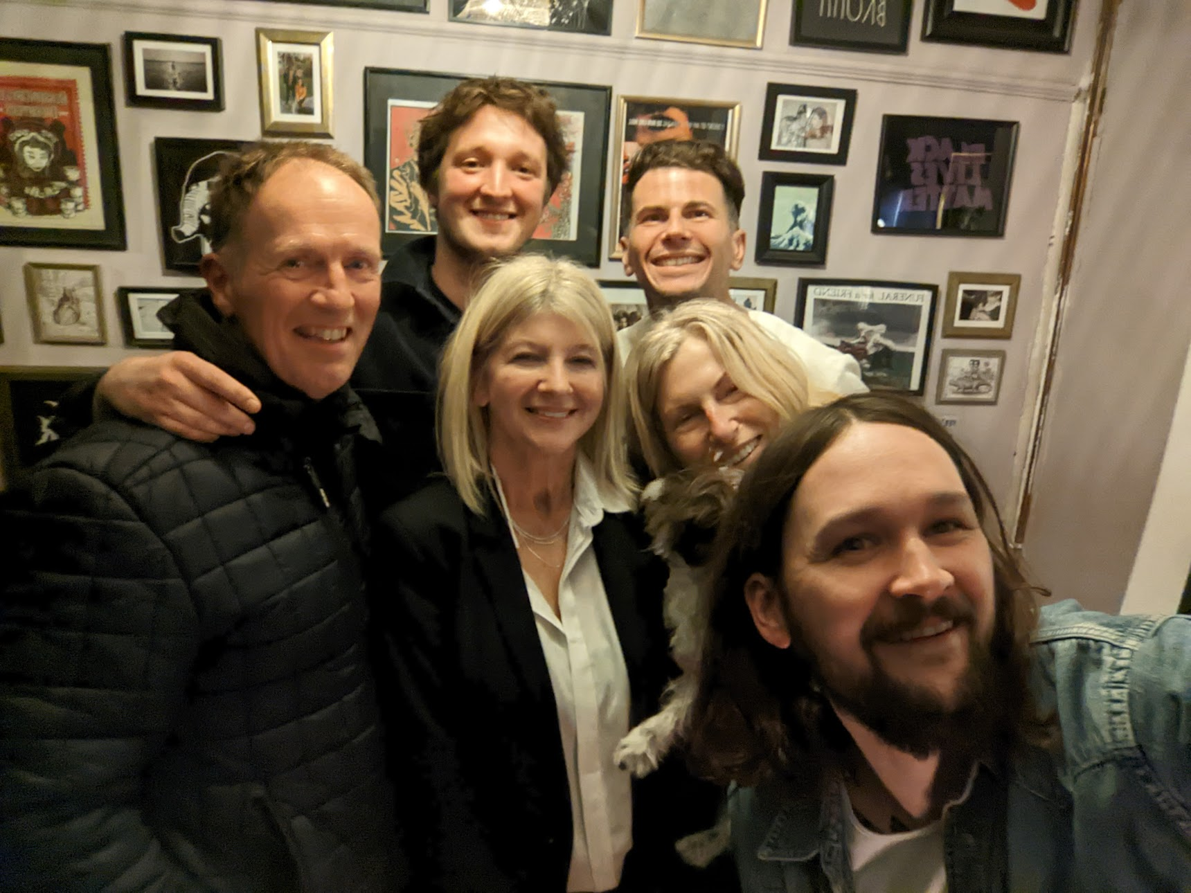
MDMA Therapist training
  Charleston, South Carolina
  Boulder, Colorado
2 x 8 hour therapy sessions
  Placebo
  125mg + 62.5mg MDMA 2 hours later
Eye masks, music, non-verbal
  No “comedown”
  No adverse reactions

Slide 46
Cardiff MP18 study

Slide 47
Two minute task
Can you imagine any ways MDMA could be adapted to better help pts with traumatic stress?
Consider what elements of conventional TFPT you’d integrate.
Consider resource implications for the NHS

