Slide 1

POLAR – developing an integrated intervention pathway for traumatic stress in prisons
Professor Andrew Forrester (Cardiff University)
Dr. Natasha Kalebic (Cardiff University)
Clare Crole-Rees (Oxford Health NHS Foundation Trust /Cardiff University)
Dr. Jack Tomlin (University of Greenwich)
Isidora Popovic & Claudia Berrington (Cardiff University
Dr. Oliver John (Royal College of Psychiatrists Wales)

Slide 2
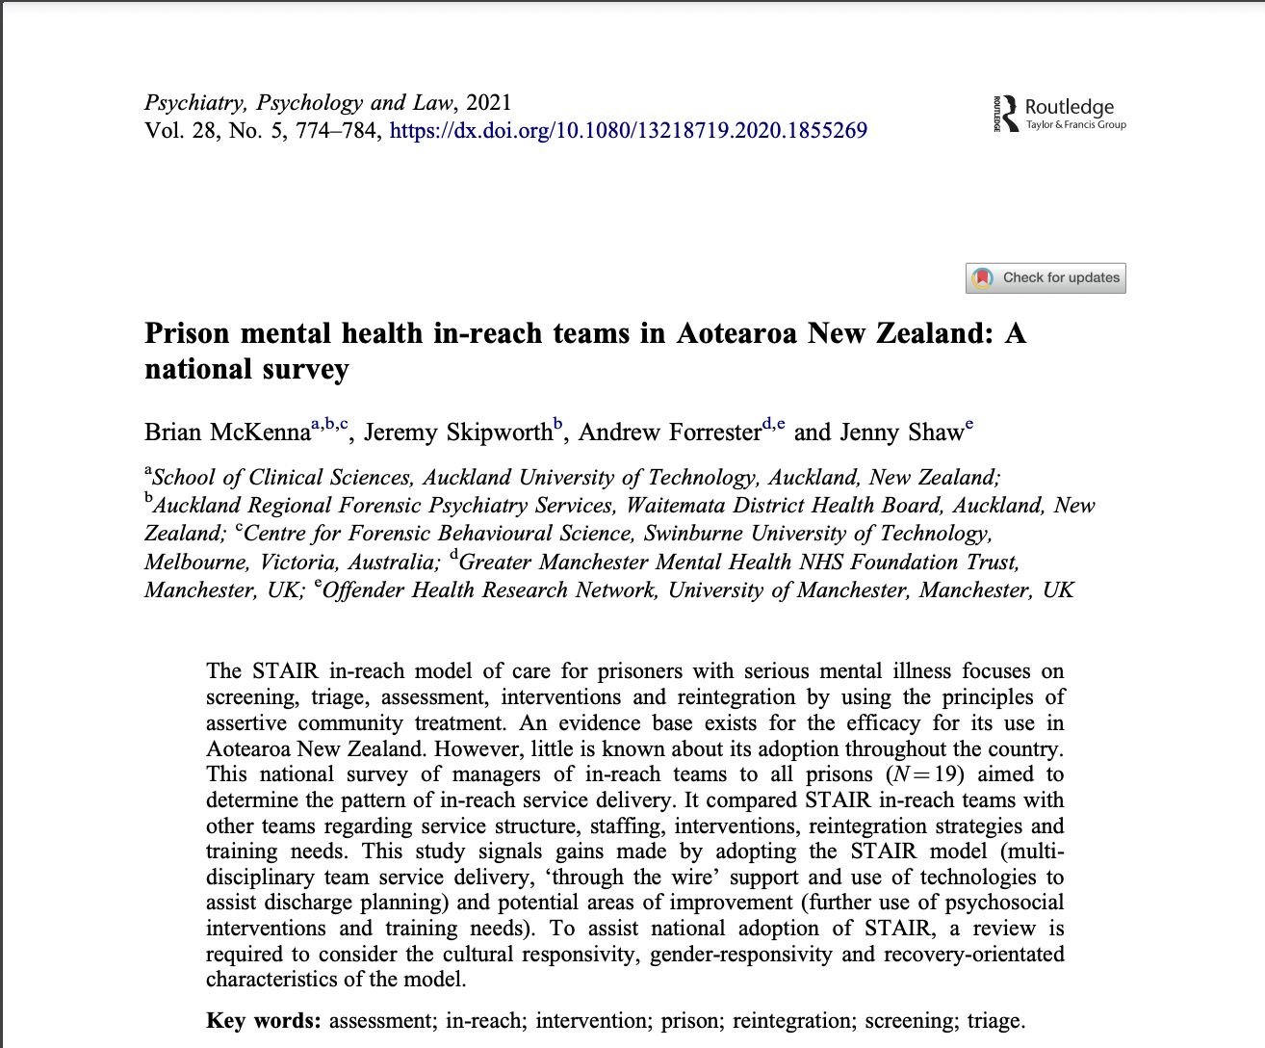
The Survey
The survey (designed in-house) was based on existing research from a New Zealand study (McKenna et al, 2021)
There were 4 main aims:
  To gather information about existing services and current intervention pathways for traumatic stress within prisons
  To look at how these existing services and intervention pathways are currently delivered
  To collect information about trauma-informed practice
  To elicit views about an optimal pathway
We identified service managers / senior clinicians within each Welsh prison who could complete the survey which was sent via email.
Notes:
The survey, which was designed in-house, was based on existing research from a New Zealand study (McKenna et al, 2021).
The survey aimed to gather information about existing services and current intervention pathways for traumatic stress within prisons and how these are delivered as well as information about trauma-informed practice, and to elicit views about an optimal pathway.
We identified service managers / senior clinicians within each prison in Wales who could complete the survey and sent it to each person via email.
McKenna, B., Skipworth, J., Forrester, A., & Shaw, J. (2021). Prison mental health in-reach teams in Aotearoa New Zealand: A national survey. Psychiatry, Psychology and Law, 28(5), 774-784.

Slide 3
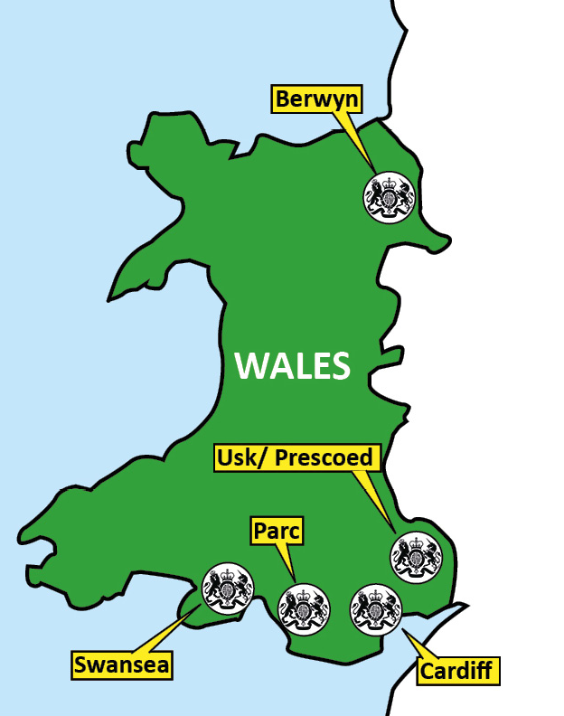
The Survey
The survey - 4 main sections
Information about the establishment (e.g., mental health care provider)
Service structure (how mental health care is structured; multi-disciplinary?; integrated health and substance misuse services? Inpatient hospital; safe cells?
Details of staffing levels (numbers & professional groups)
Types of interventions available (psychological therapies and mental health interventions for patients with PTSD, Complex PTSD, and other co-occurring conditions)
Notes:
* The survey took no more than 15 minutes to complete and included sections on………Information about the establishment, the service structure, details of staffing levels, and types of interventions available

Slide 4
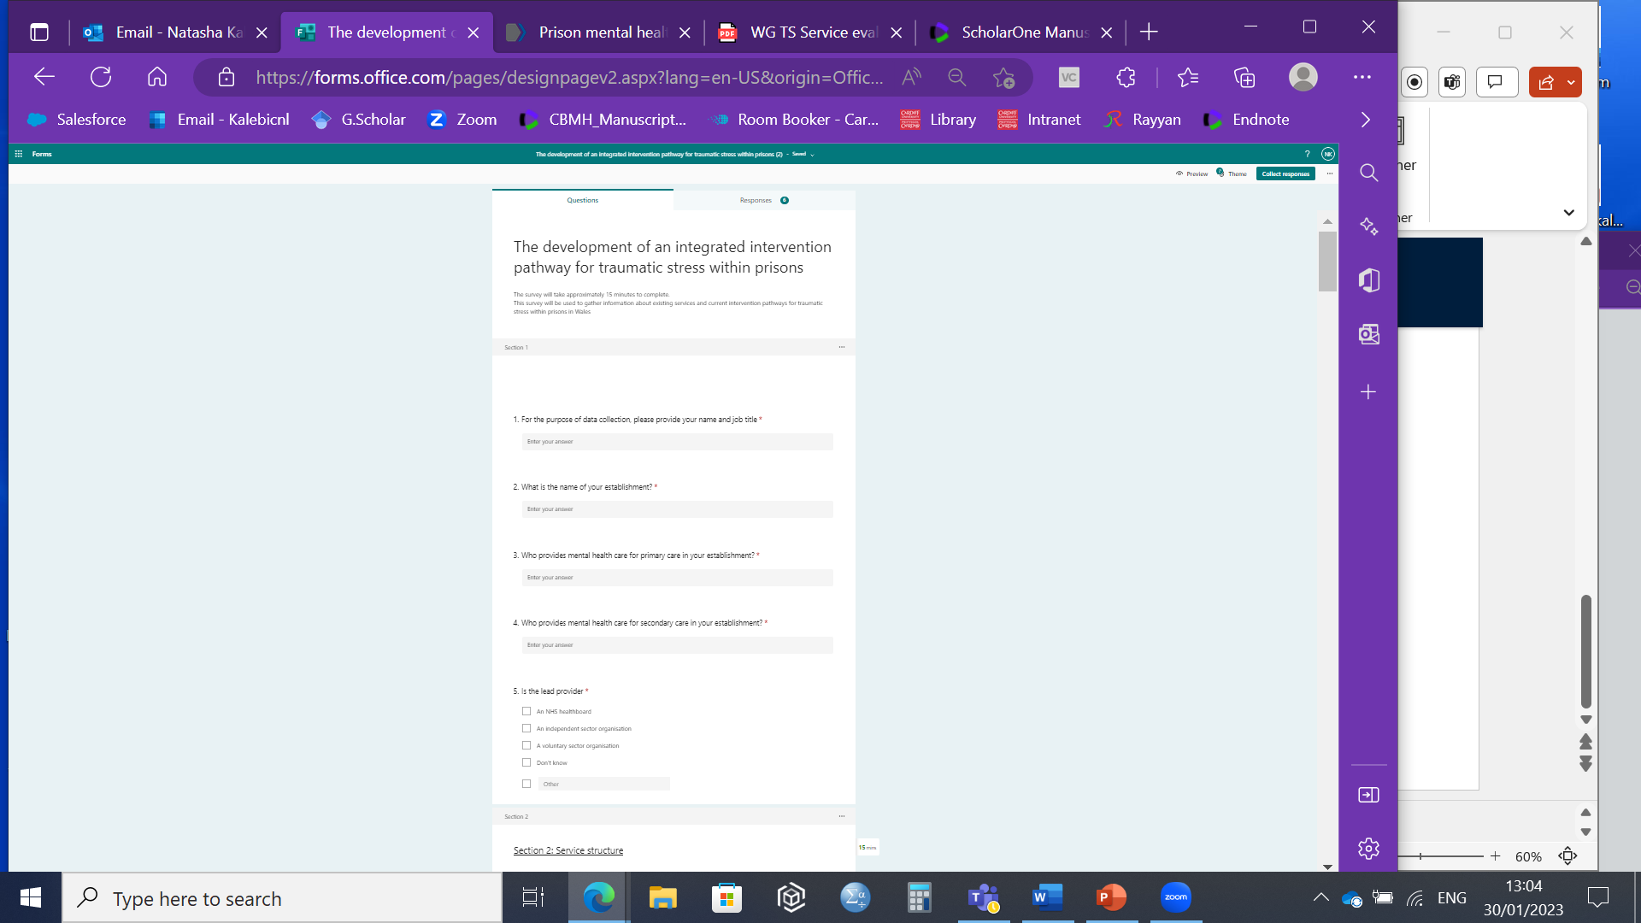


The Survey
Notes:
This slide simply shows how the survey looks online and can be made available to anyone who wishes to see the entire document. The survey consisted of 56 questions, a combination of quantitative and qualitative questions on Microsoft Forms.
All 6 prisons responded

Slide 5
Results: Identifying trauma
Notes:
Now we'll discuss some of the main results. When asked whether they had a screening process for the identification of traumatic experiences, 3 of the 6 prisons said no

Slide 6
Results: PTSD/C-PTSD interventions
Notes:
We were interested in primary and secondary care interventions carried out within prisons. In primary care, guided self help, emotional stabilization, mentalisation based therapy and EMDR were used with trauma focused CBT being stated as the most common.
In secondary care there was a greater range, maybe consistent with a greater complexity of presentations and greater specialism

Slide 7
Results: PTSD/C-PTSD interventions - continued
Notes:
A broad mix of professions provide trauma and PTSD therapies including, psychiatry, occupational therapy and psychology with Nursing being the most common

Slide 8

Results: PTSD treatment
All 6 prisons prescribed medication for PTSD
In all 6 prisons, Psychiatrists were listed as prescribers
In 2 prisons, GPs were also listed as prescribing medication for PTSD
Notes:
Regarding treatment, all Welsh prisons prescribe medication for PTSD and psychiatrists were always listed as prescribers. In 2 prisons, GPs were also listed as prescribing medication for PTSD

Slide 9
Results: Using a trauma-informed approach
Notes:
In addition to trauma focused therapies, we're also interested in organisational trauma informed approaches and it was really positive that half the prisons were taking a trauma informed or psychologically informed approach. And we were interested in specific aspects of the trauma informed approach and one aspect of this is about reflective practice. Again, half the prisons said they do offer reflective practice and this will be talked about in more detail later

Slide 10
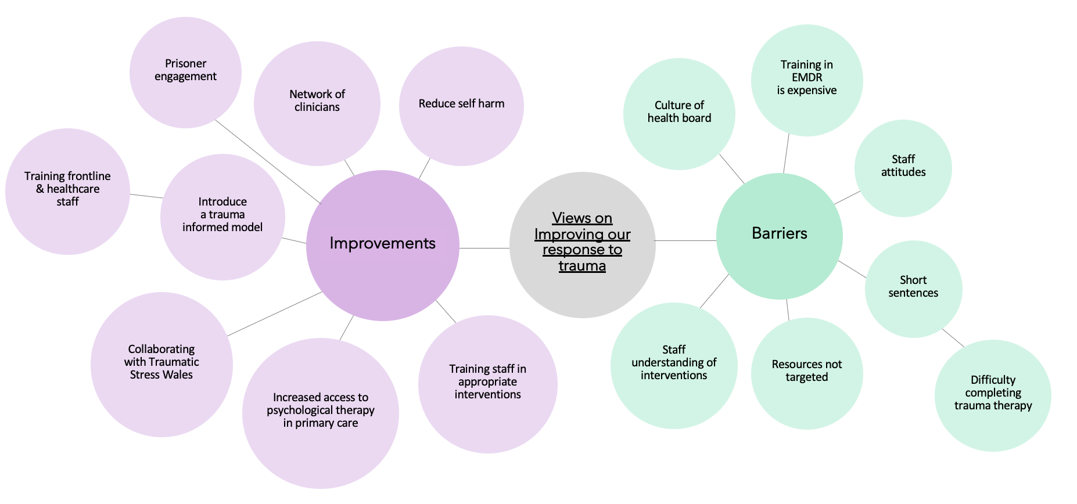
Results – Qualitative questions
Notes:
We asked prison staff views on prospective improvements, current initiatives, thinking about potential advantages and barriers in some free text questions. From the qualitative questions in the survey two main themes emerged from the responses; improvements and barriers. An example of a barrier that was mentioned was short sentences with people talking more specifically about difficulty completing trauma therapy. As well as the culture of the health board, resources not being targeted and staff understanding of the interventions. In improvements people talked about introducing a trauma informed model and more specifically about training frontline & healthcare staff in specific interventions. Some others were psychological therapy in primary care, collaborating with TSW and clinicians working together.

Slide 11
What do we know so far?
Up to 85% of prison population have experienced developmental trauma (Bramley et al. 2015)
High proportion will experience Severe and Multiple Disadvantage (SMD) – two or more of offending, mental health, substance use or homelessness
Under-detection of mental health conditions, and modest outcomes (Facer-Irwin et al. 2021)
Most in need of effective trauma-informed pathways
Significant challenges in designing and implementing these pathways

Slide 12
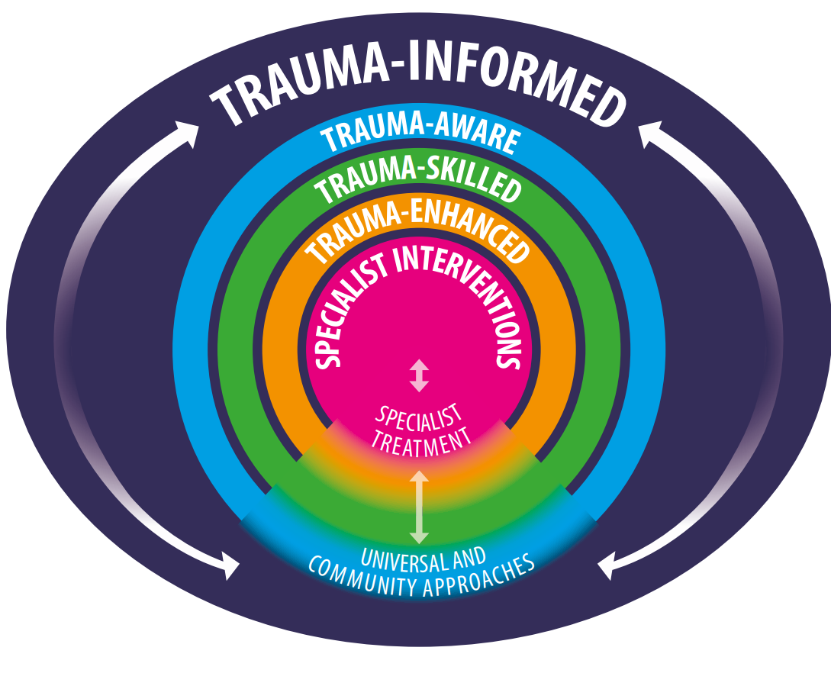
Trauma-informed pathways
Multi-level
Embedded within coherent framework
Improving access to, retention in, and effectiveness of specialist therapies
Whole system approach

Slide 13
Outcomes from a community training pilot
Trauma-enhanced training for frontline staff
6/7 weekly sessions (plus 3 training sessions) plus 6 x monthly reflective practice sessions
Then cascaded within networks and organisations
Results:
Positive outcomes in terms of satisfaction, knowledge and skills and impact on practice
Feasible and acceptable when rolled-out within organisations and networks
Organisational factors included:
Management support, protected time for training and reflective practice, time-pressures and own wellbeing

Slide 14

Outcomes from a prison training pilot
Difficulty retaining staff over six week training due to shift patterns and high operational demands of role
Recommendations:
Different training design recommended (one or two day intensive)
More clearly differentiated training for specific roles
Impact on practice:
Impact on practice was greater than expected
Led to implementation of changes within screening and assessment processes and development of a TIP for staff

Slide 15

An exploration of staff views
Interviews carried out with staff at a prison within Wales, within a range of roles within the pathway – senior managers, healthcare staff, prison officers
Aims of study:
To gather in-depth knowledge of staff views to inform the development and implementation of the pathway
To understand the factors that may contribute to the development and implementation of an integrated pathway for traumatic stress within prisons
To gain a detailed exploration of staff views of the contextual and organisational factors that are pertinent to custodial settings within Wales
Views on components of an optimal trauma pathway
Analysed by two members of the research team (JT and CCR) using reflexive thematic analysis
Outcomes from a prison training pilot​
Outcomes from a prison training pilot​
Outcomes from a prison training pilot​

Slide 16
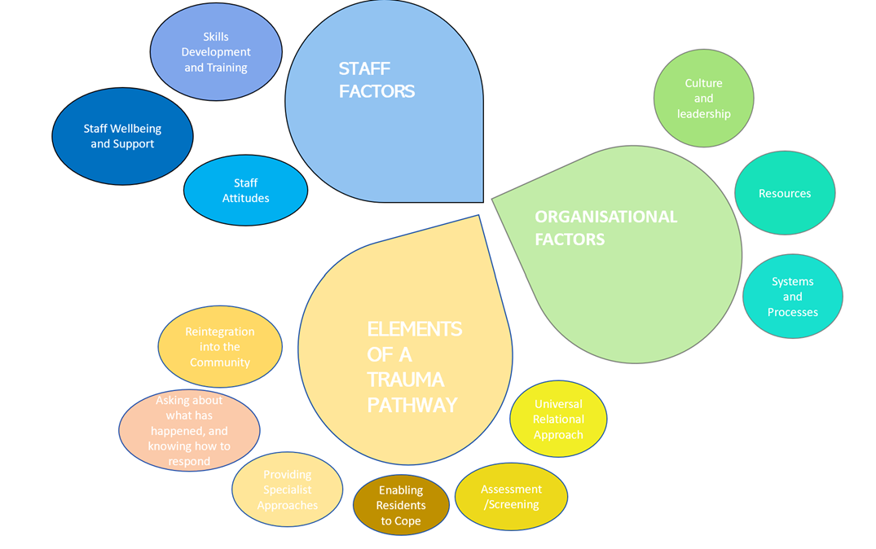
Thematic analysis

Slide 17

So what does this mean?
Findings provide broad support for the use of a multi-level trauma informed approach
Compassionate and empowering relationships seem to be the most important element of TIP - reflect a wider discussion about the role of prisons within society (rehabilitative versus punitive)
Embedding trauma-informed practice within frontline non-specialist services was seen as essential
Importance of improving access to a treatment pathway for evidence-based interventions
Significant unmet needs in staff – TIP must be applicable and accessible to everyone
Pathways have to be embedded within whole-system processes
Thematic analysis​
Notes:
multi-level trauma-informed frameworks as a way of defining the roles of staff in the prison within the pathway and providing guidance on the content and design of training to support a multi-level approach
(improved was consistent with recent research that shows that mental health conditions, particularly PTSD and Complex PTSD are under-detected and treated in prisons
a multi-level approach that provides trauma responsive environments, services and relationships, and trauma-specific services (Champine et al. 2021).

Slide 18

What do we still need to find out?
What would we like to find out?
Views of service users/people with lived experience of prisons/criminal justice system on:
The optimal trauma-informed pathway
What outcomes are important to them
How can it best be designed and implemented
What training approaches are most effective?
What are the organisational factors that most impact on outcomes?
How can specialist therapies best be delivered and accessed?
Notes:
Outcomes –short and long term in wellbeing, mental health, reoffending and social inclusion

Slide 19
Next steps: Consensus Day
Aim: to produce a consensus statement that describes effective intervention pathway for people in the CJS with experiences of trauma
N=12-15 experts (by experience) from psychiatry, psychology, HMPPS, academia
Methods: presentations, specialised focus groups, group discussion
Special topics: screening, triage, interventions, important outcomes, whole-system trauma-informed practice
Outputs: consensus report

Slide 20
Next steps: Qualitative interviews
Growing (but limited) body of knowledge of resident and healthcare staff experiences of trauma-informed in prison
Less known about POs and operational support staff
Example
  Potentially psychologically traumatic events (PPTEs) linked to symptoms of PTSD, major depressive disorder, panic disorder, GAD in correctional staff
    Not healthcare staff (Fusco et al., 2021)
    How does this affect TI-practice?
Also: self-efficacy; organisational culture; and individual experiences of traumatic events; personal characteristics such as age, gender, and ethnicity
Notes:
McKenna, B., Skipworth, J., Forrester, A., & Shaw, J. (2021). Prison mental health in-reach teams in Aotearoa New Zealand: A national survey. Psychiatry, Psychology and Law, 28(5), 774-784.

Slide 21
Next steps: Qualitative interviews
Aim: prison officers & operational support staff experiences and attitudes towards trauma-informed/aware practices
Methods: Interviews, N=20, 3 prisons
Analysis: reflexive thematic analysis
Outputs: publications, recommendations for best practice
Future study: people with lived experience
Notes:
McKenna, B., Skipworth, J., Forrester, A., & Shaw, J. (2021). Prison mental health in-reach teams in Aotearoa New Zealand: A national survey. Psychiatry, Psychology and Law, 28(5), 774-784.

