Slide 1



The Rewind Technique for PTSD: a Randomised Controlled Trial
Laurence Astill Wright, ST3 NIHR Academic Clinical Fellow
(on behalf of the RETURN study team)

Slide 2

The Rewind Technique
Developed for the treatment of PTSD by Dr David Muss in 1991
Up to three sessions of one hour although, in some instances, only two sessions will be required
Follows a strict protocol
Taught as a new skill
Widely used

Slide 3
Rewind
Imagine sitting in a cinema, nobody else there, behind is the projection room, in front the big screen
Start where the situation was normal, just before the event happened (good starting point)
Once the film ends step into it just where it ended
The film immediately starts to rewind, at speed
The rewound film must stop exactly where the forward part of the film started
Forward film c. 2 minutes, rewound film c. 10 seconds

Slide 4
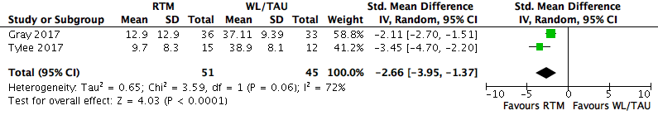
Existing Evidence
No randomised controlled trials
Reconsolidation of Traumatic Memories (RTM)
  Activation of a traumatic memory
  Imagining a black and white movie of the event
  Dissociated from its content, and re-winding it when fully-associated over two seconds.

Slide 5
Aims
Pilot RCT
Is Rewind effective?
Is symptom improvement maintained over 16 weeks?
Does it also have an impact on depression/anxiety/sleep?
Future trial - Rewind good candidate to take forward?

Slide 6
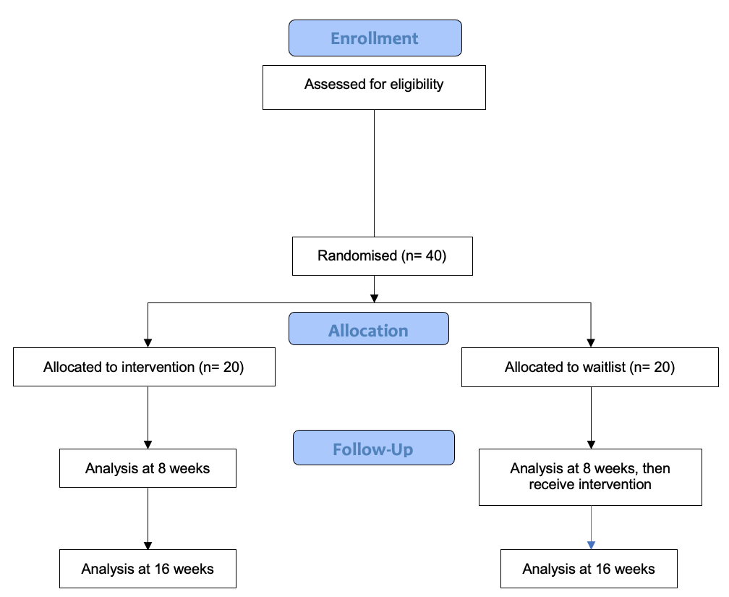
Design
Rewind
  Up to three 60-minute sessions following a modified treatment protocol
  Administered by experienced and trained psychological therapists under the supervision of David Muss
Delayed Treatment
  Wait list for 8 weeks, then Rewind

Slide 7
Inclusion Criteria
Single event trauma
PTSD primary condition (TSQ positive at telephone interview)
Adults aged 18 or over
English speaking
Able to provide informed consent

Slide 8
Exclusion Criteria
• Current psychotic or bipolar disorder
• Traumatic brain injury
• Substance dependence
• Personality disorder
• Learning disability
• Acute suicidal ideation
• Previous trauma-focused psychological treatment for PTSD
• Change to the type or dosage of psychotropic medication within one month of baseline assessment

Slide 9
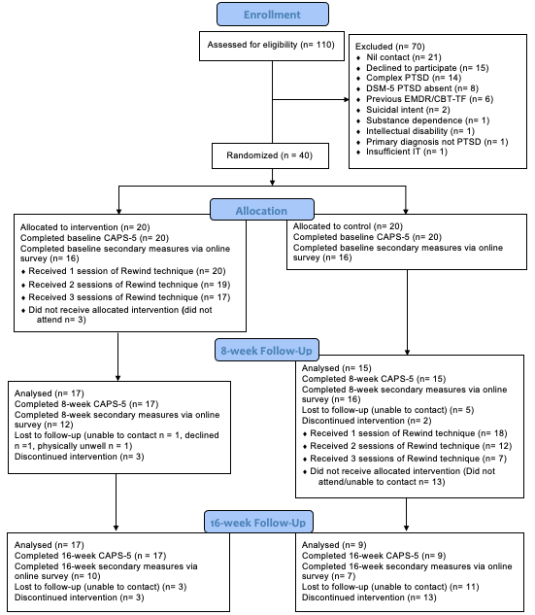
RCT Flow

Slide 10
Primary Outcome

Slide 11

Discussion
• Cohen’s d: 1.05 - large effect size
• 3 sessions - 3 hours total delivered remotely
• Minimal barriers to delivery & low cost
•?Non-traumatising ?less compassion fatigue
• Potential to be delivered as part of stratified care approach by low-intensity psychological therapists e.g in IAPT services
• Premature to recommend routinely
• Current prevalence of Rewind in UK unlikely to do harm - CBT-TF/EMDR remain the NICE recommended psychological interventions

Slide 12
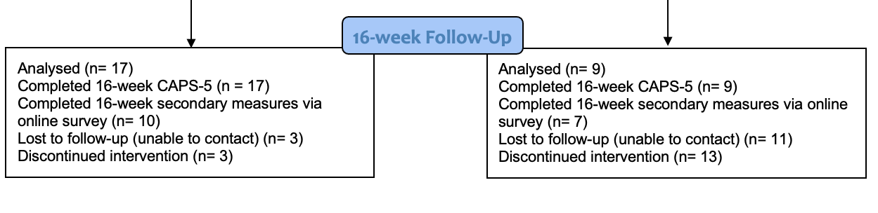
Limitations
Relatively small trial
High attrition at 16 weeks on clinician assessed (55%) and self-report (65%) outcomes
Impossible to double blind (psychological therapy)
Limited insight into non-responders/attrition
Nil comparison to existing treatments
Limited process evaluation
Nil evaluation of mechanism of action

Slide 13
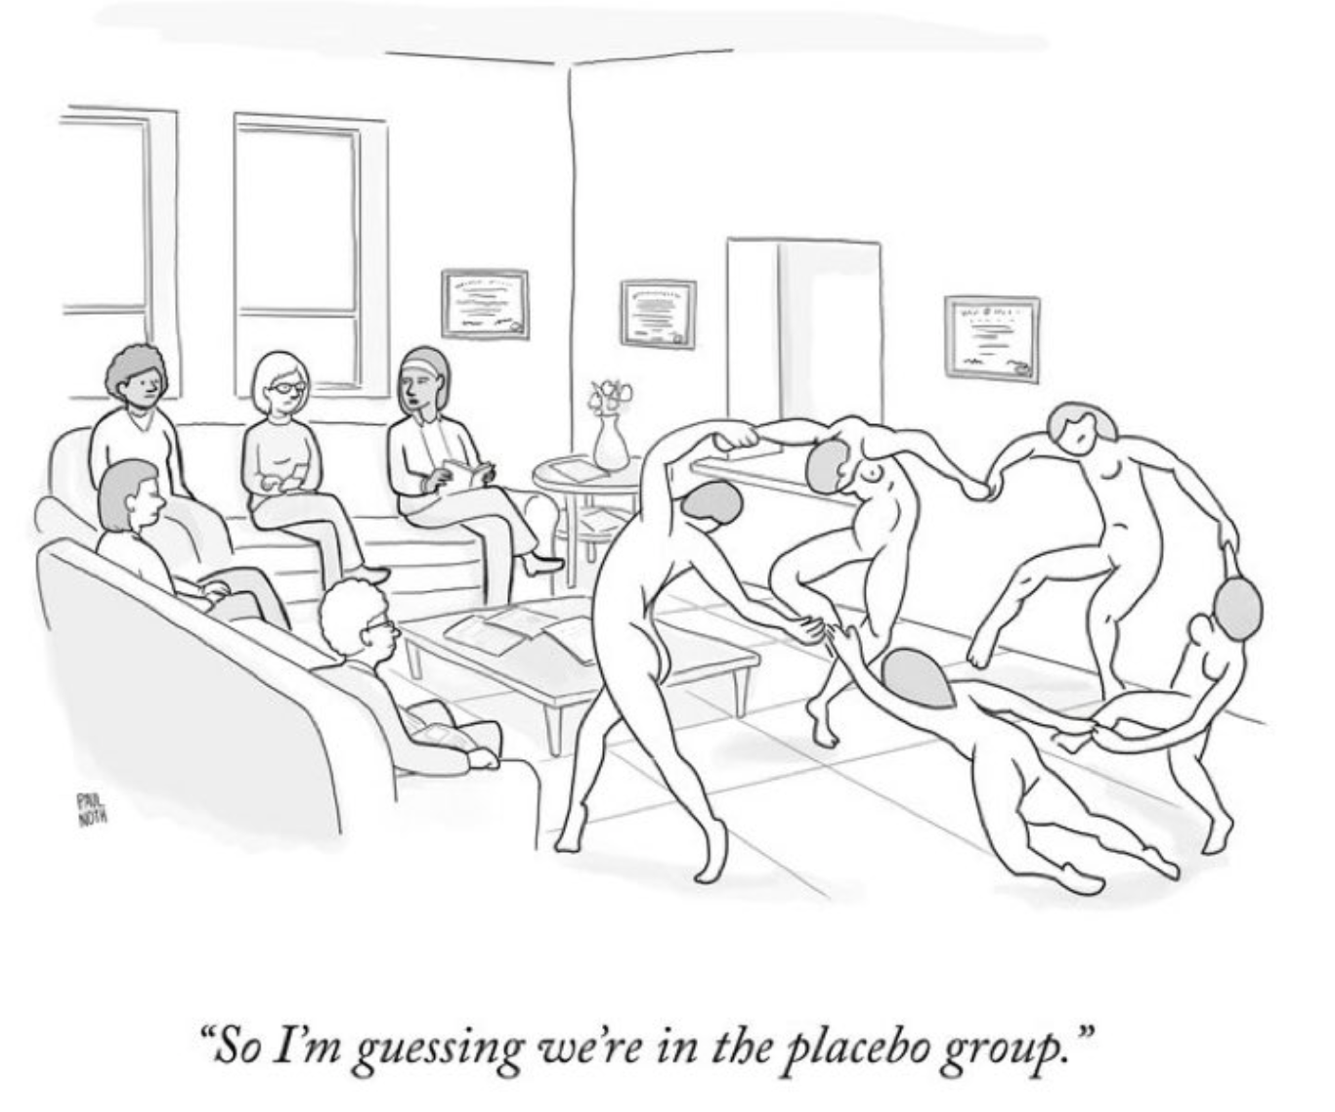
Conclusions
Strong preliminary signal of efficacy
Large potential for scalability as remote therapy
Unsure how this compares to existing therapies
Back-translational work needed

Slide 14
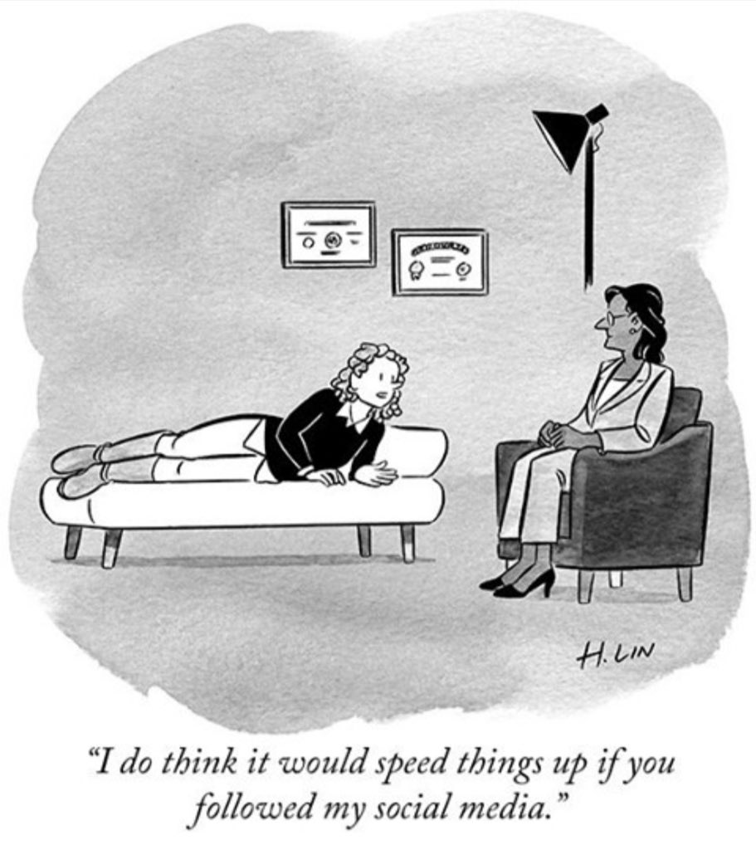
Thank you!
Participants
Everyone who referred into the trial - PMHSS !
Rewind therapists
David Muss
C&V UHB
NCMH
Traumatic Stress Service
Cardiff researchers
NIHR/Wellcome

Slide 15
References
Adams, S. Allan, S. 2018. Muss' Rewind treatment for trauma: description and multi-site pilot study. Journal of Mental Health. 27(5).
Astill Wright, L., Barawi, K., Simon, N., Lewis, C., Muss, D., Roberts, N. P., Kitchiner, N. J. and Bisson, J. I. (2021a) 'The reconsolidation using rewind study (RETURN): trial protocol', Eur J Psychotraumatol, 12(1), pp. 1844439.
Astill Wright, L., Horstmann, L., Holmes, E.A. and Bisson, J.I., 2021. Consolidation/reconsolidation therapies for the prevention and treatment of PTSD and re-experiencing: a systematic review and meta-analysis. Translational psychiatry, 11(1), pp.1-14.
Bisson, J. I., Roberts, N. P., Andrew, M., Cooper, R., & Lewis, C. 2013. Psychological therapies for chronic post-traumatic stress disorder (PTSD) in adults. Cochrane Database Systematic Reviews. Chichester: Wiley & Sons.
Gray, R. 2011. NLP and PTSD: The visual-kinesthetic dissociation protocol. Current Research in NLP. 2.
Gray, R., Budden-Potts, D. and Bourke, F. (2019) 'Reconsolidation of Traumatic Memories for PTSD: A randomized controlled trial of 74 male veterans', Psychother Res, 29(5), pp. 621-639.
Human Givens Institute. 2019. The ‘rewind’ technique [Online]. Available at: https://www.hgi.org.uk/useful-information/treatment-dealing-ptsd-trauma-phobias/rewind-technique. Accessed 18/10/19.
IARTT (International Association for Rewind Trauma Therapy). 2019. The Rewind (Closure Without Disclosure) for adults and children [Online]. Available at: http://www.iartt.com. Accessed: 4/10/2019.
Lewis, C., Roberts, N. P., Andrew, M., Starling, E. and Bisson, J. I. (2020a) 'Psychological therapies for post-traumatic stress disorder in adults: systematic review and meta-analysis', Eur J Psychotraumatol, 11(1), pp. 1729633.
Muss, D. 1991. A new technique for treating Post-traumatic Stress Disorder. British Journal of Clinical Psychology. 30.
Nollett, C. Lewis, C. Kitchiner, N. Roberts, N. Addison, K. Brookes-Howell, L.et al. 2018. Pragmatic RAndomised controlled trial of a trauma-focused guided self-help Programme versus InDividual trauma-focused cognitive Behavioural therapy for post-traumatic stress disorder (RAPID): trial protocol. BMC Psychiatry. 18(1).
PTSD Resolution. 2019. Need help? [Online]. Available at: http://www.ptsdresolution.org. Accessed: 18/10/19.
Tylee, D. G., R. Glatt, S. Bourke, F 2017. . Evaluation of the reconsolidation of traumatic memories protocol for the treatment of PTSD: a randomized, wait-list-controlled trial.: Journal of Military, Veteran and Family Health. 3(1):21-33.

Slide 16

Questions?

Slide 17
Participant Demographics
Broadly similar across groups
mean age 37, 57% female, 93% white British, 27% degree level education, 55% unemployed
83% PHQ-9 >10
Duration of PTSD 37 months
60% directly experienced index trauma, 40% witnessed
15% sexual violence
Primary traumatic event | N (%)
Sexual assault | 6 (15)
Life-threatening illness or injury | 6 (15)
Sudden accidental death | 5 (12.5)
Serious accident at work, home or during recreational activity | 4 (10)
Physical assault | 3 (7.5)
Assault with a weapon | 3 (7.5)
Serious injury, harm, or death you caused to someone else | 3 (7.5)
Transportation accident | 2 (5)
Combat or exposure to a war-zone | 2 (5)
Severe human suffering | 2 (5)
Any other very stressful event or experience | 2 (5)
Sudden violent death | 1 (2.5)
Childhood physical abuse | 1 (2.5)

Slide 18
Population
CAPS-5 categorical diagnosis at multiple time points
 |  | Immediate n (%) | Delayed n (%) | Total n (%) | Completers n
CAPS-5Baseline | Positive | 20 (100) | 20 (100) | 40 (100) | 40
 | Negative | 0 (0) | 0 (0) | 0 (0)
CAPS-5 8-weeks | Positive | 7 (35) | 12 (60) | 19 (47.5) | 32
 | Negative | 10 (50) | 3 (15) | 13 (32.5)
CAPS-5 16-weeks | Positive | 6 (30) | 2 (10) | 8 (20) | 26
 | Negative | 11 (55) | 7 (35) | 18 (45)

Slide 19
Attrition
 | Intervention n = 20 | Control n = 20
Attended 1 session of Rewind technique n (%) | 20 (100) | 18 (90)
Attended 2 sessions of Rewind technique n (%) | 19 (95) | 12 (60)
Attended 3 sessions of Rewind technique n (%) | 17 (85) | 7 (35)
Completed CAPS-5 baseline n (%) | 20 (100) | 20 (100)
Completed CAPS-5 8-week n (%) | 17 (85) | 15 (75)
Completed CAPS-5 16-week n (%) | 17 (85) | 9 (45)
Completed secondary measures via online survey baseline n (%) | 20 (100) | 19 (95)
Completed secondary measures via online survey 8-week n (%) | 12 (60) | 16 (80)
Completed secondary measures via online survey 16-week n (%) | 10 (50) | 7 (35)

Slide 20
Participant Demographics
Table 1: Demographics and clinical characteristics
 |  | Immediate Arm n (%) mean|SD | Delayed Arm n (%) mean|SD | Total n (%) mean|SD
n |  | 20 | 20 | 40
Age |  | 38.16 | 12.75 | 36.46 | 13.44 | 37.31 | 12.96
Female gender |  | 9 (45) | 14 (70) | 23 (57.5)
Ethnic origin | White British | 19 (95) | 18 (90) | 37 (92.5)
 | Any other Mixed/multiple ethnic background | 0 (0) | 1 (5) | 1 (2.5)
 | Minority ethnic | 1 (5) | 0 (0) | 1 (2.5)
Highest level of qualification | Degree level | 8 (40) | 3 (15) | 11 (27.5)
 | 2+ A levels of equivalent | 2 (10) | 7 (35) | 9 (22.5)
 | 5+ GCSEs or equivalent | 2 (10) | 5 (25) | 7 (17.5)
 | 1-4 GCSEs or equivalent | 4 (20) | 2 (10) | 6 (15.0)
 | Apprenticeship | 1 (5) | 1 (5) | 2 (5.0)
 | Other qualifications | 2 (10) | 1 (5) | 3 (7.5)
 | No qualifications | 1 (5) | 0 (0) | 1 (2.5)
Current employment status | Employed | 12 (60) | 10 (50) | 22 (55.0)
 | Self-employed or freelance | 2 (10) | 1 (5) | 3 (7.5)
 | Student | 2 (10) | 6 (30) | 8 (20.0)
 | Retired | 1 (5) | 1 (5) | 2 (5.0)
 | Unable to work | 2 (10) | 1 (5) | 3 (7.5)
 | Unemployed and looking for work | 1 (5) | 0 (0) | 1 (2.5)

Slide 21
Participant Demographics
Table 1: Demographics and clinical characteristics
 |  | Immediate Treatment Arm n (%) mean|SD | Delayed Treatment Arm n (%) mean|SD | Total n (%) mean|SD
Possible Major Depressive Disorder (PHQ ≥10) | Yes | 16 (80) | 17 (85) | 33 (82.5)
 | No | 4 (20) | 2 (10) | 6 (15)
Duration of symptoms in months |  | 42.83 | 70.32 | 30.38 | 37.21 | 36.60 | 55.89
Directly experienced traumatic event |  | 12 (60) | 12 (60) | 24 (60)
Witnessed traumatic event |  | 8 (40) | 8 (40) | 16 (40)
Sexual violence |  | 3 (15) | 4 (20) | 7 (17.5)

Slide 22
Primary Traumatic Event
Primary traumatic event | N (%)
Sexual assault | 6 (15)
Life-threatening illness or injury | 6 (15)
Sudden accidental death | 5 (12.5)
Serious accident at work, home or during recreational activity | 4 (10)
Physical assault | 3 (7.5)
Assault with a weapon | 3 (7.5)
Serious injury, harm, or death you caused to someone else | 3 (7.5)
Transportation accident | 2 (5)
Combat or exposure to a war-zone | 2 (5)
Severe human suffering | 2 (5)
Any other very stressful event or experience | 2 (5)
Sudden violent death | 1 (2.5)
Childhood physical abuse | 1 (2.5)

Slide 23
Population
Table 3: Primary and secondary outcome results at 8 and 16-week follow-up for non-imputed data
 |  | Time point
 |  | Immediate |  |  | Delayed
 |  | n | Mean | SD | n | Mean | SD
CAPS-5 | Baseline | 20 | 36.50 | 8.24 | 20 | 40.15 | 5.77
 | 8-week | 16 | 18.06 | 14.96 | 15 | 35.0 | 9.20
 | 16-week | 17 | 16.94 | 14.51 | 9 | 21.33 | 12.99
PCL-5 | Baseline | 20 | 52.65 | 11.56 | 19 | 57.21 | 12.31
 | 8-week | 12 | 21.25 | 20.41 | 16 | 44.12 | 14.83
 | 16 week | 10 | 24.50 | 24.29 | 7 | 23.71 | 21.68
WSAS | Baseline | 19 | 21.16 | 9.44 | 18 | 23.39 | 9.85
 | 8-week | 11 | 10.27 | 10.78 | 16 | 22.88 | 9.24
 | 16 week | 9 | 14.66 | 13.36 | 6 | 13.50 | 13.82
PHQ-9 | Baseline | 20 | 14.65 | 6.17 | 19 | 17.74 | 5.65
 | 8-week | 12 | 5.58 | 6.72 | 16 | 15.06 | 6.14
 | 16 week | 10 | 7.70 | 8.56 | 7 | 8.29 | 7.11

Slide 24
Population
Table 3: Primary and secondary outcome results at 8 and 16-week follow-up for non-imputed data
 |  | Time point
 |  | Immediate |  |  | Delayed
 |  | n | Mean | SD | n | Mean | SD
GAD-7 | Baseline | 20 | 13.10 | 4.73 | 19 | 14.53 | 4.274
 | 8-week | 12 | 5.75 | 6.20 | 16 | 12.69 | 4.85
 | 16 week | 10 | 7.20 | 6.78 | 7 | 5.43 | 4.69
ISI | Baseline | 20 | 17.65 | 5.96 | 19 | 19.00 | 6.21
 | 8-week | 12 | 10.00 | 8.42 | 16 | 17.06 | 6.81
 | 16 week | 10 | 11.00 | 10.85 | 7 | 12.57 | 5.32
Audit-O | Baseline | 18 | 5.61 | 8.64 | 17 | 4.29 | 5.62
 | 8-week | 11 | 4.36 | 6.12 | 16 | 4.25 | 4.84
 | 16 week | 10 | 3.40 | 5.42 | 7 | 3.86 | 4.74
MSPSS | Baseline | 20 | 56.75 | 15.95 | 19 | 54.89 | 15.81
 | 8-week | 12 | 63.25 | 14.72 | 15 | 52.80 | 17.80
 | 16 week | 10 | 64.00 | 16.81 | 7 | 54.43 | 22.10

Slide 25
Population
Table 4: Primary and secondary outcome analyses for differences between 8 and 16 weeks using completer only data
 |  | Time point
 |  | Immediate |  |  |  | Delayed |  |  |  | Mean difference | p-value
 |  | n | mean | SE | 95% CI | n | mean | SE | 95% CI
CAPS-5 | Baseline | 20 | 37.79 | 1.66 | 34.41 to 41.17 | 20 | 39.69 | 1.66 | 36.30 to 43.07 | 1.90 | 0.446
 | 8-week | 16 | 20.25 | 3.34 | 13.33 to 27.16 | 15 | 32.88 | 3.47 | 25.71 to 40.05 | 12.64 | 0.019
 | 16-week | 17 | 18.00 | 3.63 | 10.37 to 25.63 | 9 | 22.25 | 5.24 | 11.24 to 33.26 | 4.25 | 0.525
PCL-5 | Baseline | 20 | 55.26 | 1.97 | 59.27 to 58.16 | 19 | 54.16 | 1.97 | 50.16 to 58.16 | 1.10 | 0.708
 | 8-week | 12 | 22.63 | 5.53 | 11.08 to 34.17 | 16 | 41.87 | 4.65 | 32.17 to 51.58 | 19.25 | 0.020
 | 16 week | 10 | 22.94 | 6.70 | 8.02 to 37.86 | 7 | 27.77 | 8.72 | 8.34 to 47.20 | 4.83 | 0.675

Slide 26
Population
Table 4: Primary and secondary outcome analyses for differences between 8 and 16 weeks using completer only data
 |  | Time point
 |  | Immediate |  |  |  | Delayed |  |  |  | mean diff | 95% CI | p-value
 |  | n | mean | SE | 95% CI | n | mean | SE | 95% CI
WSAS | Baseline | 19 | 23.40 | 2.03 | 19.26 to 27.53 | 18 | 21.66 | 2.03 | 17.52 to 25.79 | 1.74 | -4.42 to 7.90 | 0.568
 | 8-week | 11 | 10.86 | 3.54 | 3.46 to 18.26 | 16 | 22.70 | 2.76 | 16.91 to 28.48 | 11.83 | 1.52 to 22.15 | 0.027
 | 16 week | 9 | 11.87 | 3.61 | 3.55 to 20.19 | 6 | 20.84 | 5.09 | 9.10 to 32.57 | 8.97 | -6.51 to 24.45 | 0.218
PHQ-9 | Baseline | 20 | 14.44 | 1.38 | 11.64 to 17.25 | 19 | 17.88 | 1.38 | 15.07 to 20.68 | 3.43 | -0.65 to 7.52 | 0.097
 | 8-week | 12 | 6.94 | 1.93 | 2.92 to 10.97 | 16 | 13.58 | 1.62 | 10.20 to 16.96 | 6.63 | 1.08 to 12.19 | 0.022
 | 16 week | 10 | 7.24 | 2.14 | 2.48 to 12.01 | 7 | 9.27 | 2.79 | 3.06 to 15.47 | 2.03 | -5.93 to 9.98 | 0.583
GAD-7 | Baseline | 20 | 13.85 | 0.76 | 12.30 to 15.40 | 19 | 13.89 | 0.76 | 12.34 to 15.43 | 0.04 | -2.26 to 2.34 | 0.974
 | 8-week | 12 | 5.95 | 1.82 | 2.16 to 9.74 | 16 | 12.43 | 1.53 | 9.25 to 15.62 | 6.48 | 1.25 to 11.72 | 0.018
 | 16 week | 10 | 6.88 | 1.87 | 2.71 to 11.04 | 7 | 6.37 | 2.43 | 0.95 to 11.79 | 0.51 | -6.44 to 7.46 | 0.874

Slide 27
Population
Table 4: Primary and secondary outcome analyses for differences between 8 and 16 weeks using completer only data
 |  | Time point
 |  | Immediate |  |  |  | Delayed |  |  |  | Mean diff | 95% CI | p-value
 |  | n | mean | SE | 95% CI | n | mean | SE | 95% CI
ISI | Baseline | 20 | 18.27 | 1.36 | 15.49 to 21.05 | 19 | 18.26 | 1.36 | 15.48 to 21.03 | 0.01 | -4.11 to 4.14 | 0.995
 | 8-week | 12 | 10.37 | 2.52 | 5.12 to 15.62 | 16 | 15.93 | 2.12 | 11.52 to 20.34 | 5.56 | -1.69 to 12.82 | 0.125
 | 16 week | 10 | 10.43 | 2.53 | 4.79 to 16.07 | 7 | 13.79 | 3.30 | 6.44 to 21.13 | 3.36 | -6.05 to 12.77 | 0.445
Audit-O | Baseline | 18 | 5.16 | 1.95 | 1.17 to 9.15 | 17 | 5.02 | 1.95 | 1.03 to 9.01 | 0.14 | -5.75 to 6.03 | 0.961
 | 8-week | 11 | 3.30 | 1.62 | -0.10 to 6.69 | 16 | 4.47 | 1.30 | 1.75 to 7.19 | 1.17 | -3.37 to 5.71 | 0.596
 | 16 week | 10 | 3.41 | 1.23 | 0.67 to 6.16 | 7 | 2.31 | 1.60 | -1.26 to 5.89 | 1.10 | -3.48 to 5.68 | 0.605
MSPSS | Baseline | 20 | 55.59 | 3.88 | 47.68 to 63.50 | 19 | 55.68 | 3.88 | 47.77 to 63.59 | 0.10 | -11.66 to 11.84 | 0.988
 | 8-week | 12 | 60.59 | 5.34 | 49.41 to 71.77 | 15 | 52.82 | 4.67 | 43.04 to 62.60 | 7.77 | -7.87 to 23.40 | 0.311
 | 16 week | 10 | 66.03 | 4.87 | 55.19 to 76.87 | 7 | 47.79 | 6.34 | 33.67 to 61.91 | 18.24 | 0.15 to 36.32 | 0.048

Slide 28

Strengths
• First RCT evaluating Rewind
• Improves on previous work - diversity & quality of outcomes, trial methodology
• Clinician assessed outcomes
• Pragmatic study with broad inclusion criteria - may have resulted in higher attrition
• Involvement of patient and public representatives
• Entirely remote delivery

Slide 29

Questions Raised
How does it work?
Is there equivalence to CBT-TF/EMDR?
Can it be personalised? e.g more/fewer sessions as required - dose/response effect
Is it effective in Complex PTSD?
Can anything be done to decrease the attrition rate?

Slide 30
Discussion
• Signal of good efficacy - promising results with high potential for scalability - primary & secondary outcomes
• Longevity of effects - 16 week outcome assessment
• Improvement of waitlist control group - ?suitability of control
• ?regression to the mean effects ?contact with trial team
• Psychological/waitlist controlled trials - usually exacerbate treatment effects
• Smaller effect size than other Rewind/RTM trials - less methodologically rigorous

