Slide 1
Trauma and Adverse Childhood Experiences (TrACE) and the NHS
Dr Joanne Hopkins, Programme Director Adverse Childhood Experiences, Criminal Justice and Violence Prevention, Public Health Wales
Visiting Professor, Faculty of Social and Life Sciences, Wrexham University

Slide 2

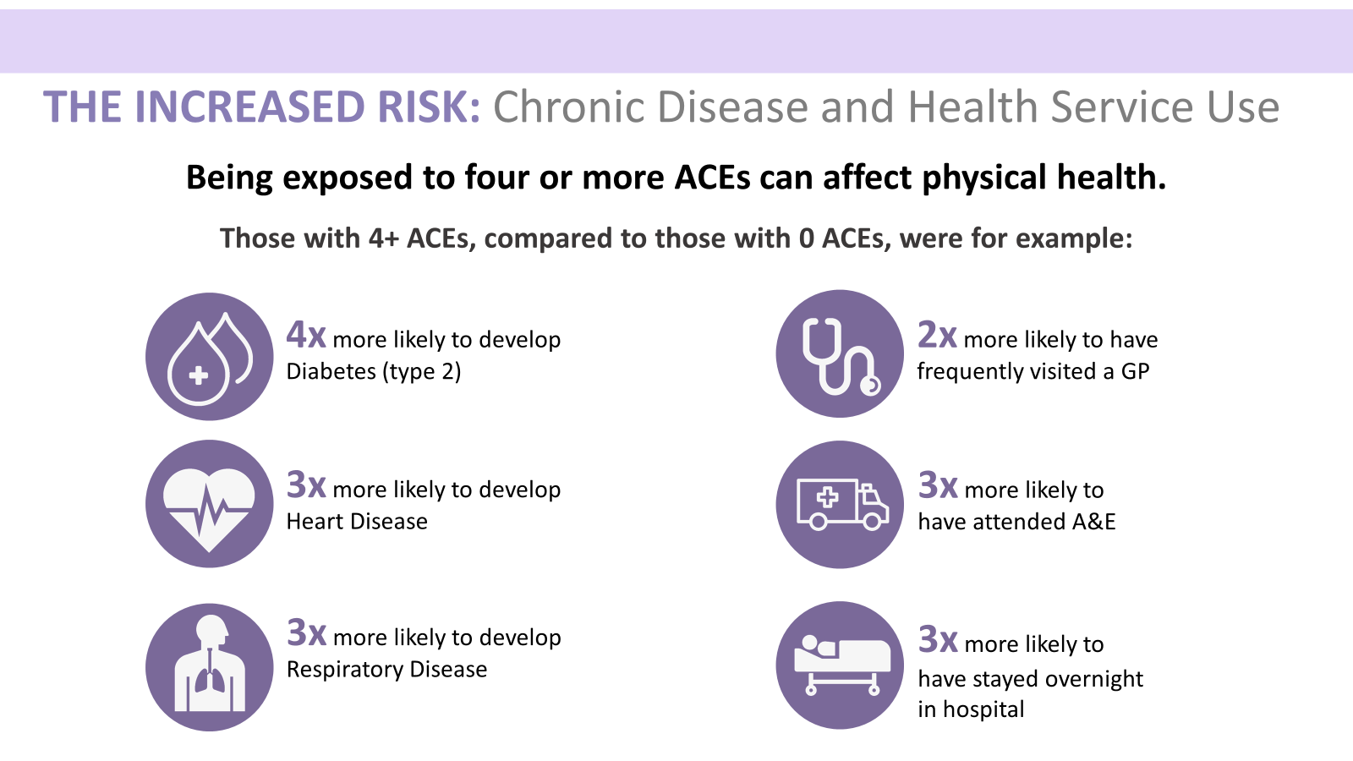
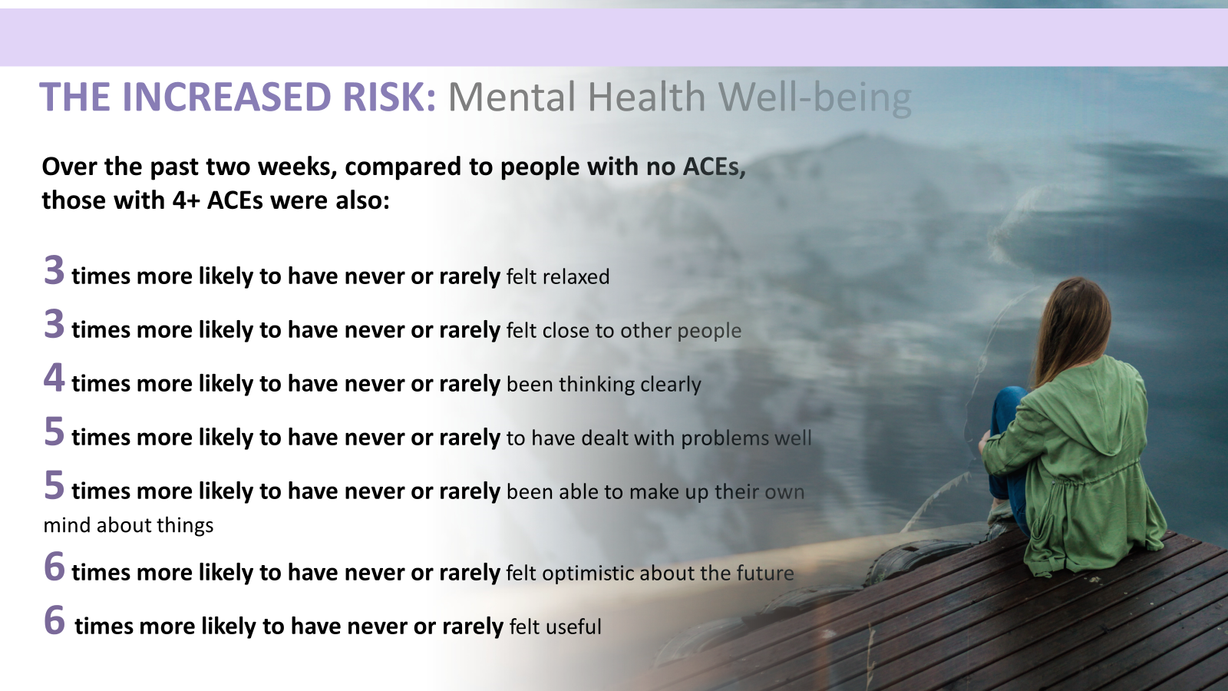
Overview
Adverse Childhood Experiences and Health impact
ACEs Research 2015-2017
Health service use increases
Mental Health and Wellbeing
Our research showed that half the population in Wales had experienced at least one ACE and 14 % 4 or more
There is a significant increase (and cost implication) for the NHS if people are exposed to more ACEs
Exposure to ACEs without the right support and protective factors increases the risk to mental health and wellbeing and increases support needs
Trauma and Adverse Childhood Experiences (TrACE) and the NHS

Slide 3
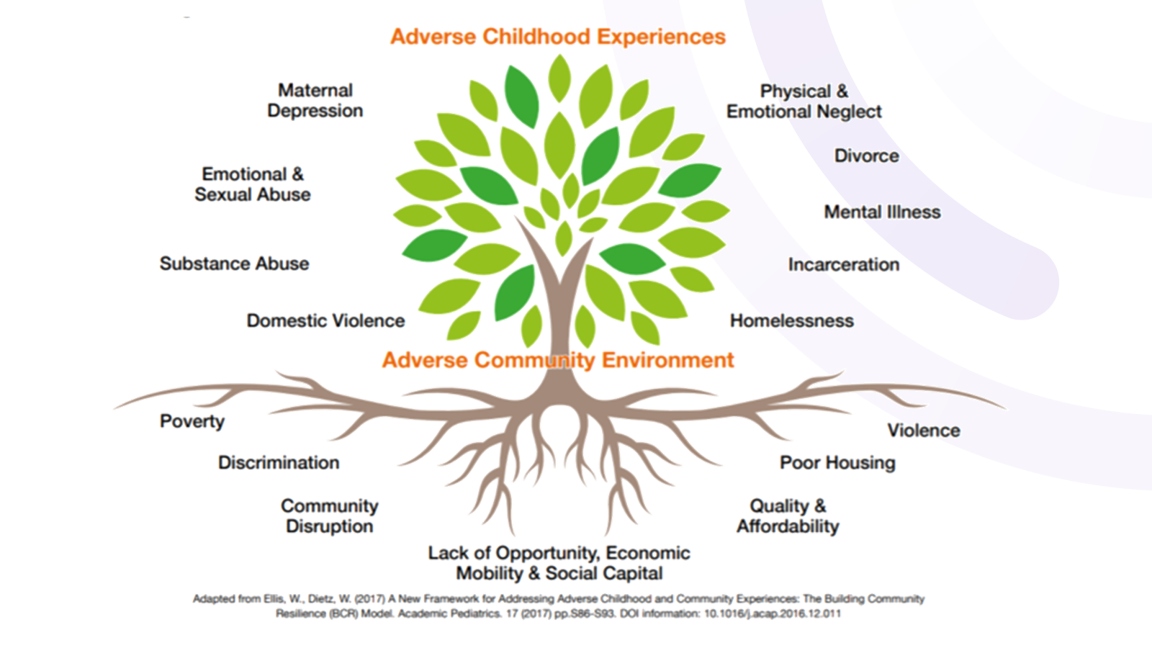
ACEs, Inequality and Society
The relationship to broader harms
ACEs occur in the home, and have an exacerbating relationship with the community environment underpinned by structural inequality – the experience of ACEs and adversity can be traumatic
Trauma and Adverse Childhood Experiences (TrACE) and the NHS

Slide 4
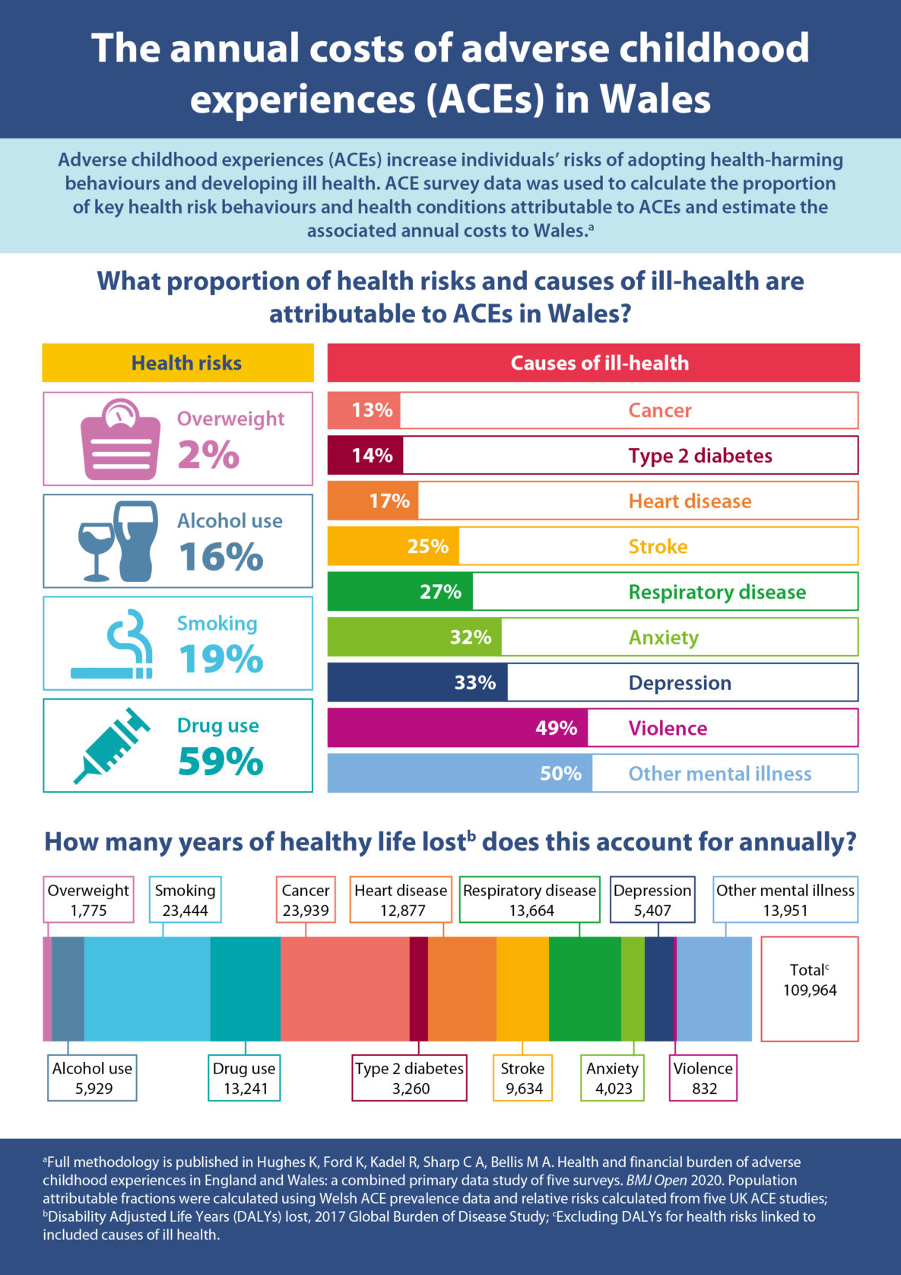
Costs of ACEs to Health in Wales
Research By Public Health Wales and Bangor University 2021
The financial cost of adverse childhood experiences (ACEs) in Wales has been estimated to be equivalent to £2.2 billion a year
This is likely to have worsened since COVID-19, not improved
The annual costs of adverse childhood experiences (ACEs) in Wales and are based on figures originally published in Health and financial burden of adverse childhood experiences in England and Wales: a combined primary data study of five surveys. BMJ Open 2020 (Hughes K, Ford K, Kadel R, Sharp C A, Bellis M A).
Trauma and Adverse Childhood Experiences (TrACE) and the NHS

Slide 5
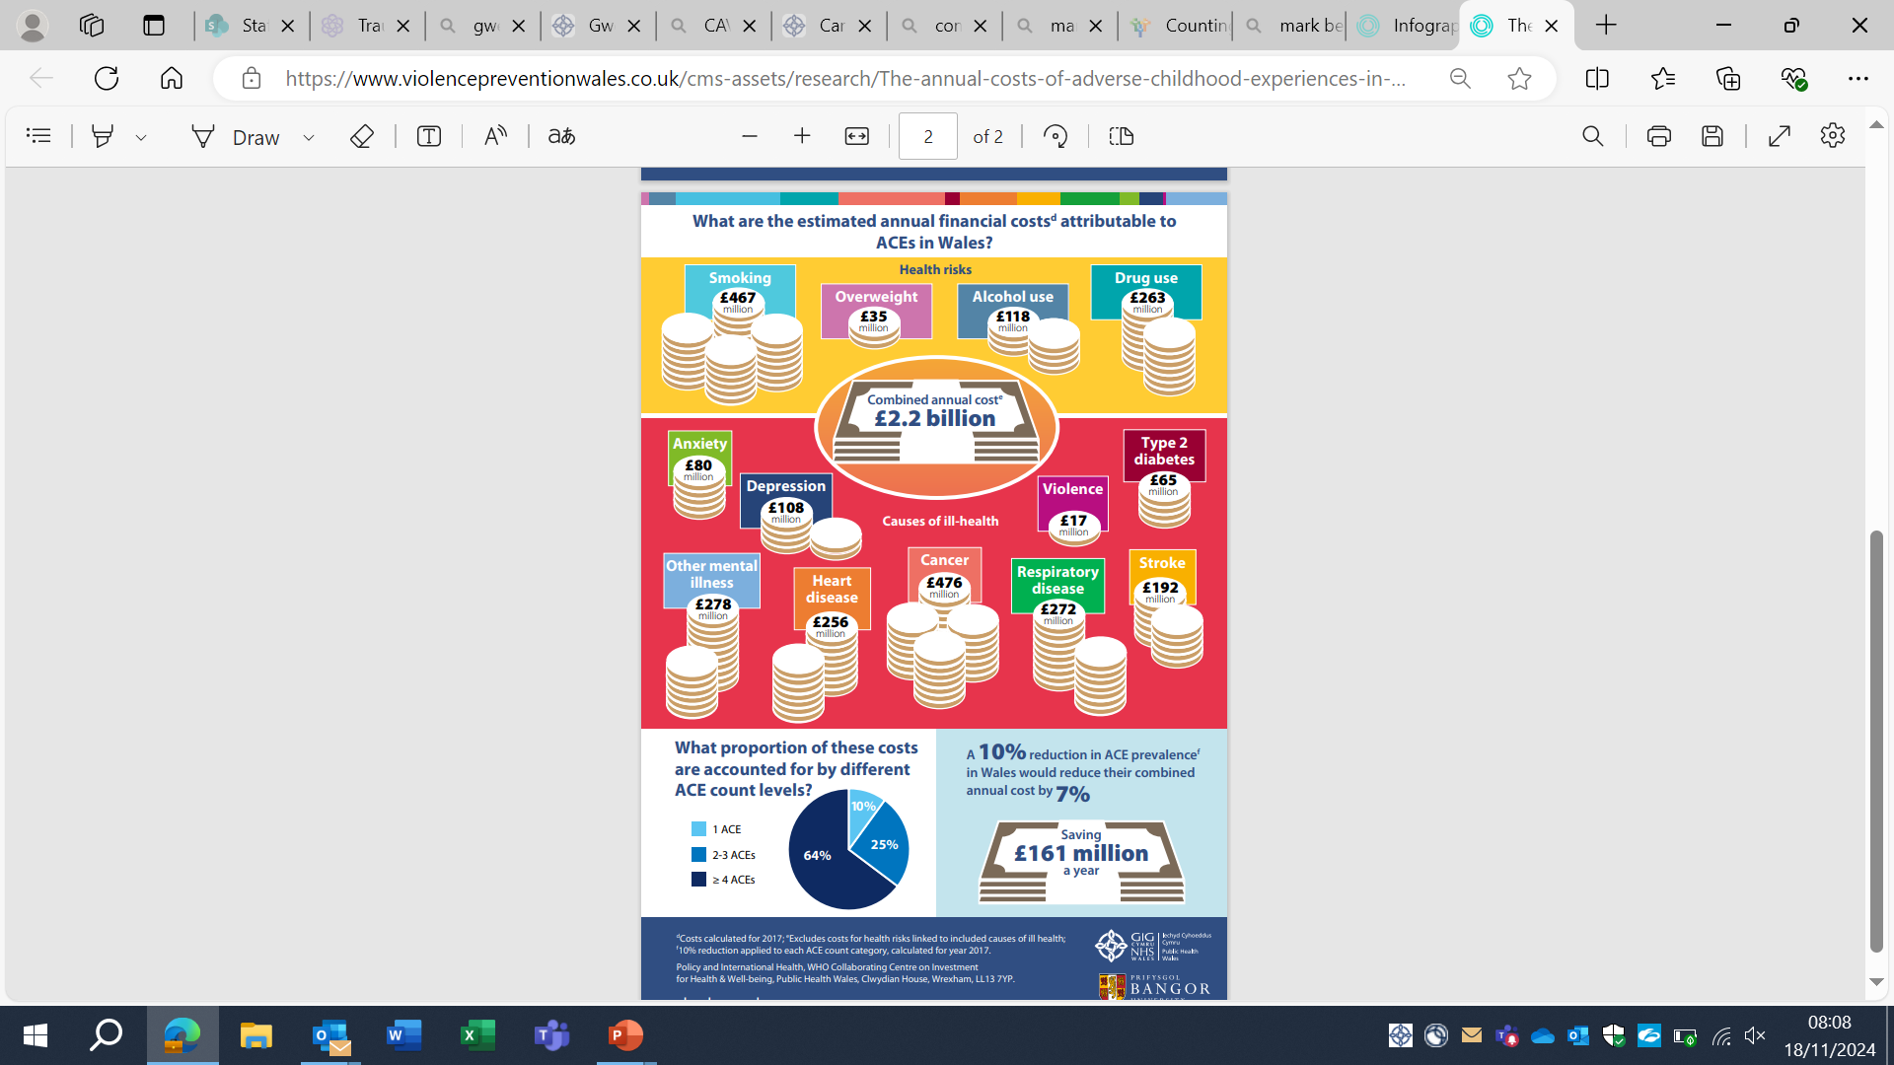
Costs of ACEs to Health in Wales
Research By Public Health Wales and Bangor University 2021
ACEs were likely to be responsible for 59% of drug use, associated with a cost equivalent to £263 million per year. Around a third of anxiety and depression and half of other mental illnesses were also associated with exposure to ACEs, carrying a combined annual cost of £466 million.
Further, 13% of cancers were attributable to ACEs, with an annual cost to Wales of £476 million. Two thirds (64%) of the costs of ACEs were accounted for by those who were exposed to four or more ACEs. The study estimated that a 10% reduction in ACEs in Wales would result in an annual saving of £161 million.
Trauma and Adverse Childhood Experiences (TrACE) and the NHS

Slide 6
The Trauma-informed Wales Framework
All Age, All of Society and Co-produced with People and Organisations in Wales, supported by the Welsh Government
Published in July 2022
Co-lead by Jo Hopkins (ACE Hub Wales) and Prof Jonathan Bisson (Traumatic Stress Wales)
Support a coherent, consistent approach to developing and implementing trauma-informed practice across Wales, providing the best possible support to those who need it most.
Implementation Steering Group with strong health/NHS representation
Ministerial Leadership from Dawn Bowden, MS, Minister for Children and Social Care and Sara Murphy, MS, Minister for Health and Wellbeing, Lynne Neagle, MS Cabinet Secretary for Education.
Trauma and Adverse Childhood Experiences (TrACE) and the NHS

Slide 7
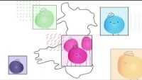

Trauma Framework: Animation

Slide 8
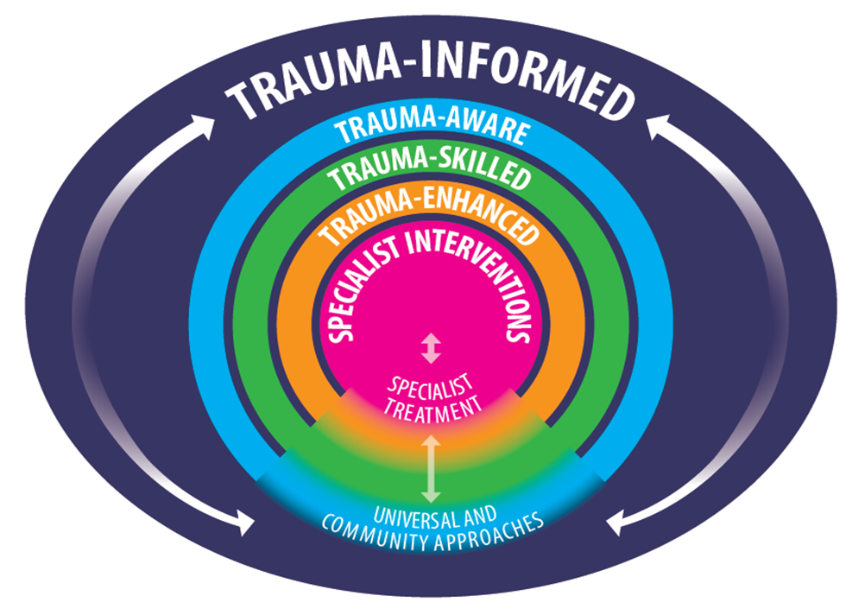
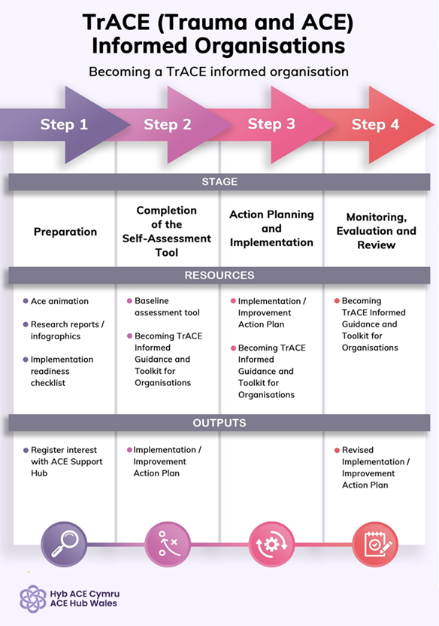
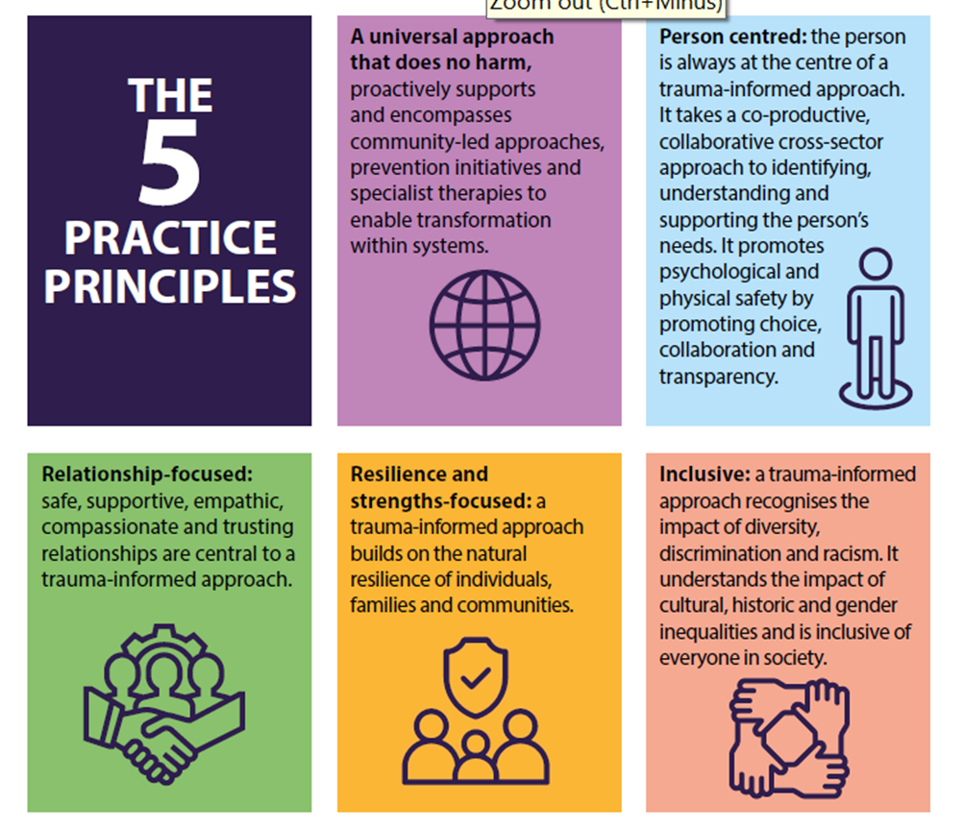
Trauma and ACE-informed Organisations
The Organisational /Systems Offer from ACE Hub Wales
An organisational/sector Toolkit to promote culture change and support the ambition of trauma-informed services across Wales.
Focus on workforce and the people that workforce help. A trauma-informed workforce has improved health and wellbeing and is more able to deliver trauma-informed services.
Builds on strengths of the organisation which will be working in this way, but maybe not systemically or consistently across all areas.
Trauma and Adverse Childhood Experiences (TrACE) and the NHS

Slide 9
TrACE Implementation across Wales
Sectors and Organisations are implementing the Toolkit
Further Education System – all colleges across Wales
Criminal Justice System – 4 police Forces, 4 Police and Crime Commissioners, HM Courts and Tribunal Service, HM Prisons and Probation
Education- all schools across Wales have been offered training
Substance Use Community and clinical settings
Housing and Homelessness services
Wrexham and Aberystwyth Universities
Communities (Ynys Mon, Bettws)
Trauma and Adverse Childhood Experiences (TrACE) and the NHS

Slide 10
More information
Resources and E-Learning
E-Learning (Welsh) Profiadau Niweidiol yn ystod Plentyndod (ACEs) ac Ymarfer sy’n Ystyriol o Drawma yng Cymru: Cwrs e-Ddysgu - Hyb Ace Cymru
E-Learning (English) https://acehubwales.com/resources/e-learning-course-on-adverse-childhood-experiences-aces-and-trauma-informed-practice-in-wales/
www.acehubwales.com
www.traumaframeworkcymru.com
Trauma and Adverse Childhood Experiences (TrACE) and the NHS

Slide 11
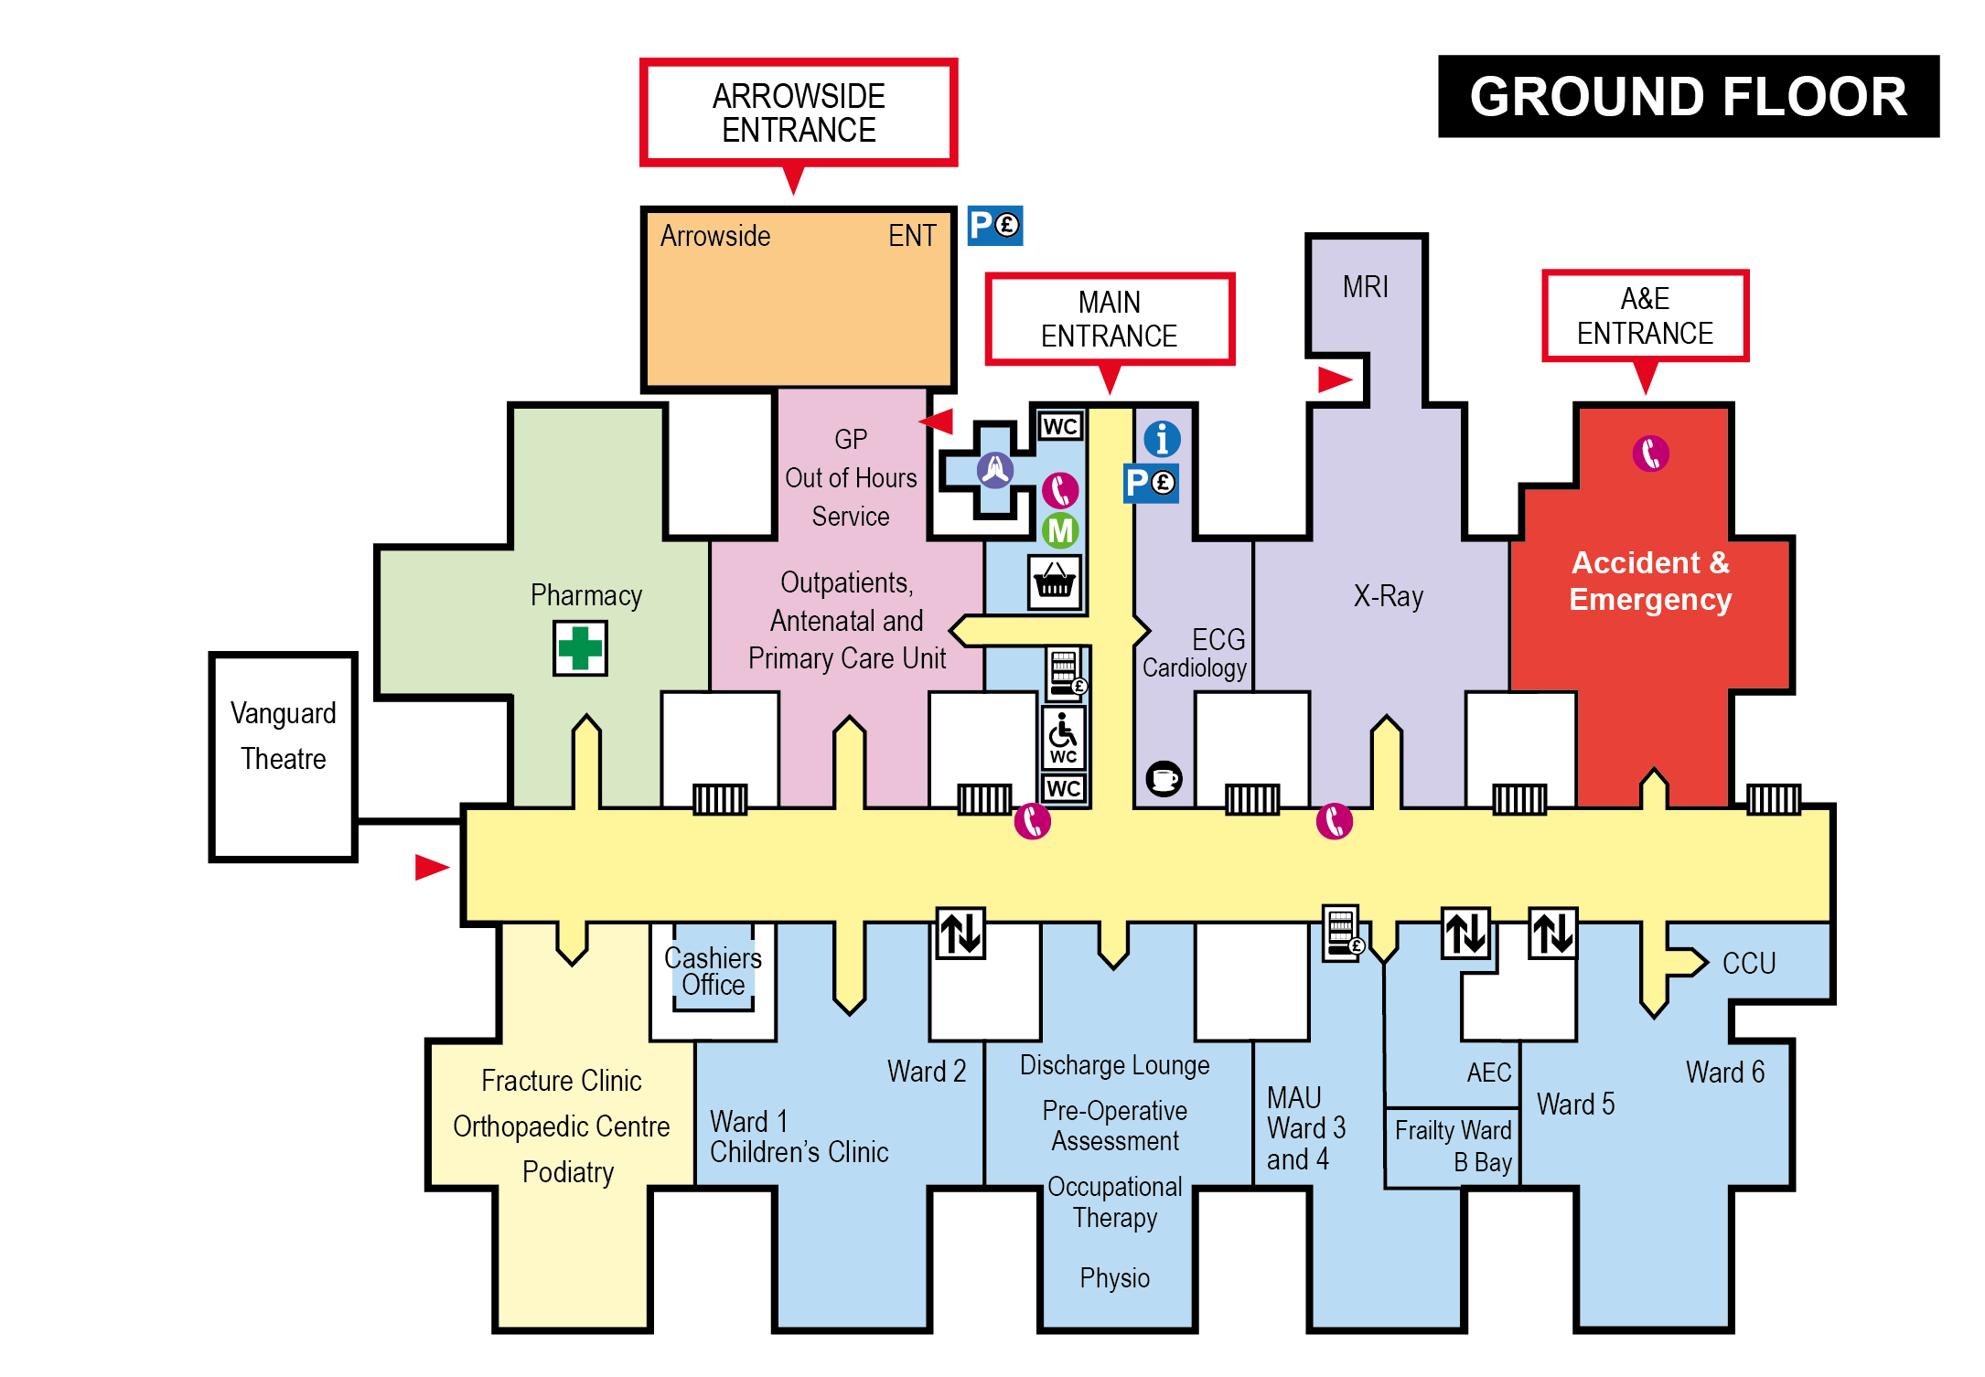

Slide 12

Discussion 1 – People
Who are the people we encounter in these places:
Accident and Emergency Department
Frailty Ward
Children’s Ward
What are their roles and how do they do that in a trauma-informed way?

Slide 13
Trauma-informed People
 | Why are you in this role?
What skills do you have ? | How do you behave?
Who are you?

Slide 14
Discussion 2 - Provision
Who needs help, from whom, and what does a trauma-informed approach look like for:
A woman in A and E with cut and bruised arms, intoxicated and with a male?
An elderly person alone on a ward
A child who is not speaking

Slide 15
Trauma-informed Support
Who will be helping?
 | What might they say?
What might they do? | What might they feel?

Slide 16
Discussion 3 - Support
What do the people in your personas need to do their job? How do we ensure that they have enough:
Time
Skills
Supervision
Debrief

Slide 17



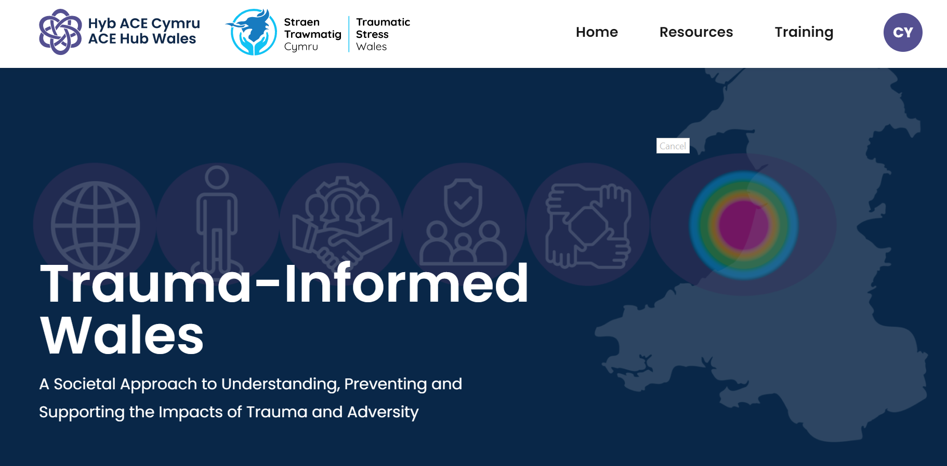
For more information
Trauma-Informed Wales
Website:
www.traumaframeworkcymru.com
MAILING List :
Traumaframework@wales.nhs.uk
#traumaframeworkcymru

