Slide 1
EMDR for Schizophrenia and psychosis
Dr Darren James B.Sc., PhD, DClinPsy
Consultant Clinical Psychologist
Europe Accredited EMDR Consultant Supervisor
Acknowledgement and special thanks to Professor Paul Miller

Slide 2
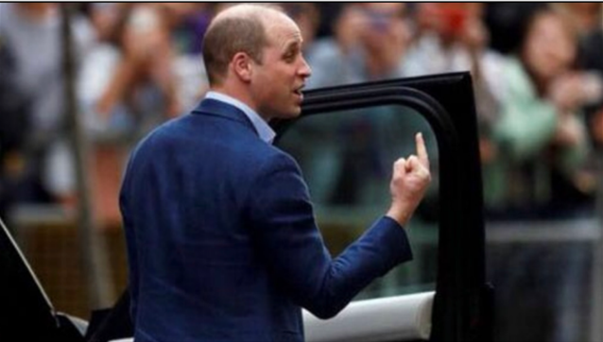
Things are not always as they initially appear…

Slide 3

Observe…

Slide 4
The Greek word
“trauma” means
an injury or wound
The human mind is created to generate narrative

Slide 5
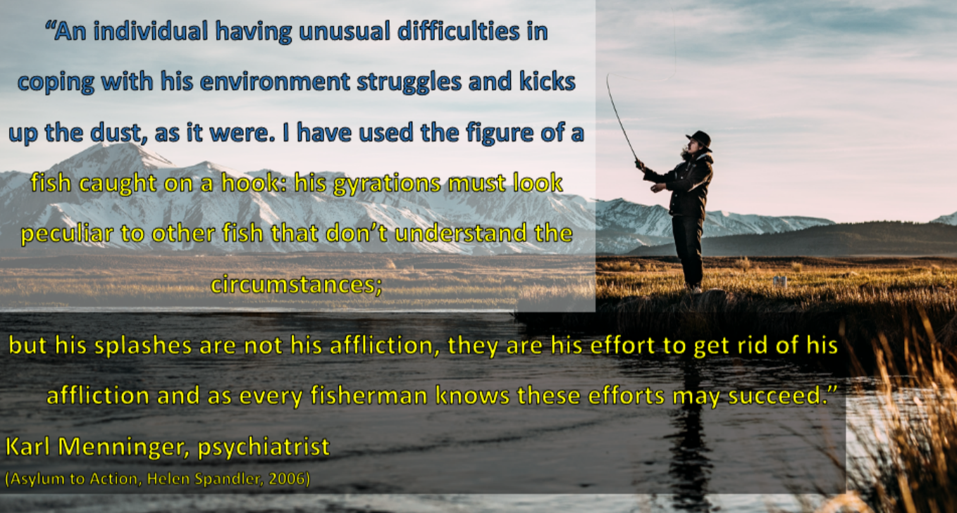
Karl Menninger- against classification
Phenomena have meaning

Slide 6
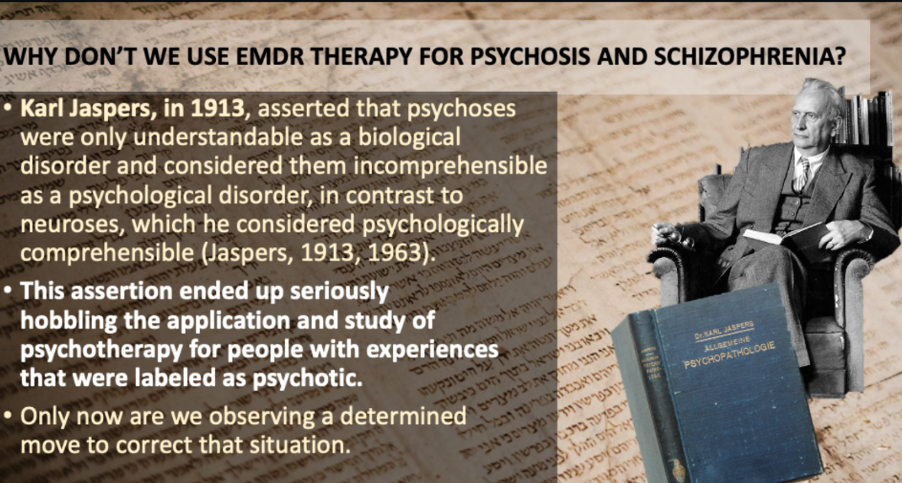

Slide 7
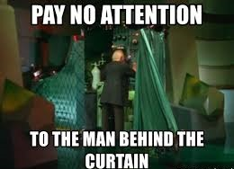

Slide 8
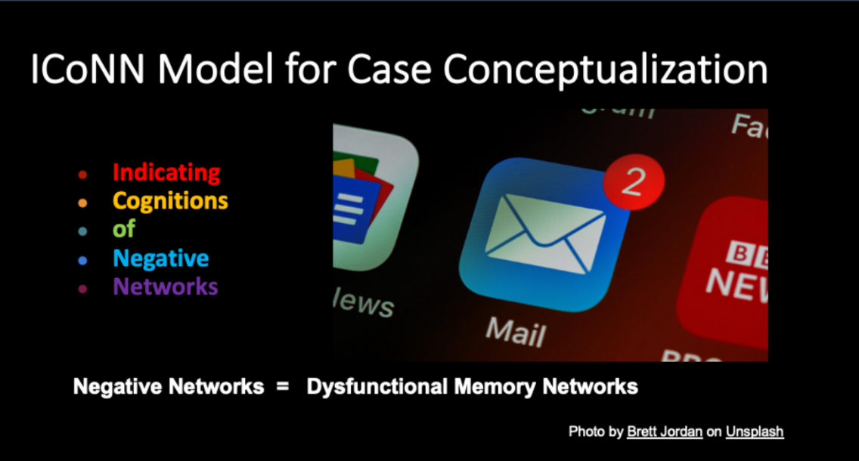
DMN= trauma memories but in the literature this is Default Mode Network (the edynamic unconscious)

Slide 9
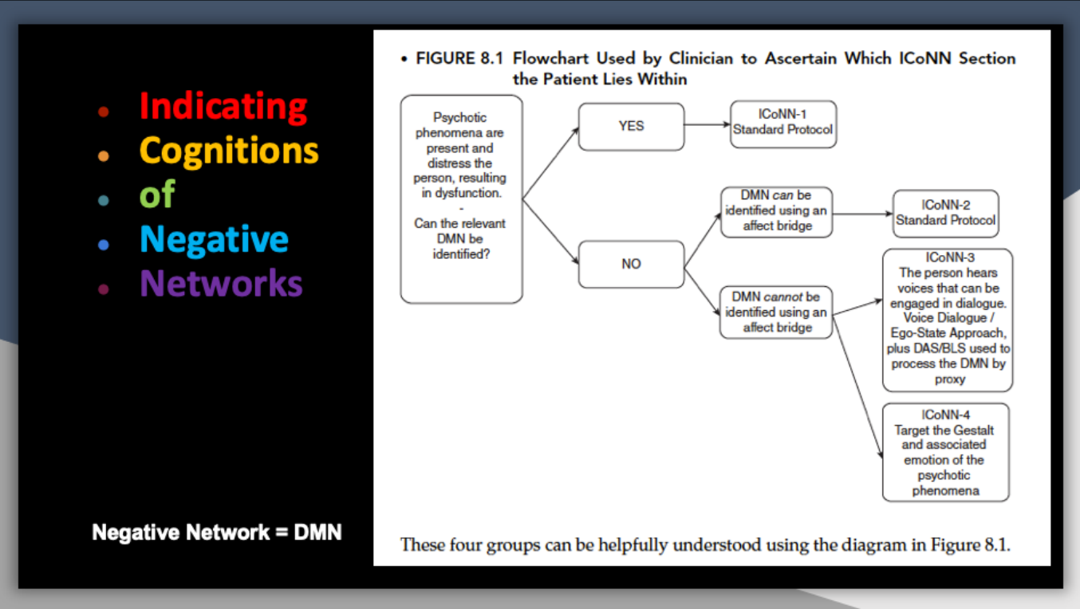
ICoNN 1- DMN identifiable as usual; ICoNN 2- DMN via affect bridge
ICoNN 3- engaging voices; ICoNN 4- gestalt

Slide 10
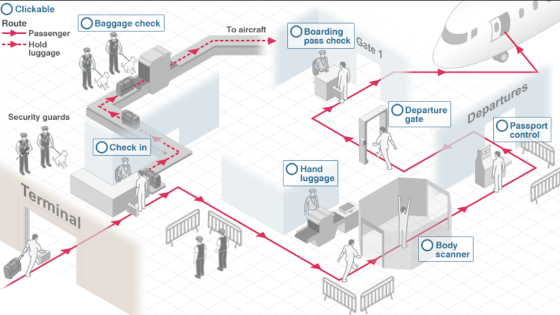

Slide 11
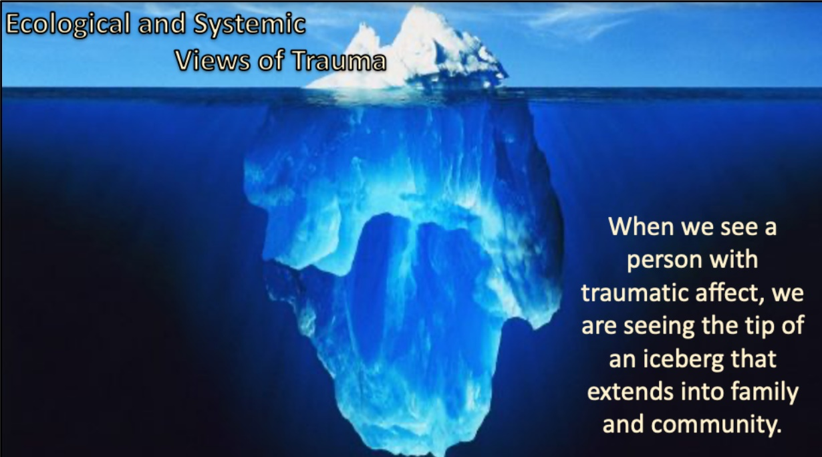

Slide 12
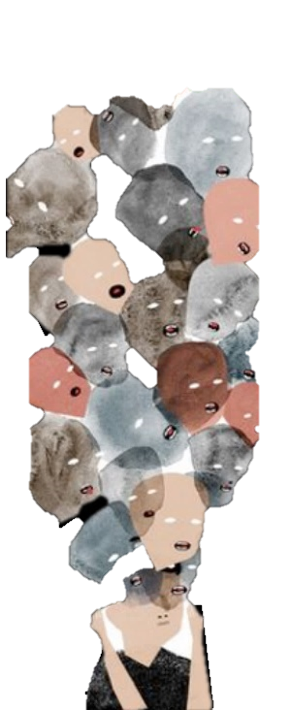
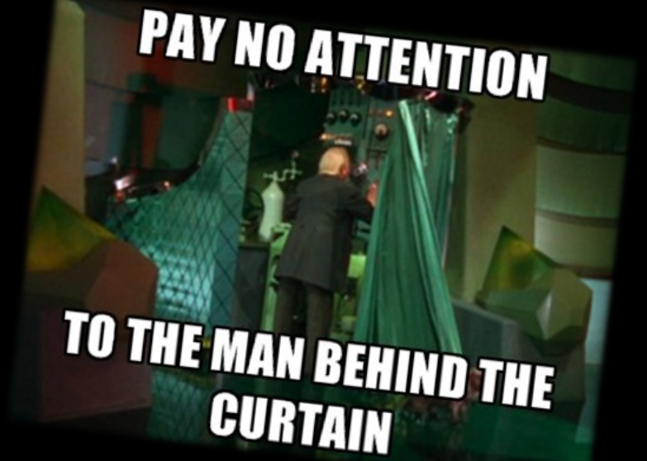
The Wizard of Oz fallacy
The key is getting to the DMN
In viewing voices as a “peopled wound”, we need to acknowledge that they are a system of interrelating memory networks. This system may be complex and cryptic, taking many clinical contact hours to understand.
In some cases, there are disowned child parts that hide behind the voice of an abuser.
“The voices took the place of my pain.” Eleanor Longden (2013)

Slide 13
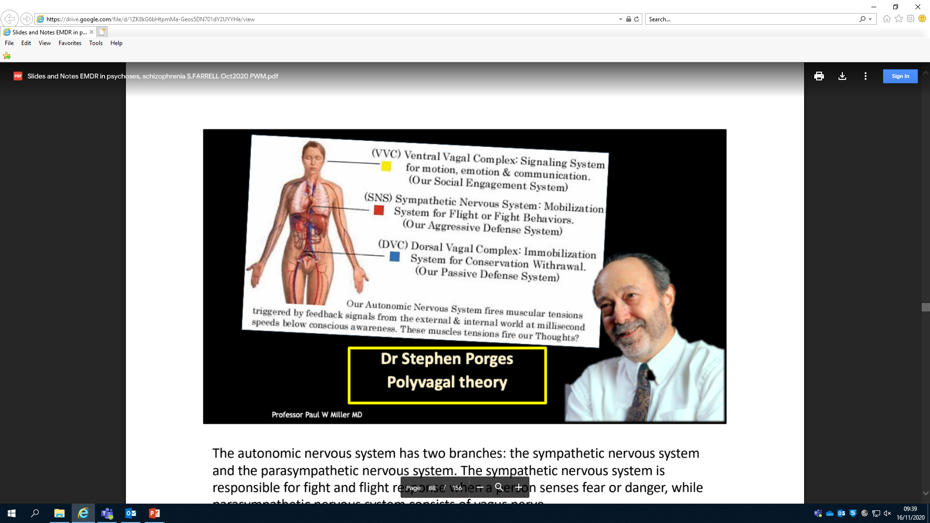
The autonomic nervous system has two branches: the sympathetic nervous system and the parasympathetic nervous system. The sympathetic nervous system is responsible for fight and flight response when a person senses fear or danger, while the parasympathetic nervous system consists of the vagus nerve.
The vagus nerve has two branches- dorsal and ventral. The dorsal branch is older and in case of fear or danger immobilises a person i.e. to faint or act dead.
The ventral branch is recent in evolutionary history as is found in mammals. The function of the ventral branch is to put a brake on fight and flight responses and make a person feel calm and safe and able to indulge in social communication

Slide 14
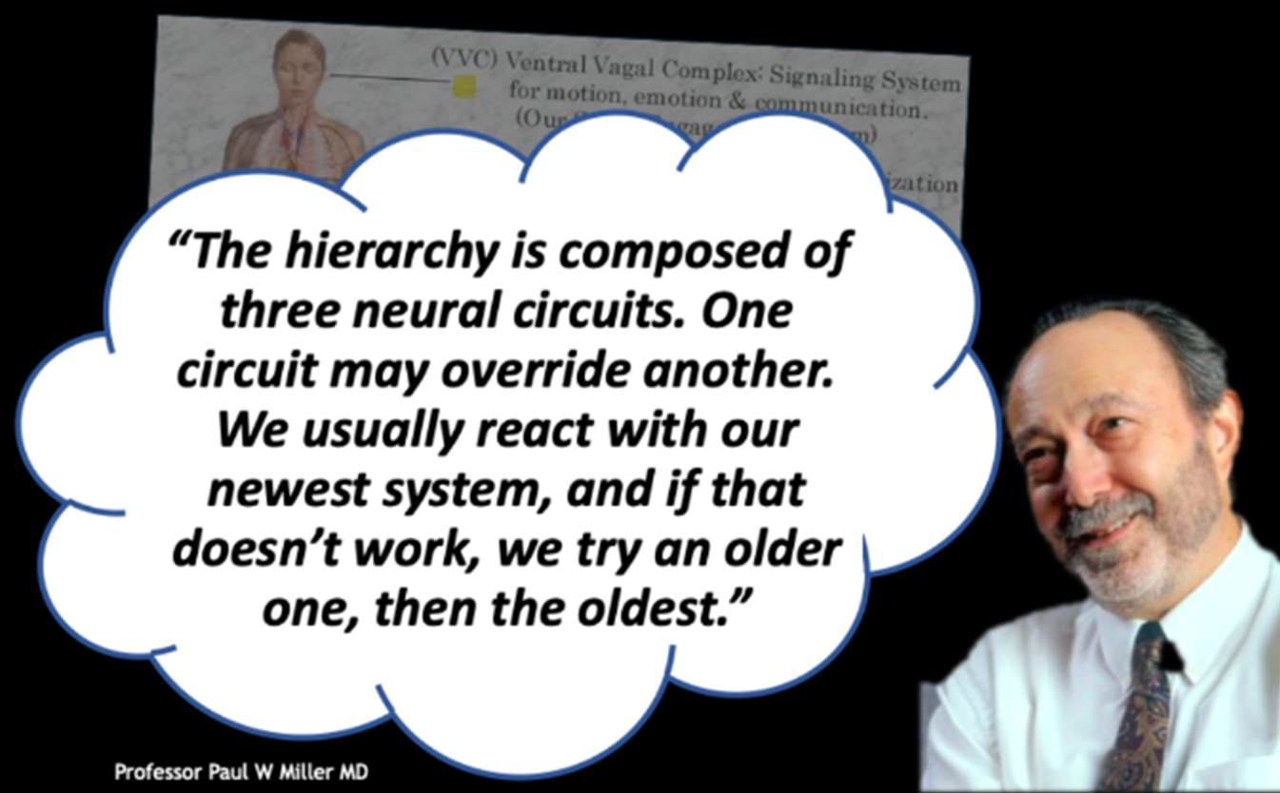

Slide 15
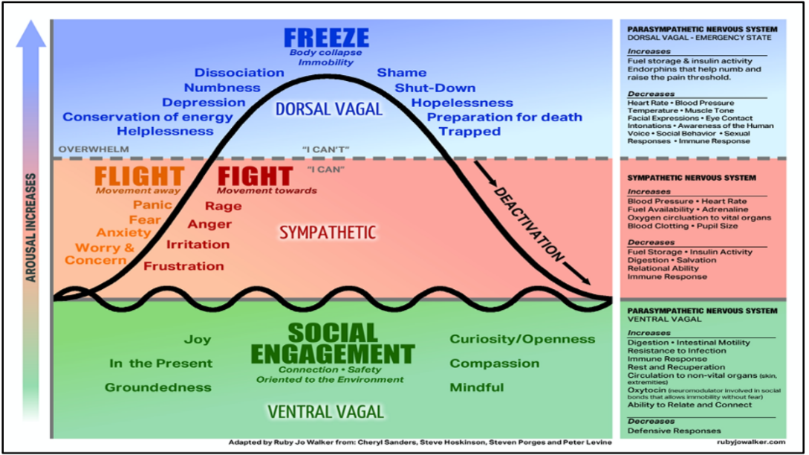
When we sense fear our first response is to calm down and to engage socially (ventral vagus system) e.g. cry for help, plead for forgiveness etc.
If this fails we move to the next level which is fight or flight (sympathetic nervous system), if that mechanism also fails we become immobilized by fear (dorsal vagus system).

Slide 16
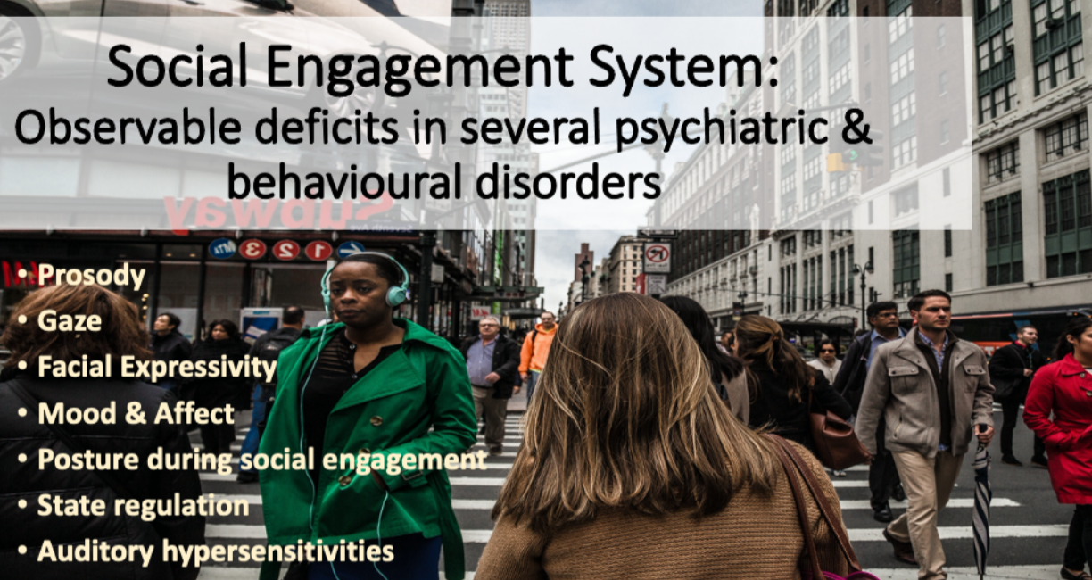

Slide 17
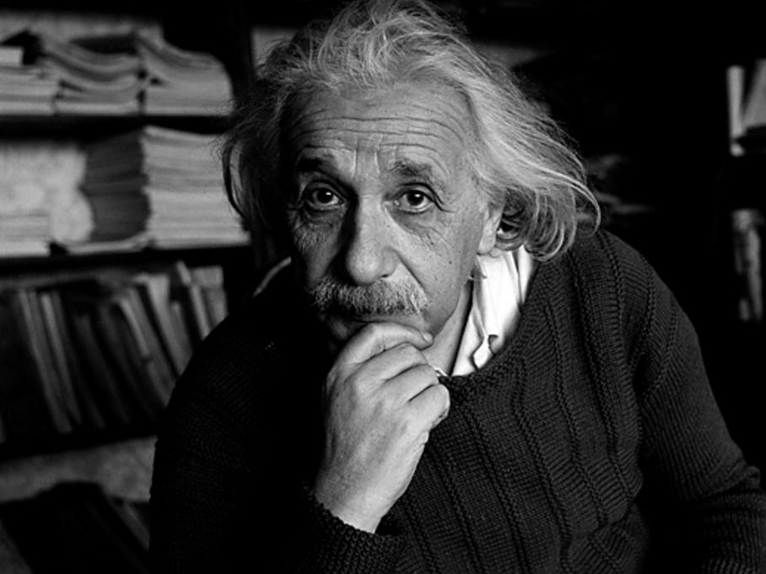
EMDR?
WTF?

Slide 18
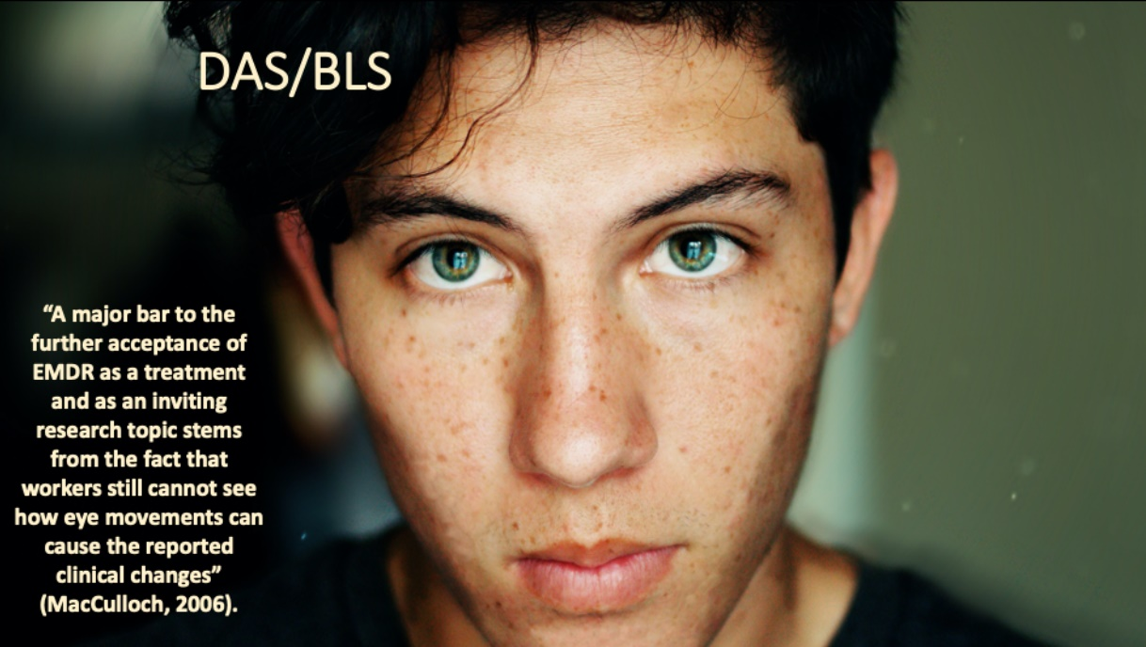

EMDR?
WTF?
How/why do eye movements work?

Slide 19
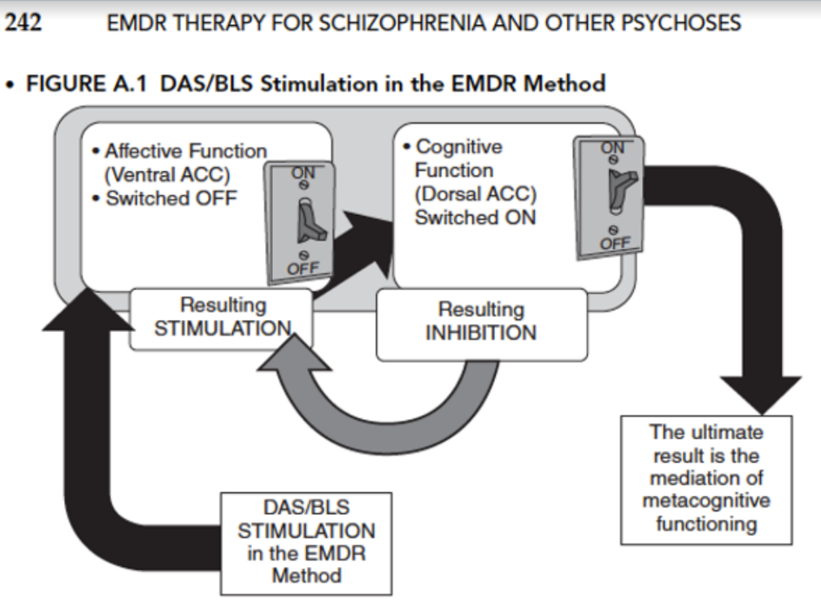
The effects of DAS/BLS
DAS/BLS switched OFF the Ventral/Affective Anterior Cingulate Cortex
This results in -> Switching ON the Dorsal/Cognitive ACC
Neurobiological interest in these brain regions is consistent with later work (Kaye, 2007) suggesting that EMs utilize error monitoring to reverse the suppression of the dorsal (cognitive) subdivision of the ACC by lowering activity of the ventral (affective) subdivision. In other words, DAS/BLS switches off the emotional area of the ACC, which then switches on the thinking area of the ACC.

Slide 20

Working Memory- overload
EMDR 2.0
Ad De Jongh

Slide 21





EMDR
PAUL
PETER

Slide 22
The Wizard of Oz fallacy
The key is getting to the DMN
In viewing voices as a “peopled wound”, we need to acknowledge that they are a system of interrelating memory networks. This system may be complex and cryptic, taking many clinical contact hours to understand.
In some cases, there are disowned child parts that hide behind the voice of an abuser.
“The voices took the place of my pain.” Eleanor Longden (2013)

Slide 23
EMDR: Case Examples

Slide 24
EMDR Case Examples – Scott

Slide 25

EMDR: Case Examples
Scott
  Male (late 20’s)
  Psychotic episode at university
  Stress, depression and substance misuse (alcohol and cannabis)
  Treated for psychosis as an inpatient
  Delusional Belief System:
  Believed other inpatients were rapists and paedophiles
  He had special powers to ‘cure’ them by sitting near them and conducting complex cognitive rituals

Slide 26

EMDR: Case Examples
1st Floatback – ‘Infected with Paedophilia’
  28 y/o
  Picture: Cognitive ritual ricocheting off a ‘strong’ patient and ‘infecting’ Scott with paedophilia
  Negative Cognition (N.C): “I am in danger”
  Emotion: Fear
  Body: Visceral feeling throughout body

Slide 27

EMDR: Case Examples
2nd Floatback – ‘In the van’
  16 y/o
  Picture: Sitting in the van with dad while children were crossing the road and dad was shouting at him
  N.C: ‘I am in danger’
  Emotion: Fear
  Body: Visceral feeling all over

Slide 28

EMDR: Case Examples
3rd Floatback – ‘Hiding from Dad’
  3 y/o
  Picture: Scott hiding behind the banister on the stairs from Dad as he came towards him
  N.C: ‘I am in danger’
  Emotion: Fear & a “bad feeling”
  Body: Visceral feeling throughout
Note: Scott then thought his father had done something to him when he was 3 y/o. Scott later asked his mother about this memory, who informed him that he became mute at 3 y/o and saw a psychologist. Scott had no recollection of this…

Slide 29


EMDR: Case Examples
Delusional Belief
Delusional Belief
‘Infected with Paedophilia’
28 y/o
N.C: “I am in danger”
Emotion: Fear
Body: Throughout
‘Infected with Paedophilia’
28 y/o
N.C: “I am in danger”
Emotion: Fear
Body: Throughout
TARGET
‘In the van’
16 y/o
N.C: “I am in danger”
Emotion: Fear
Body: Throughout
‘In the van’
16 y/o
N.C: “I am in danger”
Emotion: Fear
Body: Throughout
SUDs =10 Reprocessed SUDs =0
TARGET
‘Hiding from Dad’
3 y/o
N/C: “I am in danger”
Emotion: Fear
Body: Throughout
‘Hiding from Dad’
3 y/o
N/C: “I am in danger”
Emotion: Fear
Body: Throughout
SUDs =10 Reprocessed SUDS = 0
TARGET
SUDs =10 Reprocessed SUDs =0

Slide 30

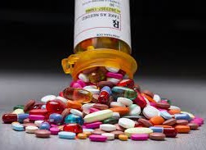

EMDR: Case Examples
1 Year on…
Medication
FREE
Symptom
Driving again
Working in construction
Scott is living with his partner and…
…they are expecting their first baby together!

Slide 31
EMDR: Case Examples
Insert Video

Slide 32
EMDR Case Examples – Annie

Slide 33

EMDR: Case Examples
Annie
  Female (Late 20’s)
  Gang raped by her ex-boyfriend and three of his friends
Delusional Belief System:
Ex boyfriend and friends will break into her home, rape her, cut out her tongue, gouge out her eyeballs and murder her
  Annie also believed someone was spying on her:
      Her dog had a microchip
      Her daughter was a robot
      Annie believed that EIS staff were trying to kill her

Slide 34

EMDR: Case Examples
1st Floatback: ‘Weights by the door’
  24 y/o
  Picture: sitting on the stairs screaming, weights blocking the door with three of them in the house
  N.C: “I am in danger and going to be killed”
  Emotion: Fear
  Body: Visceral feeling in stomach and chest, feeling sick

Slide 35
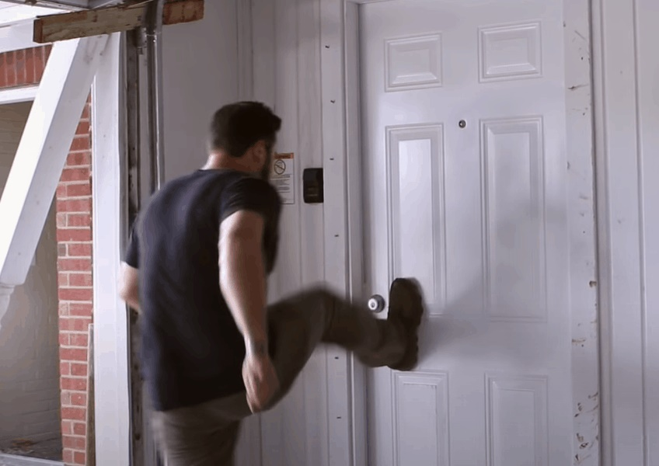
EMDR: Case Examples
2nd Floatback: ‘He kicked the door down’
  23 y/o
  Picture: ex-boyfriend kicking the door down while on bail and strangling Annie against a wall
  N.C: “I am in danger”
  Emotion: Fear
  Body: Visceral feeling in chest

Slide 36

EMDR: Case Examples
3rd Floatback: ‘In the corner’
  20 y/o
  Picture: Being curled up in a ball in the corner beaten up by her ex-boyfriend
  N.C: “I am in danger”
  Emotion: Fear
  Body: Heart tightening

Slide 37

EMDR: Case Examples
4th Floatback: ‘When he glassed me’
  19 y/o
  Picture: ex boyfriend glassing Annie in the pub
  N.C: “I’m in danger”
  Emotion: Fear
  Body: Visceral feeling throughout

Slide 38

EMDR: Case Examples
Flash Forward
Worst case scenario – breaking in & being sexually assaulted
Emotion: Fear
Body: throughout
Flash Forward
Worst case scenario – breaking in & being sexually assaulted
Emotion: Fear
Body: throughout
Delusional Belief
Delusional Belief
“Weights by the Door”
24 y/o
N.C: “I am in danger & going to be killed”
Emotion: Fear (anger)
Body: Stomach and chest
“Weights by the Door”
24 y/o
N.C: “I am in danger & going to be killed”
Emotion: Fear (anger)
Body: Stomach and chest
SUDs =10 Reprocessed SUDs =0
TARGET
When he kicked the door down
23 y/o
N.C: “I am in danger”
Emotion: Fear
Body: Chest
When he kicked the door down
23 y/o
N.C: “I am in danger”
Emotion: Fear
Body: Chest
SUDs =10 Reprocessed SUDs =0
TARGET
“In the corner”
20 y/o
N.C: “I am in danger”
Emotion: Fear
Body: Heart tightening
“In the corner”
20 y/o
N.C: “I am in danger”
Emotion: Fear
Body: Heart tightening
SUDs =10 Reprocessed SUDs =0
TARGET
“When he glassed me”
19 y/o
N.C: “I am in danger”
Emotion: Fear
Body: throughout
“When he glassed me”
19 y/o
N.C: “I am in danger”
Emotion: Fear
Body: throughout
TARGET
SUDs =10 Reprocessed SUDs =0
SUDs =10 Reprocessed SUDs =0

Slide 39

EMDR: Case Examples
1 Year on…
Delusional beliefs are gone and Annie has been discharged from EIS to CMHT
Struggles with anxiety but is self managing using her coping techniques
Annie’s daughter is living with her again
Annie enjoys walking and is doing regular exercise which has meant she has lost 4 stone in weight

Slide 40
EMDR: Case Examples
(Insert video)

Slide 41
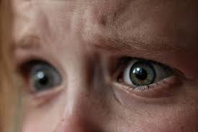
EMDR: Case Examples
Overall…
Delusional Belief System is characterised by fear (shame)
This causes corrupt thinking processes, distorted negative cognition and somatic body disturbances
Resulting in odd behaviours and belief systems

Slide 42


Slide 43

EMDR Case Examples
Road to recovery through…
1. Identifying the early traumatic experience(s)
DELUSIONS
2. Reprocessing this emotion
3. Reducing distress and allowing memories to be stored more functionally

Slide 44


Before EMDR
After EMDR

Slide 45
Questions..?

