Slide 1

Embracing a Holistic Approach to Health and Care: the Sociopsychobio Model
Professor Jon Bisson

Slide 2

Shortcomings of the (Bio)Medical Model
Engel (1977)
  Assumes disease (including behavioural elements) to be fully accounted for by deviations from the norm of measurable biological variables
  Leaves no room for the social, psychological, and behavioural dimensions of illness
  Requires that disease be dealt with as independent of social behaviour
  Embraces both reductionism and dualism
Over-paternalistic and not co-productive
Engel, G.L. (1977). Science, 196, 129-136.
Notes:
2

Slide 3
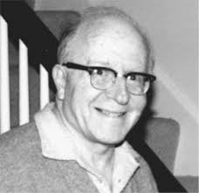
Emergence of the Biopsychosocial Model
Critical of the alternative to the medical model
  “a hodgepodge of unscientific opinions, assorted philosophies and 'schools of thought,' mixed metaphors, role diffusion, propaganda, and politicking…”
Argued for
  reliable methods of clinical data collection (high-level interviewing skills)
  Understanding of psychological, social and cultural determinants in communication
    Many verbal expressions derive from bodily experiences early in life
    The same words may serve to express primary psychological as well as bodily disturbances, both of which may coexist and overlap in complex ways.
Noted heterogeneity in presentations and courses of “disease” (e.g., diabetes and schizophrenia) and “normal reactions” (e.g., grief)

Slide 4
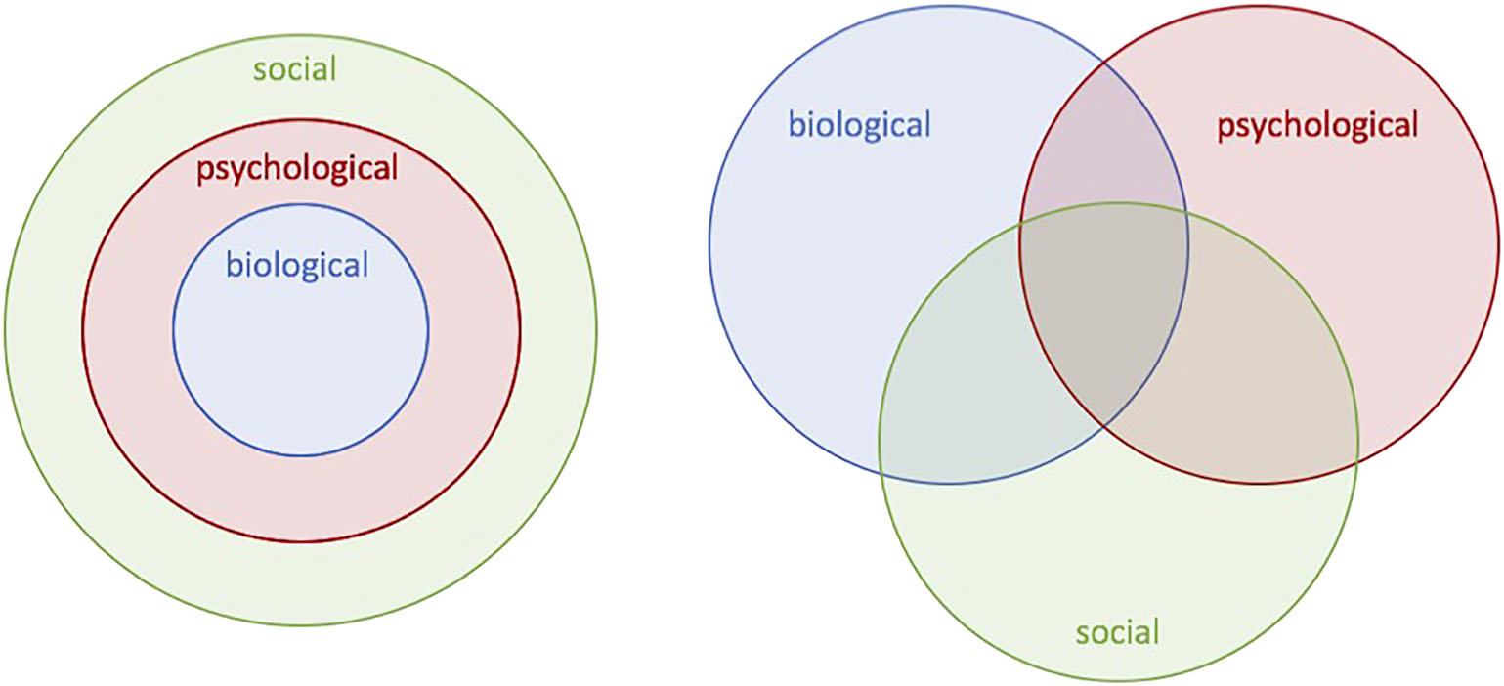
Emergence of the Biopsychosocial Model
Psychological and social factors crucial in determining whether
  People view themselves/others as sick
  People enter a health care system and become a patient
  People establish a therapeutic relationship
Optimal model must take into account
  Biological factors, the individual, their social context, society’s system to deal with the disruptive effects of illness (e.g., clinician role, health care system)
“The boundaries between health and disease, between well and sick, are far from clear and never will be clear, for they are diffused by cultural, social, and psychological considerations”

Slide 5
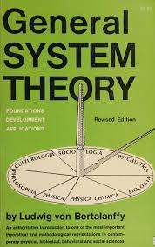
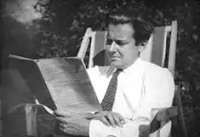

General Systems Theory
Developed by biologists to have holistic as well as reductionistic explanations of life processes
Treats sets of related events collectively as systems manifesting functions and properties on the level of the whole
Recognises similarities across different levels of organisation - molecules, cells, organs, the organism, the person, the family, the society
Holds that all levels of organisation are linked to each other so that change in one affects change in the others

Slide 6
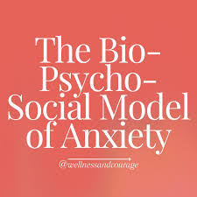
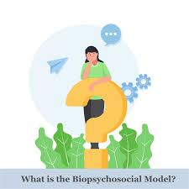
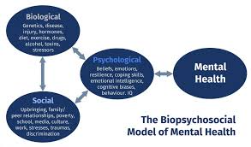
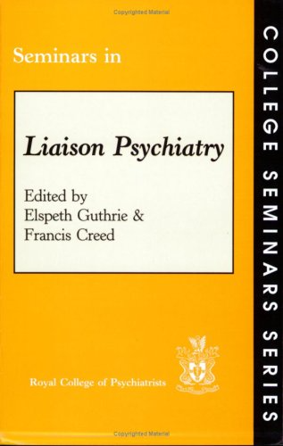
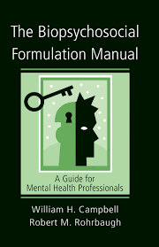
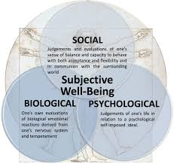
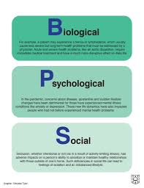
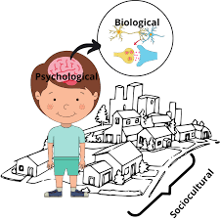

Barriers to Change, Acceptance and Adoption
"Mere emergence of new findings and theories rarely suffices to overthrow well-entrenched dogmas”
“The power of vested interests, social, political, and economic, are formidable deterrents to any effective assault on biomedical dogmatism”
“The proposed biopsychosocial model provides a blueprint for research, a framework for teaching, and a design for action in the real world of health care. Whether it is useful or not remains to be seen”

Slide 7
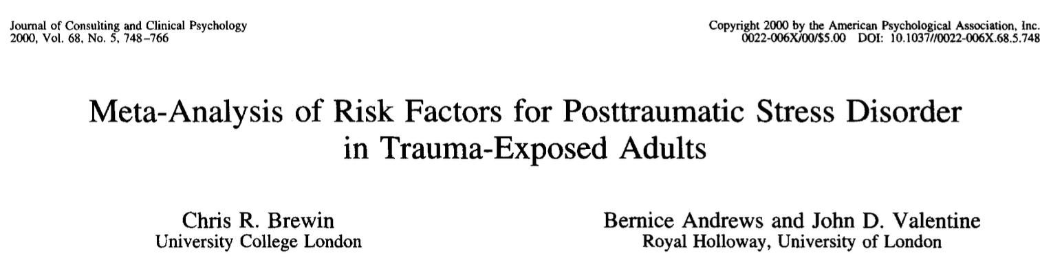
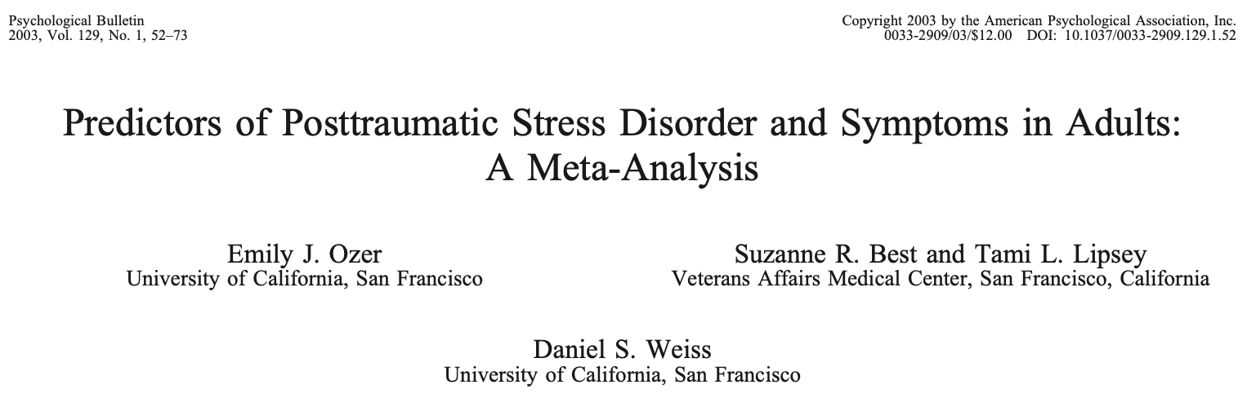
Social Support and PTSD
Perceptions of social support are a determinant of perceived capacity to cope with stressors, and the impact of stressors
Brewin et al mean weighted effect size 0.4 (subsequent life stress 0.32, trauma severity 0.23)
Ozer et al 0.28 (peritraumatic dissociation 0.35, perceived life threat and peritraumatic emotional response 0.26)
NB therapeutic alliance

Slide 8
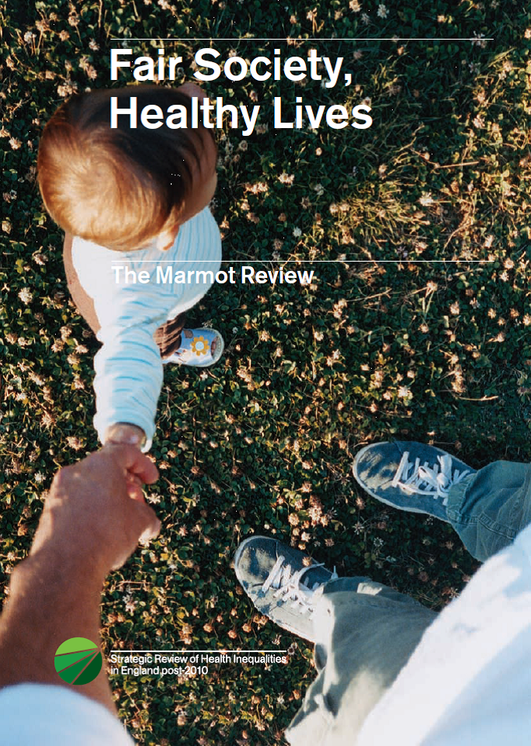
Improved Evidence of Social Determinants of Health
Early life: The conditions in which people are born and grow up
Work: The conditions in which people work, including employment, unemployment, and fair work
Education: The access and quality of education
Living standards: The conditions in which people live, including housing, transport, and neighbourhood
Social support: The conditions in which people interact with their communities, including social exclusion and addiction
Economic stability: The conditions in which people have access to money and resources
Environment: The built and natural environment, including environmental sustainability

Slide 9

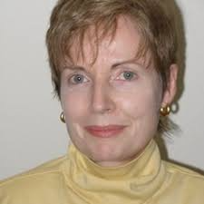
Power Threat Meaning Framework (2018)
Addresses British Psychological Society 2013 recommendation to develop a multi-factorial and contextual approach, which incorporates social, psychological and biological factors
Contributory factors are not independent but evolve out of one another
  Generally multiple, complex, highly interactive and shaped by meaning and agency
  Doesn’t assume pathology
https://www.bps.org.uk/member-networks/division-clinical-psychology/power-threat-meaning-framework

Slide 10
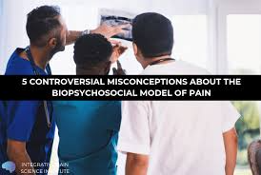
Concerns with the Biopsychosocial Model
Misconception #1 - If pain isn’t physical, it must be “all in the head”
Misconception #2 - Physical findings prove that psychosocial factors aren’t at play
Misconception #3 - A patient’s opinion trumps objective findings
Misconception #4 - Pathologising health
Misconception #5 - Taking a Stand: Biomedical or Biopsychosocial?
https://integrativepainscienceinstitute.com/biopsychosocial-controversial-misconceptions/#

Slide 11
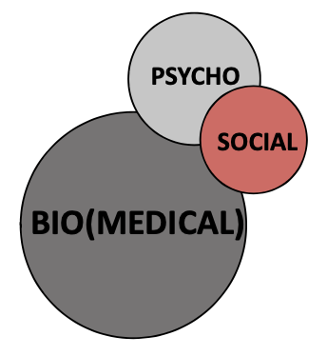
Concerns with the Biopsychosocial Model
Despite Engel’s vision of equal weighs, often dominated by the bio
Public perceptions of health dominated by a medical imagination
  Physical determinants seen as far more important than social ones
Unclear about how precisely the social and psychological elements interact
Biological processes moderated by psychological and social factors rather than a model of dynamic interaction in which the elements have the capacity to fundamentally transform each other
Some psychological therapies fail to properly consider social contextual factors leading to replacing one form of reductionism (biologisation) with another (psychologisation)
Haslam et al (2019)

Slide 12
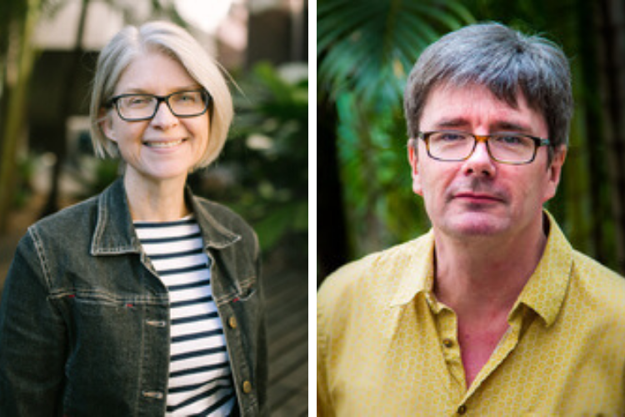
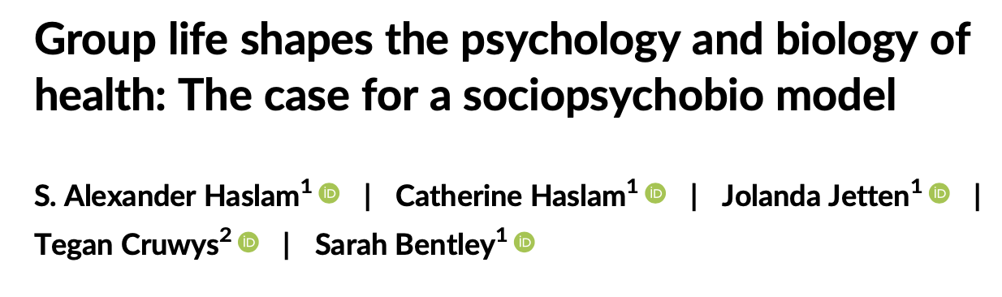
Haslam et al (2019)
Groups shape the psychology and biology of their members beyond individual functioning
Groups provide members with a basis for seeking to change the world rather than simply accepting it
Internalised social identity (e.g., “us Smiths,” “us Cardif City fans”) makes group behaviour possible (e.g., “we are in the same boat”)
Group life not merely an appendage to psychology and biology but a basis for collective experiences that have the potential to unleash new expressions of both

Slide 13
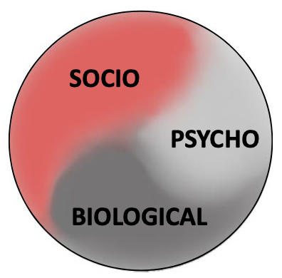
Dynamic and Interdependent Relationship
The social, psychological and biological elements are not fixed and immutable but interconnect and influence each other
Failing to appreciate the potential health-relevant power of social groups to be a source of cure (as well as harm) is routinely overlooked
Recasting Engel's framework as a sociopsychobio model of health provides an affirmative linguistic framing in which social elements are positioned as primary drivers of health processes rather than as third-class passengers
Haslam et al (2019) & Mardian et al (2020)

Slide 14
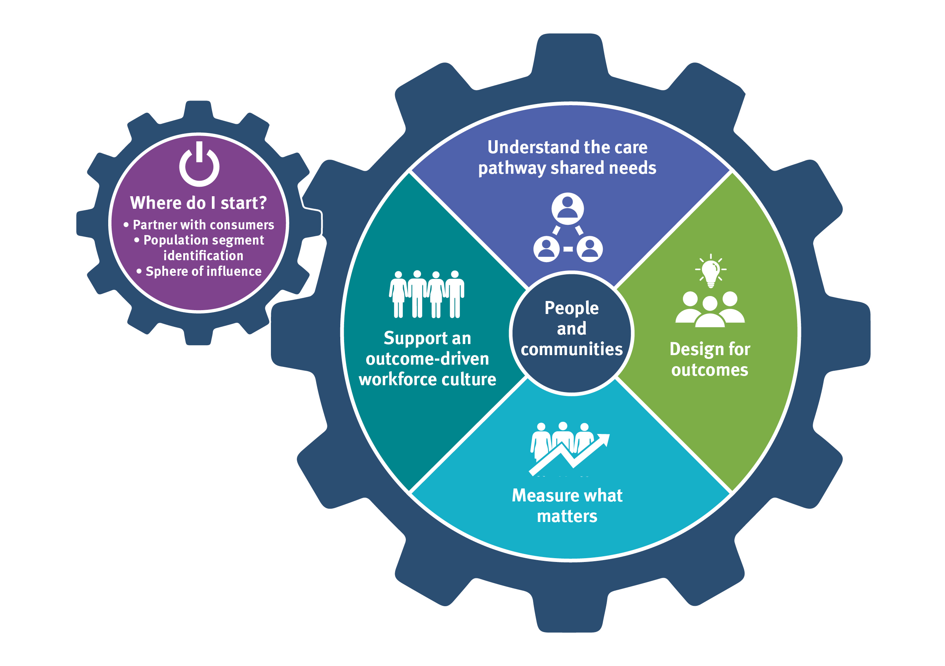
Value-Based Care Facilitation
High value health care maximizes clinical benefit while minimizing harm and financial cost
Providing care that is costly and associated with limited benefits and significant harms, represents a crisis of value (cf pain care)
Value is achieved by implementing the best available evidence (high value) into practice
The evidence practice gap (EPG), representing the disconnect between current evidence and current practice
Welsh Value in Health Centre - https://vbhc.nhs.wales/
Mardian et al (2020)

Slide 15
Transitioning to a Sociopsychobio Model of Care
Moves from focus on disease and one-off episodic treatments to a positive health and resilience approach focusing on gradual, incremental improvement in physical, psychological, social, and existential health, well-being, and function
Targets person-centred outcomes such as quality of life and function are rather than only focusing on short-term outcomes
Requires evaluating and treating the whole person, addressing common comorbidities and developing behavioural, intrapersonal, interpersonal, and existential coping strategies
Partnership between the individual and a transdisciplinary team that maintain their unique and differentiated expertise and are tightly linked through shared language, common therapeutic purpose, deep respect, and good communication
Mardian et al (2020)

Slide 16
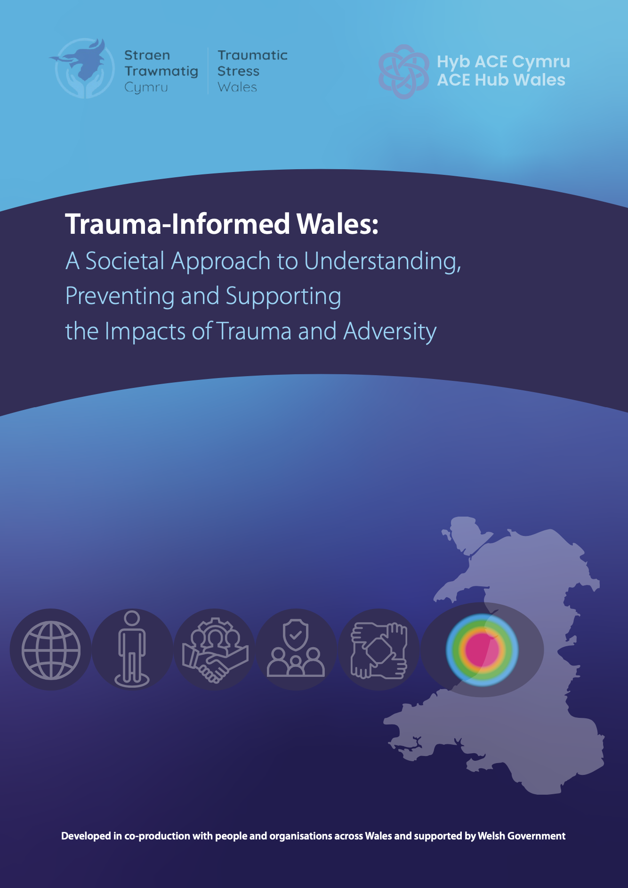
Trauma-Informed Wales Framework
Acknowledges the strengths and limitations of different paradigms and aims to support a balanced, joined-up approach that recognises and respects differences between people who share the common goal of improving the health and wellbeing of those affected by traumatic events and adversity
Recognises the need to be inclusive and consider the multiple factors, including social, psychological and biological, that contribute to the development of the many presentations encountered
Recognises alternative models to diagnostic ones, for example the Power Threat Meaning Framework, and recognises the perceived utility of different models and paradigms to different people
Recognises the need for the whole of Welsh society to work together to create a better Wales

Slide 17
Traumatic Stress Wales
Initial specification (2020)
  Seeks accurate identification of people’s biopsychosocial needs and traumatic stress symptoms to allow identification of the correct interventions for that person
Proposed specification (2025)
  Uses diagnosis and accepts and welcomes different views/paradigms in the context of a sociopsychobio, rights-based and culturally informed model of care
https://traumaticstress.nhs.wales/

Slide 18
Diolch Yn Fawr
bissonji@cardiff.ac.uk

