Slide 1




Substance Use and
Trauma –
TSW Film World Premiere
Lucie James, Lewis Jones and Neil Roberts
Notes:
Lucie - This is about work that we have been involved in at the request of traumatic stress wales to develop some resources to fill a gap in learning to help people with trauma related difficulties and substances misuse.
We all came from different backgrounds….
This project has been funded by Traumatic Stress Wales and Welsh Government
Gap in learning recognised, we were approached by TSW
How it came about – based on clinican, research and clients experiences...
Background – TW/WG funded
Targeted at clinicians working in m.h services and addiction services (including 3rd sector)- in line with all wales co-occuring framework
Area where not much research/awareness
Some of the challenges/ difficulties/myths

Slide 2
Rationale for Films
Need for increased understanding of working with those presenting with trauma and substance use problems
Lack of research
Clinicians don’t feel confident/competent
TSW and WG funded
In-line with the All Wales Co-occurring Framework

Slide 3
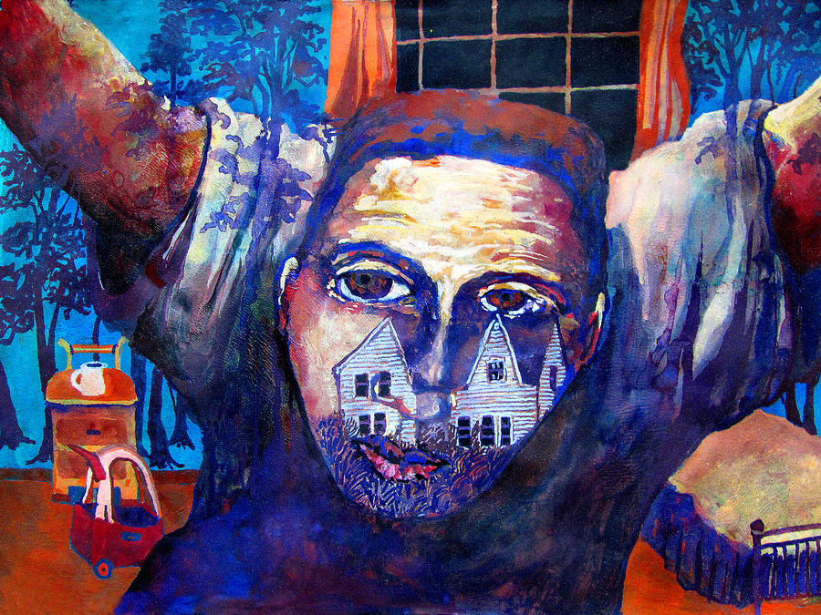
Prevalence
SUD populations
High levels of trauma exposure
PTSD lifetime 26-52%
PTSD current 15-42%
PTSD populations
Comorbid Problematic substance use 19-35%
Comorbid Problematic alcohol use 36-52%
James Huntley
Breslau 1992; Kessler 1995; Mills 2006 AJP; Pietrzak 2011, Cottler 1992 AJP; Dragan 2007 Addictive Behaviours; Driessen 2008 Alcoholism; Helzer 1987 NEJM; Reynolds 2005 Drug & Alc Dep; Schäfer 2010 Alc & Drg Dep
Notes:
Neil

Slide 4

PTSD and SUD:
A Non-Random Association
Notes:
4

Slide 5

Common Issues and Challenges
Complex histories
multiple traumas and adverse events
Complex presentations
multiple problems and comorbidities
often physical and cognitive impairment
homelessness, violence, suicidal ideation
Case management needs
E.g. housing, access to health care, criminal justice system, risk management
Rashid Johnson

Slide 6
Common Issues and Challenges
Where do we start?
Fear of making things worse
Uncertainty about the need for abstinence
Uncertainty about the evidence
AUD & SUD frequent exclusions from RCTs
Rashid Johnson

Slide 7



Sequential Treatment Approach
Addiction service
CMHT/ Traumatic Stress Clinic

Slide 8

Sequential Treatment Approach
Addiction service
CMHT/ Traumatic Stress Clinic

Slide 9




Experiences from Work in Frontline Services
Notes:
I have had the pleasure and challenge of working with those who have barriers to engagement throughout my career. From starting on a needle exchange, to outreaching to the homes of those who have dropped out of addiction services, to developing a counselling service offering support to those facing homelessness. I have found that often those who could most benefit from therapy are those with the most pervasive barriers to actually engaging with this support. I recognise that the onus is on us as services to be able to adapt to accommodate these barriers through an empathetic approach bolstered by quality multi-agency working with the services around a client. I feel it is important to offer quality psychological intervention that is appropriate to a client’s current presentation. This intervention needs to be paced and targeted to the current point in their recovery journey. The complex interplay between addiction and mental health difficutlies represent a surmountable challenge to offering this support, not an exclusionary criteria. These videos highlight the power and neccisity of working in this way.

Slide 10




Barriers
Notes:
I have had the pleasure and challenge of working with those who have barriers to engagement throughout my career. From starting on a needle exchange, to outreaching to the homes of those who have dropped out of addiction services, to developing a counselling service offering support to those facing homelessness. I have found that often those who could most benefit from therapy are those with the most pervasive barriers to actually engaging with this support. I recognise that the onus is on us as services to be able to adapt to accommodate these barriers through an empathetic approach bolstered by quality multi-agency working with the services around a client. I feel it is important to offer quality psychological intervention that is appropriate to a client’s current presentation. This intervention needs to be paced and targeted to the current point in their recovery journey. The complex interplay between addiction and mental health difficulties represent a surmountable challenge to offering this support, not an exclusionary criteria. These videos highlight the power and necessity of working in this way.

Slide 11
Buvidal Psychological Support Service (BPSS) - Overview
Example of effectively treating PTSD and addiction simultaneously
Rapid access
Tiered psychological support
Trauma informed
Addressing barriers to engagement
Individualised care
Notes:
Set up service specifically designed for ppl on Buvidal and presenting with mh
Highlighting fact large prevalence on trauma
Key factors in success- Coproduced, tiered, rapid access, addressing barrier to engagement (where peple feel safe)
Safety and adaptive strategies
Demonstrated efficacy and cost effectiveness

Slide 12
BPSS - Outcomes
Highly significant improvements in:
● Psychological distress
● Quality of life
● Impairments in functioning
Cost-effective: approx. 6k QALY
Demonstrating a psychological model for addictions and mental health services across Wales

Slide 13
Time for the premiere….

Slide 14
[Rachael Video]

Slide 15
[Provider Video]
Notes:
Neil – provider perspective?/challenges
Trying to bring together the service user voice and the research and perspective of the service providers, thinkng about key elements of why it can be challnegong to work with people with trauma preenting with substance use

Slide 16
[Animation Video]
Notes:
Lucie - Things that can be incorporated in to your practice
Massive thankyou to Claire, Rachel and Vinne
Neil – plan for videos

Slide 17
Acknowledgements
Massive thankyou to Claire, Rachael and Vinnie
Cat Hopkins and Cardiff University
Cardiff and Vale University Health Board
Like an Egg productions
TSW and Welsh Government
Recovery Cymru and CAVDAS
Notes:
Neil
Applause for s

Slide 18
Any Questions or Comments?

