Slide 1
Trauma and Crime.
What’s the Connection?
Gwyn Griffith - gwg10@aber.ac.uk
Dr Gareth Norris & Gwenann Jones

Slide 2
SOME BACKGROUND
Two types of offending - “adolescent (10 to 24 yrs) limited” and “lifetime persistent (25yrs +)” Moffet, 1993. Since 2000 adolescent offending has reduced significantly but levels of lifetime persistent offending have remained more or less the same.

Slide 3
HOW THINGS HAVE CHANGED 2000-2019
Moffet, T.E. (1993). Dual taxonomy theory – Chronic offenders have experienced serious trauma. YJB Cymru – “Thickening soup”.

Slide 4
Almost all the variation in the overall crime rate (P) in England and Wales over the last 40 years is due to adolescent offending and can be explained by 3 causative factors:
A: Change income inequality; B: Change in absolute poverty level; C: Change in the intensity and duration of criminal justice interventions
R² = 0.9792
P = K + (β₁ * A) + (β₂ * B) + (β₃ * C)
ADOLESCENT OFFENDING
CHRONIC OFFENDING
Adolescent crime (10-24yrs) is the price the state pays for income inequality and poverty. To reduce the level of adolescent crime the state has to fund high levels of criminal justice intervention and/or reduce levels of inequality and poverty.

Slide 5
The adult custodial population contains a high proportion of life-time persistent offenders
Around 30% of prisoners have spent time in a YOI and many more have been involved with the youth justice system. 70% have been incarcerated on more than one occasion.
What factors characterise the adult prison population?

Slide 6
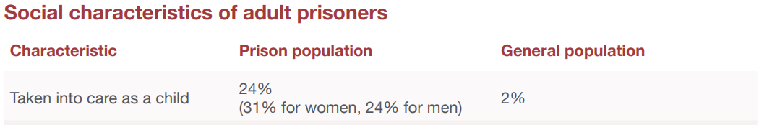
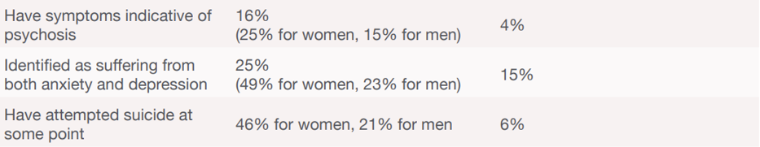
4 or more ACEs 46% (males, Welsh prison)² 12%
Neurodivergent condition 50%¹ 15-20%
Prison reform trust (2023). Prison: The facts. Bromley Briefings, summer 2023.
1
2
Ford K., Barton E.R., Newbury A., Hughes K., Bezeczky Z., Roderick J., Bellis M.A. (2019). Understanding the prevalence of adverse childhood experiences (ACEs) in a male offender population in Wales: The Prisoner ACE Survey. Public Health Wales NHS Trust & Bangor University.

Slide 7
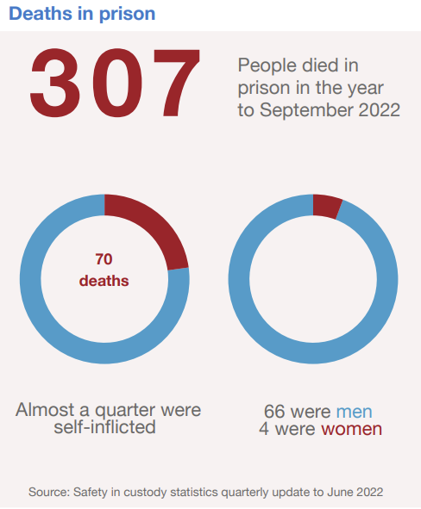
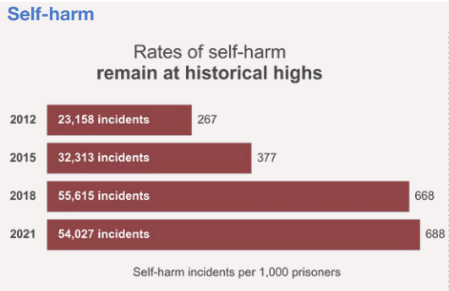

Slide 8
Problematic alcohol misuse
Drug dependence
Have ever used Class A drugs
60%¹ (males)
35%¹
64%
17%² (males)
3%³
13%
1
2
3
Drummond, C., McBride, O., Fear, N., & Fuller, E. (2016). Chapter 10: Alcohol dependence. In S. McManus, P. Bebbington, R. Jenkins, & T. Brugha (Eds.), Mental health and wellbeing in England: Adult Psychiatric Morbidity Survey 2014. Leeds: NHS Digital.
Roberts, C., Lepps, H., Strang, J., & Singleton, N. (2016). Chapter 11: Drug use and dependence. In S. McManus, P. Bebbington, R. Jenkins, & T. Brugha (Eds.), Mental health and wellbeing in England: Adult Psychiatric Morbidity Survey 2014. Leeds: NHS Digital.

Slide 9
Longitudinal study – Ceredigion YOT/Aberystwyth University: 204 children (aged 10 to 17 years) who committed at least 1 proven offence between 2014 and 2018. (Gwenann Jones, 2023)
Adolescent limited offenders – 184 individuals (90%)
Committed less than 4 proven offences and none post 18 yrs.
On average 1 proven offence per individual.
No violent offenders.
Mean onset age 15 years
75% male
15% high vulnerability
Potential chronic offenders – 20 individuals (10%)
Committed 4 or more proven offences including at least one post 18yrs.
On average 24 proven offences per individual.
7 violent offenders (3 or more violent offences on separate occasions)
Mean onset age 13 years
95% male
55% high vulnerability
Poor emotional control/impulsiveness
Poor consequential thinking skills
Poor Empathy
Attachment disorders
Many chronic offenders end up in the prison system
Jones G.M. (2023). Examining the effectiveness of the Ceredigion Youth Offending Team in reducing further offending within the context of vulnerability. MPhil Thesis, Aberystwyth University.

Slide 10
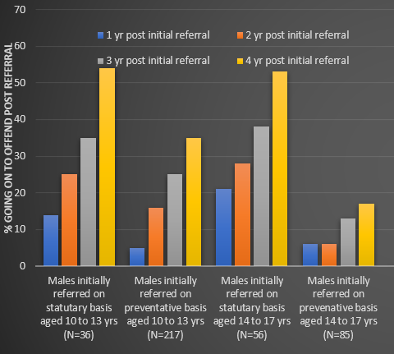
Prevention – OUTCOMES (Gwenann Jones, 2023)
Males (aged 10 to 17 yrs on referral to YOT) assessed (with validated risk assessment tool) as being at medium or high risk of offending on referral (2014 to 2018).
Tracked for at least 4 yrs post initial referral.
95% adolescent offenders with 1-3 ACEs and low levels of serious trauma related factors
ns
ns
ns
**
**
ns
**
**
ns: Not statistically significant **: Statistically significant at 99% level. Effect sizes after 1, 2, 3 and 4 yrs were 0.23, 0.30. 0.30 and 0.37 respectively. These are medium effect sizes (Cohen, 1992) and correspond to a 71, 79, 66 and 70% reduction in the number of individuals going on to offend in the prevention’s subgroup relative to the statutory subgroup.

Slide 11
ACEs – Adverse Childhood Experiences
Emotional abuse & neglect (including verbal abuse)
Household violence (domestic violence including violence from young person towards their family)
Physical abuse & neglect
House hold substance misuse (including alcohol and drug abuse by young person)
Incarcerated household member
Parental separation (including loss of parent figure and fractured family relationships)
Young people who have experienced 4 or more are 20 x more likely to end up in custody, 15 x more likely to become a victim of violence, 15 x more likely to be violent towards others. Up to 16 x more likely to develop a substance misuse issue.
Fox, B.H. et al., 2015. Trauma changes everything: Examining the relationship between adverse childhood experiences and serious, violent and chronic juvenile offenders. Child Abuse and Neglect, 46, pp 163-173. (study of 22,575 youth offenders in USA)
Bellis M.A. et al., 2015. Adverse Childhood Experiences and their impact on health harming behaviours in the Welsh adult population. Published by Public Health Wales.

Slide 12
Other indicators
Going missing
Gang or delinquent street group involvement
Victims of youth violence or exploitation
Early onset of behaviour difficulties
School attendance issues, exclusions and attendance at specialist education provision.
Violence, threats or aggressive behaviour towards staff.
Attachment issues to one or more parent.
Causing criminal damage to their home.
In the UK almost all (90%+) young people involved in serious case reviews following serious offences/child deaths and young people subject to statutory supervision by YOTs following court convictions have experienced 4 or more ACEs and/or above.
A.Chard (2016). Troubled lives Tragic consequences. Thematic review summary report, Tower Hamlets Safeguarding Children Board.
Young people who are involved in crime are also victims of crime.

Slide 13
Are there risk factors that are specific to children that go on to become lifetime persistent offenders?

Slide 14
Are there risk factors that are specific to lifetime persistent offenders?
Detailed study of the multiagency case records held on 3 groups of individuals that had been supervised by Ceredigion YOT (Gwenann Jones, 2023).
Vulnerable adolescents that did not offend
Adolescent limited offenders
Chronic offenders
Looked for presence or absence of 50 risk factors that had been identified as prominent risk factors that raise the likelihood of offending in other research studies.
Factor analysis to identify correlated groups of factors
Jones G.M. (2023). Examining the effectiveness of the Ceredigion Youth Offending Team in reducing further offending within the context of vulnerability. MPhil Thesis, Aberystwyth University.

Slide 15
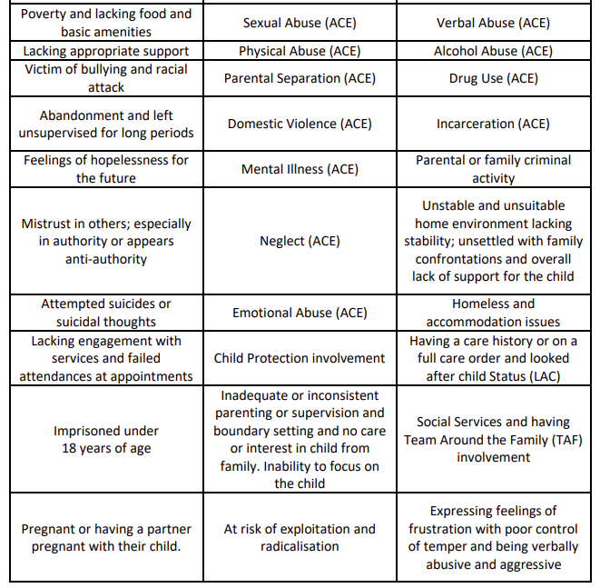
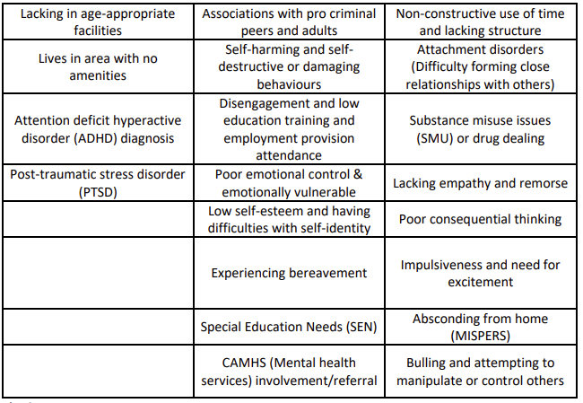
50 risk factors associated with offending
Adolescent limited offenders on average 11 out of 50 risk factors
Potential lifetime persistent offenders on average 23 out of 50 risk factors

Slide 16
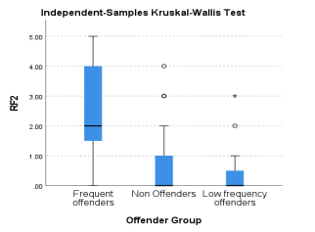
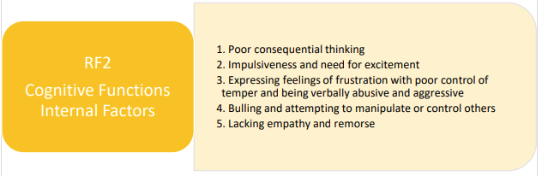
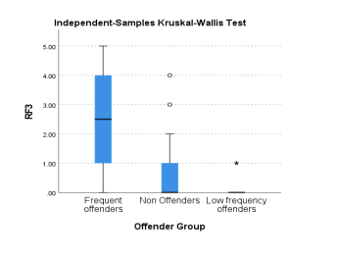
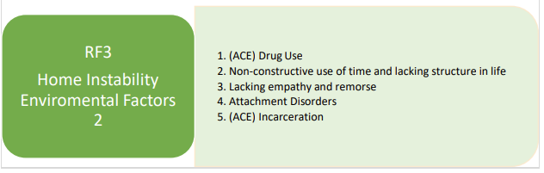
Groups of correlated risk factors associated specifically with chronic offenders
Differences between means significant at 99.9% level (p<.000)

Slide 17
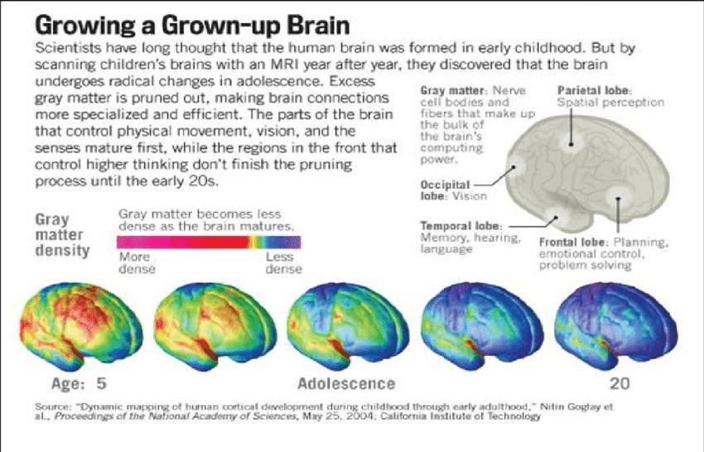
BIOLOGICAL PERSPECTIVE – BRAIN DEVELOPMENT
EXECUTIVE FUNCTIONS:
Attention, concentration, anticipation, planning,
abstract reasoning, cognitive flexibility, impulse control.

Slide 18
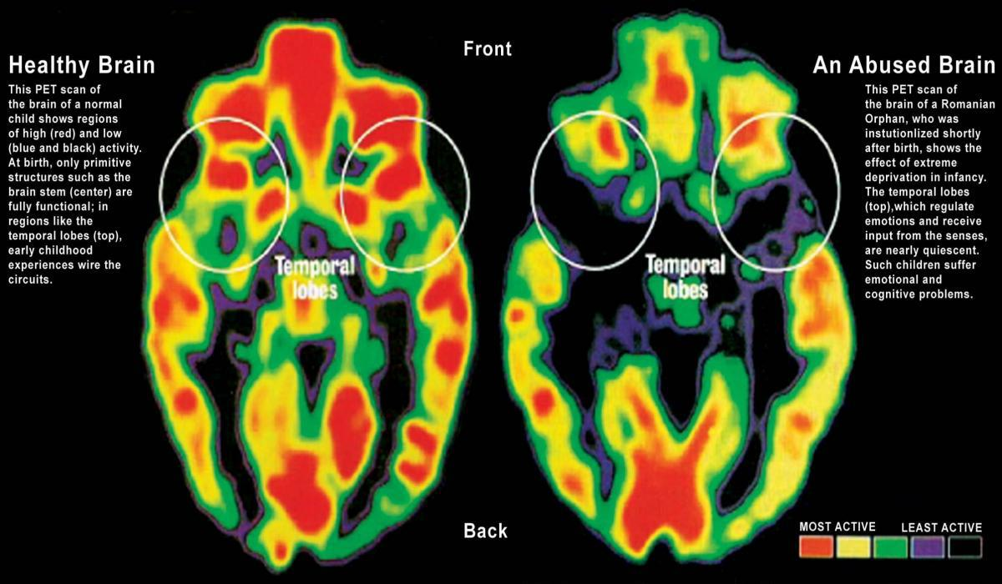
How does all of this relate to adolescent limited offending and lifetime persist offending?
Serious and persistent exposure to trauma (pre-birth and during early childhood) and impairment in the attachment relationship between child and caregiver can impact on neurobiological development.
The development of Executive functioning (frontal lobe) and other brain areas can be impaired:
This can result in Anxiety, Depression, suicidal ideation, PTSD, dissociative states, hyperactivity, aggression, violence, substance abuse, impulsivity and frequent offending.
Impacted individuals are more likely to offend during adolescence and these problems will persist into adulthood as the affected brain areas will do not mature normally at the end of adolescence.
Perry, B.D. (2001) The Neuro-developmental Impact of Violence in Childhood. In Schetky, D. & Benedek, E.P. (2001) Textbook of Child and Adolescent Forensic Psychiatry, Chapter 18, American Psychiatric Press Inc. Washington D.C. pp. 221-238. 29.
Teicher, M. (2000) Wounds That Won’t Heal, Cerebrum, Vol. 2, No. 4, pp50-67;
Creeden K. (2004) The Neurodevelopmental Impact of Early Trauma and Insecure Attachment: Rethinking Our Understanding and Treatment of Sexual Behaviour Problems. Sexual Addiction and Compulsivity 11, 223-247.

Slide 19
How do YOTs work with young people that have these trauma related difficulties to try to help them reduce their offending behaviour?
Being alert to the symptoms.
Accurate early identification of children that are being exposed to trauma.
Taking effective safeguarding actions.
Interventions guided by Trauma informed approach.
Dr Tricia Skuse and Jonny Matthew (2015). The Trauma Recovery Model: Sequencing Youth Justice Interventions For Young People With Complex Needs. Prison Service Journal 220, 16-25.
In complex high risk cases multiagency case formulation guided by clinical psychologist (Enhanced case management).
Sequencing of interventions.
Focus on therapeutic relationships

Slide 20
4 R’s – Key symptoms (TRM, Dr Tricia Skuse and Jonny Matthew)
RADAR
Hypervigilance
Pacing, shifting in seat, fidgeting
Failure to make eye contact
Very alert to the movement of others and gestures
Anxious speech
Failure to absorb spoken information
RAGING EMOTIONS
Affective dysregulation
Powerful feelings (negative and positive)
Sense of losing control/panic
Unknown triggers
Low verbal cognisance during crisis
RECYCLED TRAUMA
Intrusive re-experiencing
Switching off
Flashbacks
Poor recollection
Inattention
Sleep problems
REFUSAL &/OR RESISTANCE
Avoidance and numbing
Distracting self
Avoiding reminders of the trauma (people and places)
Avoiding speaking about the trauma
Emotional distancing from others
Substance misuse

Slide 21
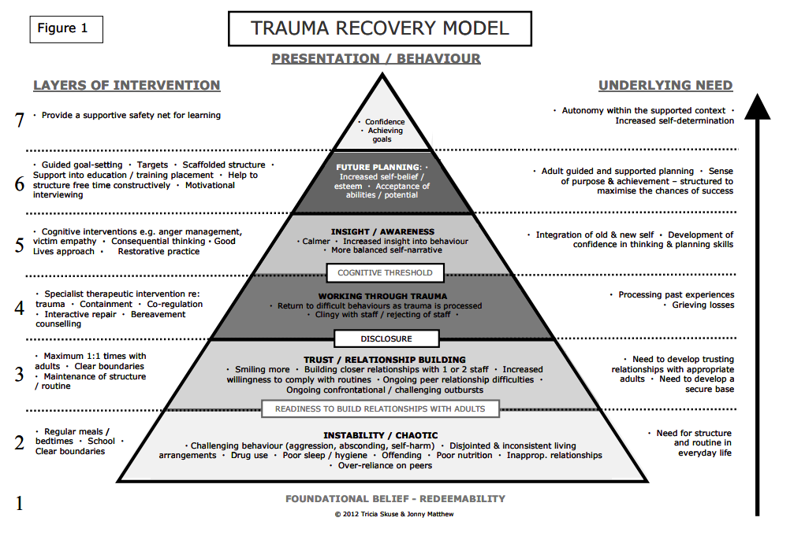
Dr Tricia Skuse and Jonny Matthew (2015). The Trauma Recovery Model: Sequencing Youth Justice Interventions For Young People With Complex Needs. Prison Service Journal 220, 16-25.

Slide 22
Importance of the relationship between the young people and the facilitators. Relationship based on ECM/trauma recovery model.
CPR
•Consistency “you deal with me the same way each time”
•Predictability “I can anticipate you. You are trustworthy”
•Reliability “I can lean on you. You don’t give up” – secure base
PACE
•Playfulness - humour
•Acceptance – Separate the behaviour and the person (not permissiveness)
•Curiosity – non-judgemental
•Empathy
Recognition that Young people that offend are also often victims

Slide 23
PAST – caseloads dominated by Adolescent limited group and at least some of the interventions targeted on this group were effective.
Adolescent limited group (1-3 ACEs)
Lifetime persistent group (4 or more ACEs, serious and repeated trauma)
PRESENT – caseloads dominated by lifetime persistent group and previous interventions not effective with, or not targeted on, this group. Whole system (youth and adult) needs to shift to a new trauma focused approach. Focus on relationship and once trust established specialist therapeutic interventions.

Slide 24
Conclusions
Serious childhood (or pre-birth) trauma can result in lifelong problems including persistent offending behavior.
This happens because the trauma impairs neurological development, especially the development of executive functions and emotional regulation.
Recovery is a difficult process that requires specialist intervention.
Prevention is better that a cure.
Little evidence of significant progress in terms of supporting these individuals over last 40 yrs.
Further research needed and more work needs to be done implementing promising approaches like ECM and TRM.

