Slide 1


Slide 2

Wellness with WNO
A breathing and singing programme delivered in partnership
with NHS Wales health boards and Welsh National Opera to support people in Wales having had a post viral illness or an energy limiting condition.
Designed by Betsi Cadwaladr University Health Board, Cardiff and Vale University Health Board, Cwm Taf Morgannwg University Health Board
and Welsh National Opera

Slide 3
Lles gyda WNO
Rhaglen anadlu a chanu a gyflwynir mewn partneriaeth â
byrddau iechyd GIG Cymru ac Opera Cenedlaethol Cymru gefnogi pobl yng Nghymru sy’n salwch ôl-firws neu gyflwr sy’n cyfyngu ar egni.
Dyluniwyd gan Fwrdd Iechyd Prifysgol Betsi Cadwaladr, Bwrdd Iechyd Prifysgol Caerdydd a’r Fro, Bwrdd Iechyd Prifysgol Cwm Taf Morgannwg ac Opera Cenedlaethol Cymru

Slide 4


Slide 5


Wellness with WNO
A Welsh National Opera pilot programme: Managing Persistent Pain
A singing and breathing programme to support people living with Persistent Pain in Wales
Funded by Welsh Government and in partnership with NHS Wales and Welsh National Opera

Slide 6
Lles gyda WNO
Rhaglen Beilot Opera Cenedlaethol Cymru: Rheoli Poen Parhaus
Rhaglen canu ac anadlu i gefnogi pobl sy’n byw
gyda phoen parhaus yng Nghymru
Caiff rhaglen beilot Opera Cenedlaethol Cymru ei hariannu gan Lywodraeth Cymru a’i chynnal mewn partneriaeth â GIG Cymru

Slide 7
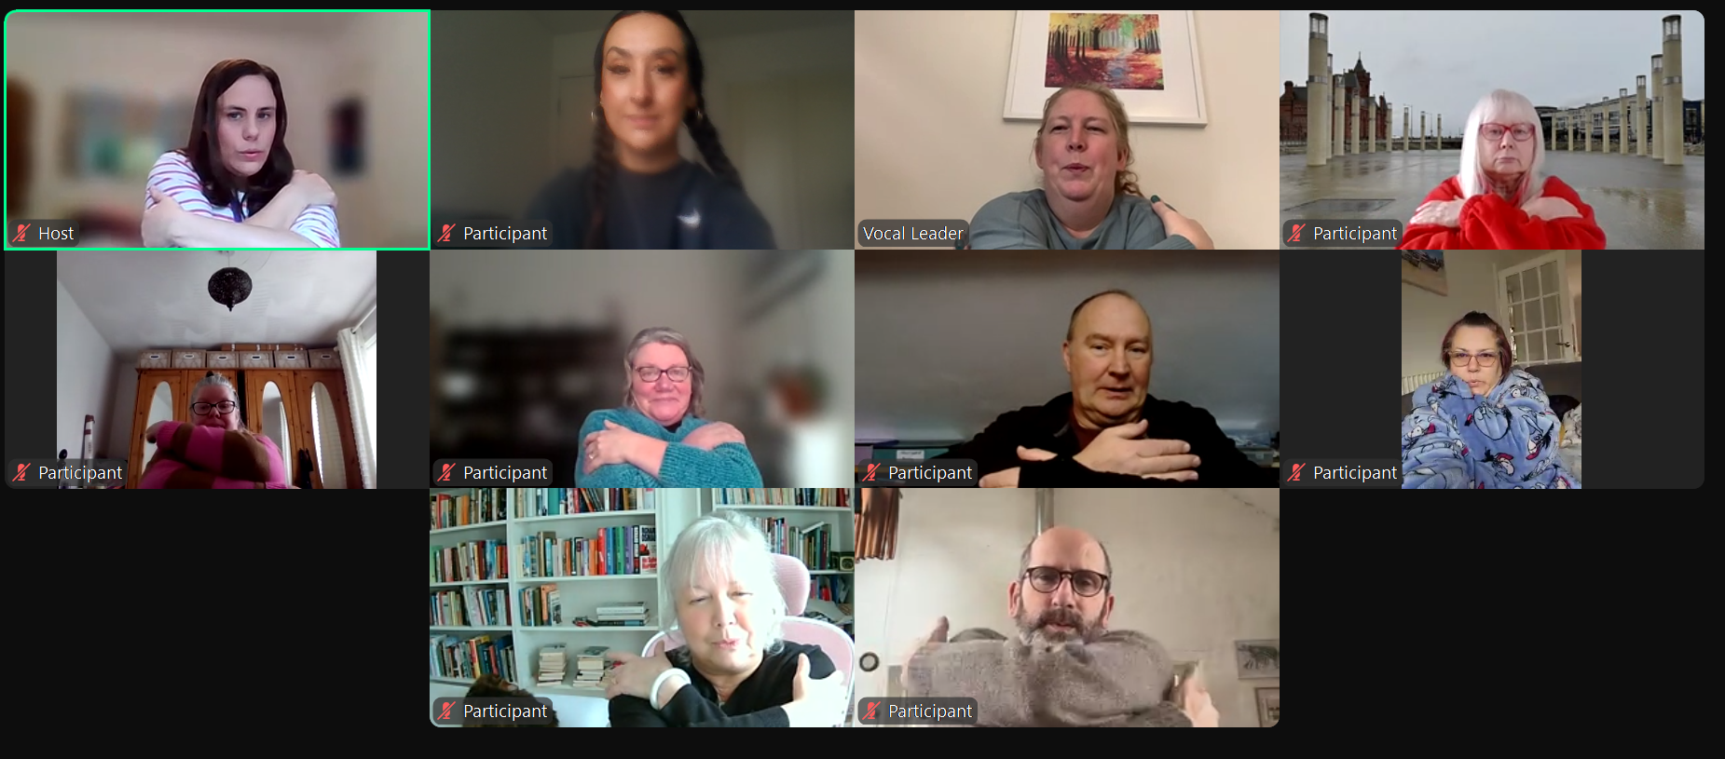

Slide 8

“At first, I noticed I’d been sleeping better on the nights we’d had our sessions, which was quite welcome after a long time having interrupted nights and loss of sleep. Then I realised my mood had been considerably better, and then I started to look forward to sessions (I’m not sure I’ve ‘looked forward’ to things for months!) I’ve also taken to singing along with the radio during the day, which has brightened my mood no end, and been a huge distraction from the constant grating, crepitus, crunching, aching and wincing I normally notice.”

Slide 9

“The other pain management techniques I have used have been medically prescribed medications. They have not been as effective as the regular use of the breathing and massage techniques taught on this programme. Using the breathing and massage techniques enhances the use of the medication. Pain levels increase if I’m tense [and] if I can keep relaxed through the breathing then the medication works better.”

Slide 10











Slide 11

wellness@wno.org.uk

