Slide 1
"What we do is more important than what we say or what we say we believe.“ Bell Hooks
Dr Joanne Hopkins, Programme Director Adverse Childhood Experiences, Criminal Justice and Violence Prevention, Public Health Wales, Visiting Professor, Wrexham University, Social and Life Sciences

Slide 2

Since 2022 we have :
Developed animations, resources, guidance, training
Held conferences, discussions workshops
Co produced and developed inspiring projects and
Developed knowledge, wisdom and reflected
Built the scaffolding of our trauma-informed approach

Slide 3
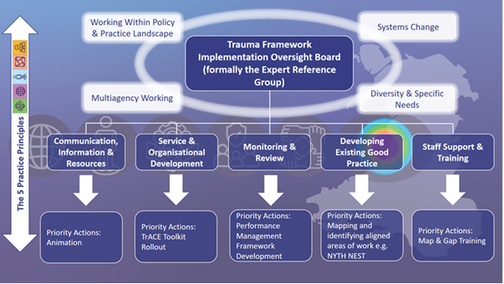

Slide 4

Trauma-informed People
Who are we and what do we do?

Slide 5
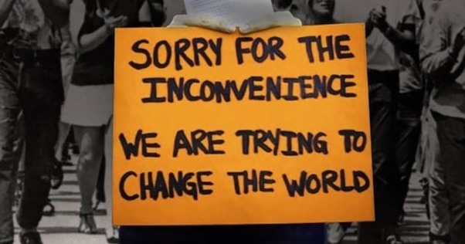

Slide 6
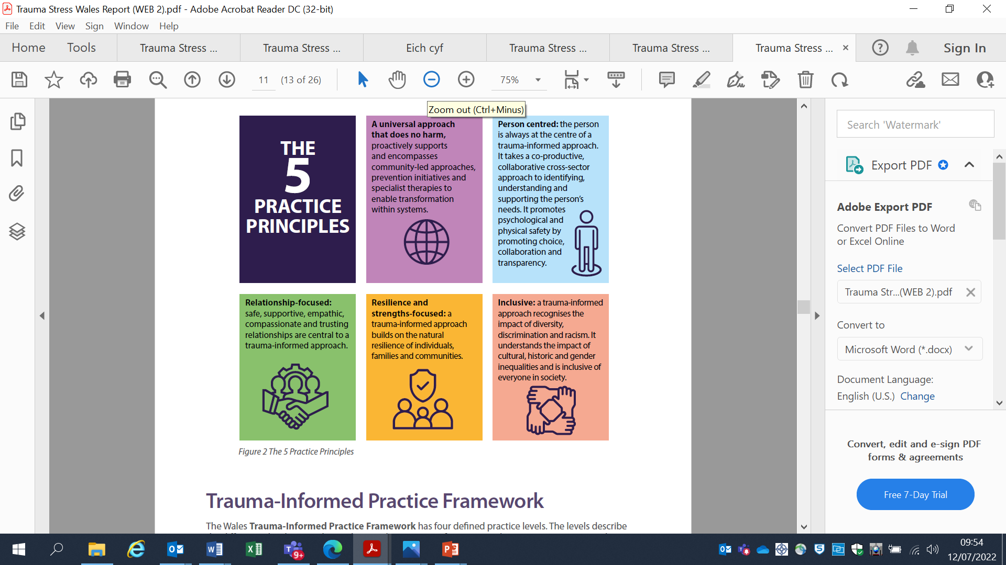
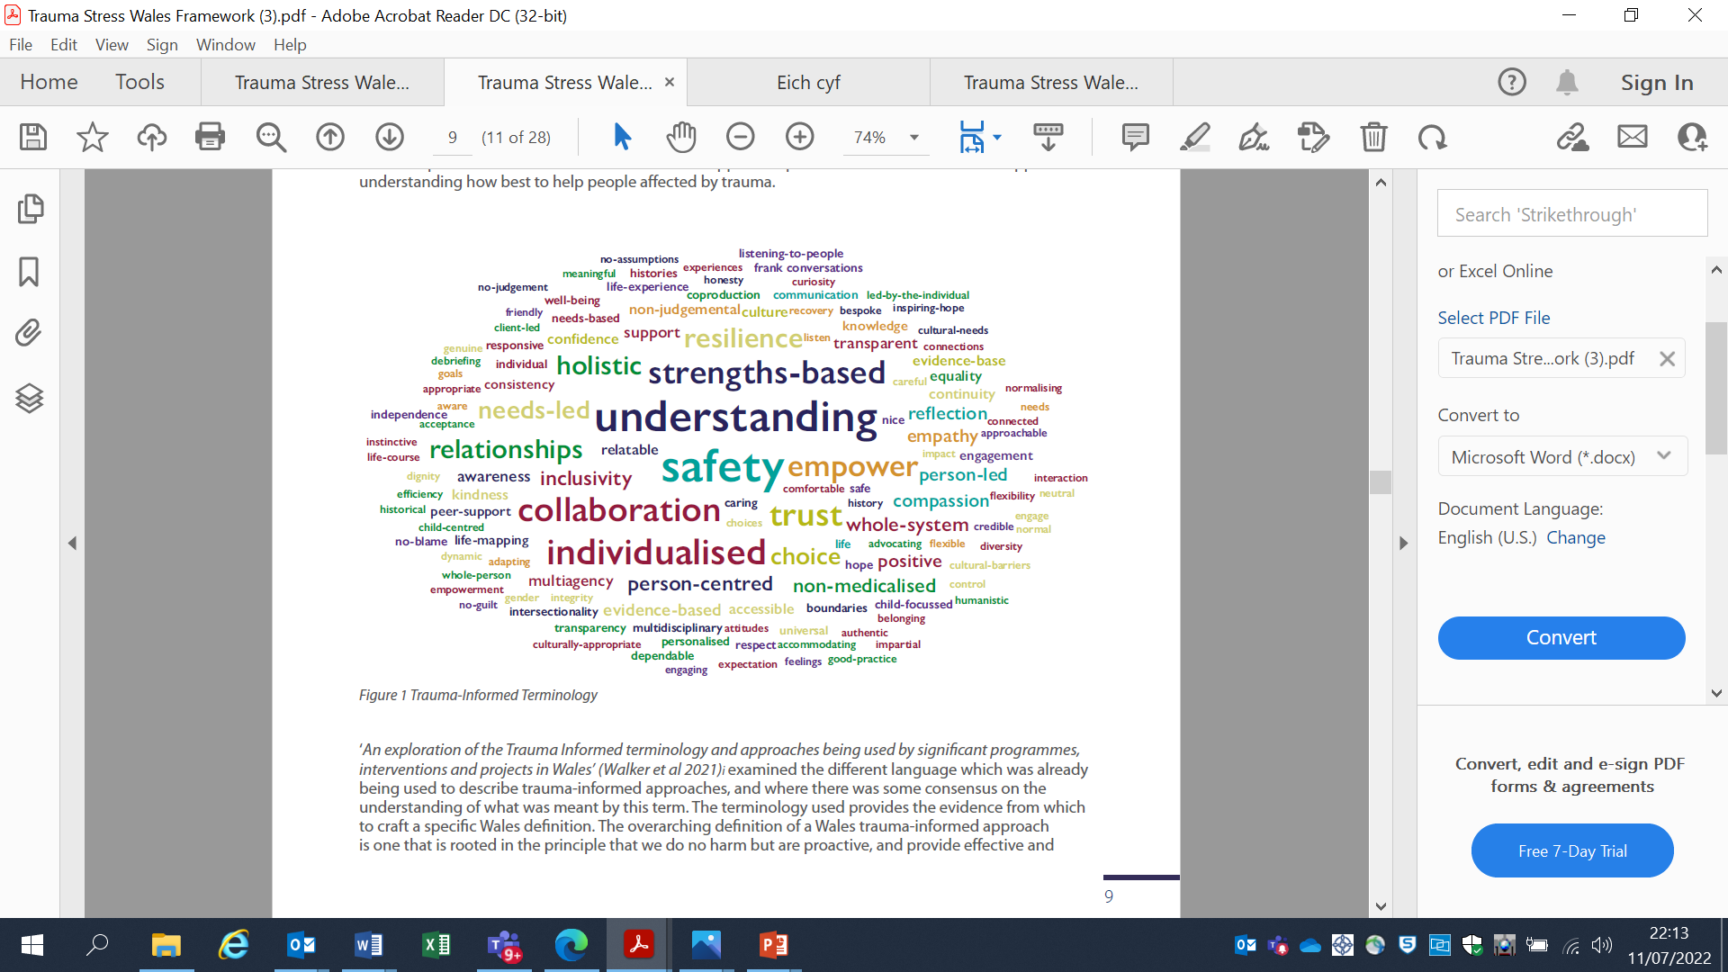
Living our trauma-informed approach

Slide 7
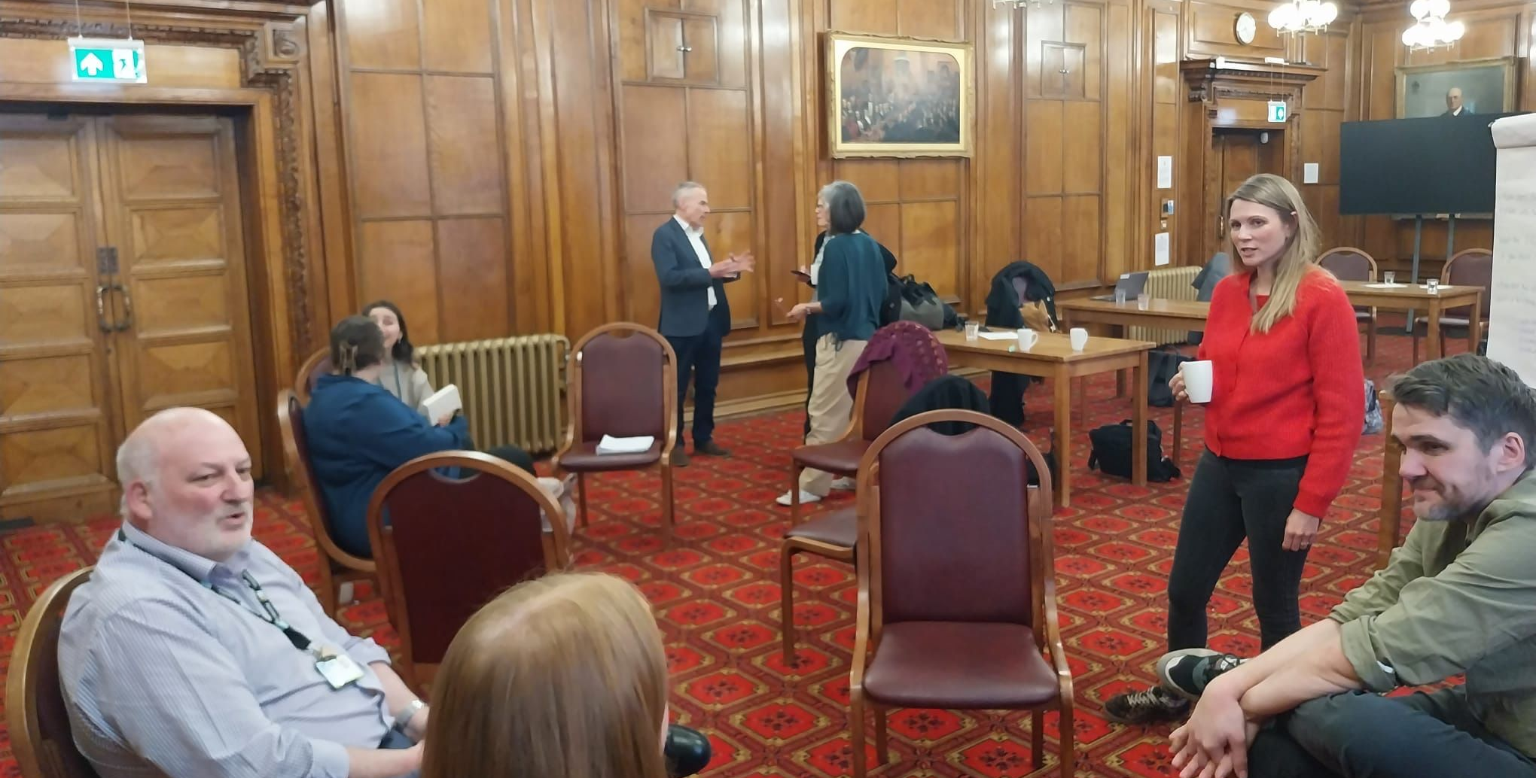

Relational Working
Developing relationships with Steering Group and Working Group co-chairs
Finding commonality and alignment to avoid duplication and learn
Understanding our motivations
Visualising the future

Slide 8
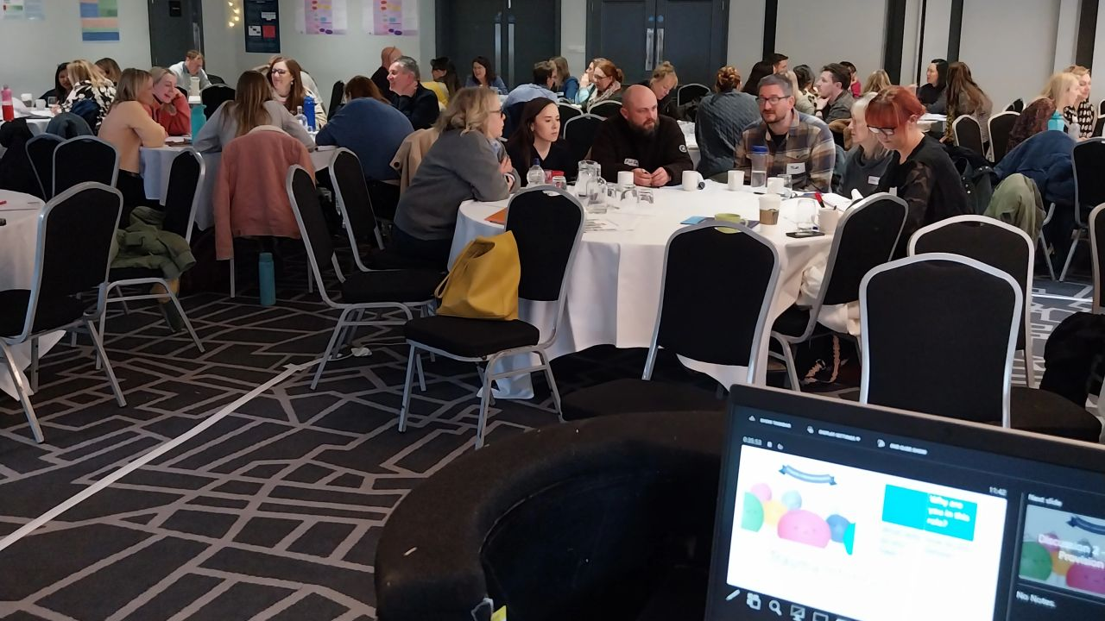

Slide 9
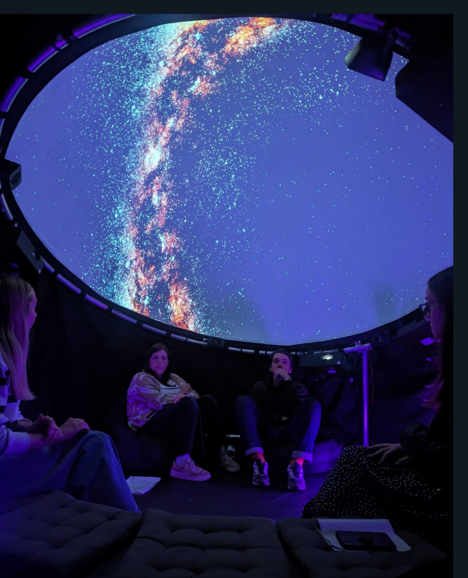
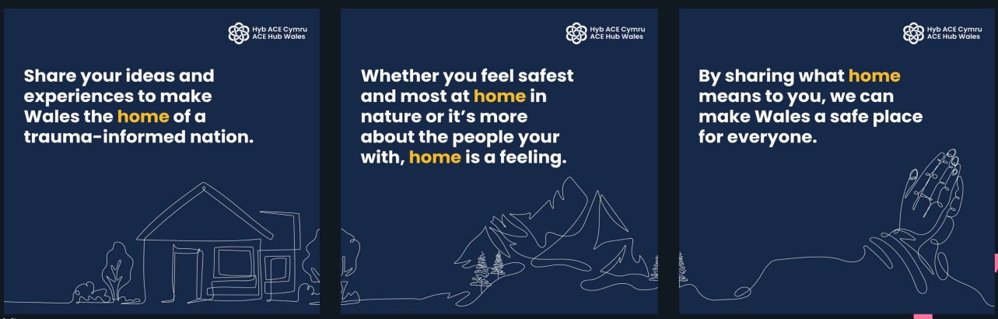

We are Wales: taking the hospital to the community - an engagement experiment
Taking inspiration from the Global We initiative, ACE Hub Wales wants to provide a platform for underrepresented voices across Wales to be heard on topics relating to adverse childhood experiences such as barriers to accessing services and what future support could look like.
By creating inclusive conversations on the topic of ‘home’ in a setting that felt safe we brought people together, with equal power, to share and learn from each other to promote better outcomes; in the place where they are.
We created space for inclusive conversations to spark collective action toward a trauma-informed Wales, and are hoping to ‘take the hospital to the community’ as national approach that creates a social movement and cultural/societal change

Slide 10

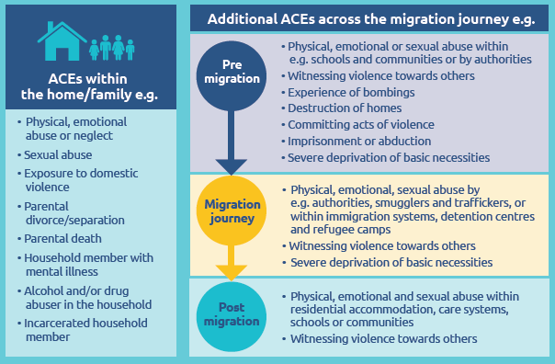
Shifting Focus - the need to prioritise an inclusive Public Health approach to trauma
We believe that there is an urgent and growing evidence that the individual, inter-relational and historical harm produced by racism constitutes a public health crisis…… (Joanna Oliver – London ACE Hub 25th October 2023)
Trauma can stem from various sources such as fleeing as refugees, childhood encounters, racism, and discrimination. The manifestations of trauma in minority communities may differ from those seen in the general population, potentially leading practitioners to overlook the signs. How can we promptly recognise trauma in minority ethnic groups and guide them towards suitable culturally sensitive support? (Jainaba Conteh, Ethnic Minorities and Youth Support Team , 15th May 2024)
Wood S, Ford K, Hardcastle K, Hopkins J, Hughes K and Bellis MA (2020). Adverse Childhood Experiences in child refugee and asylum seeking populations. Cardiff: Public Health Wales NHS Trust

Slide 11


What difference are we making?
Impact

Slide 12
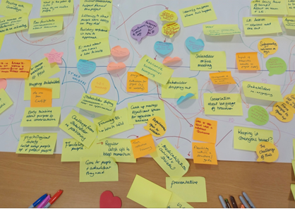
Ripple Effect is powerful

Slide 13
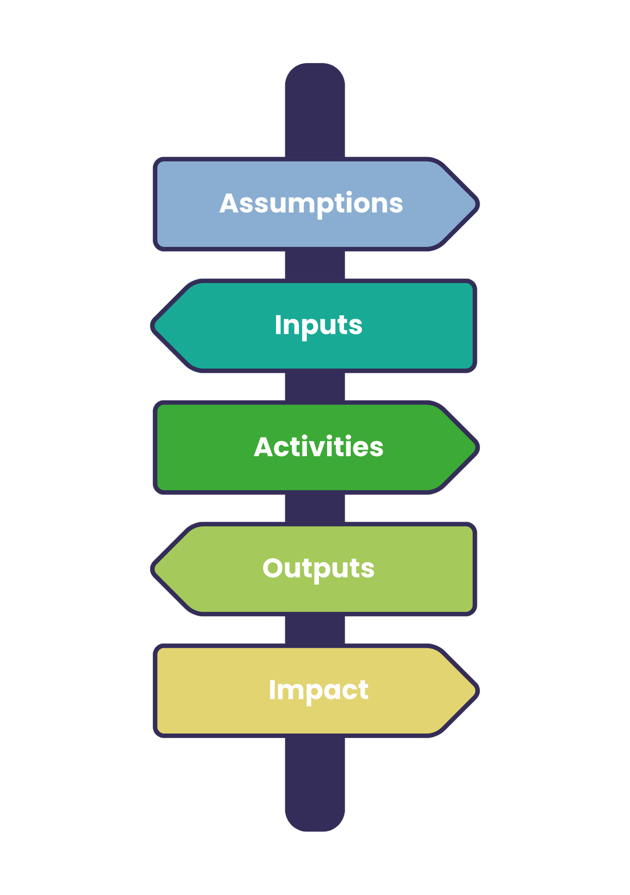
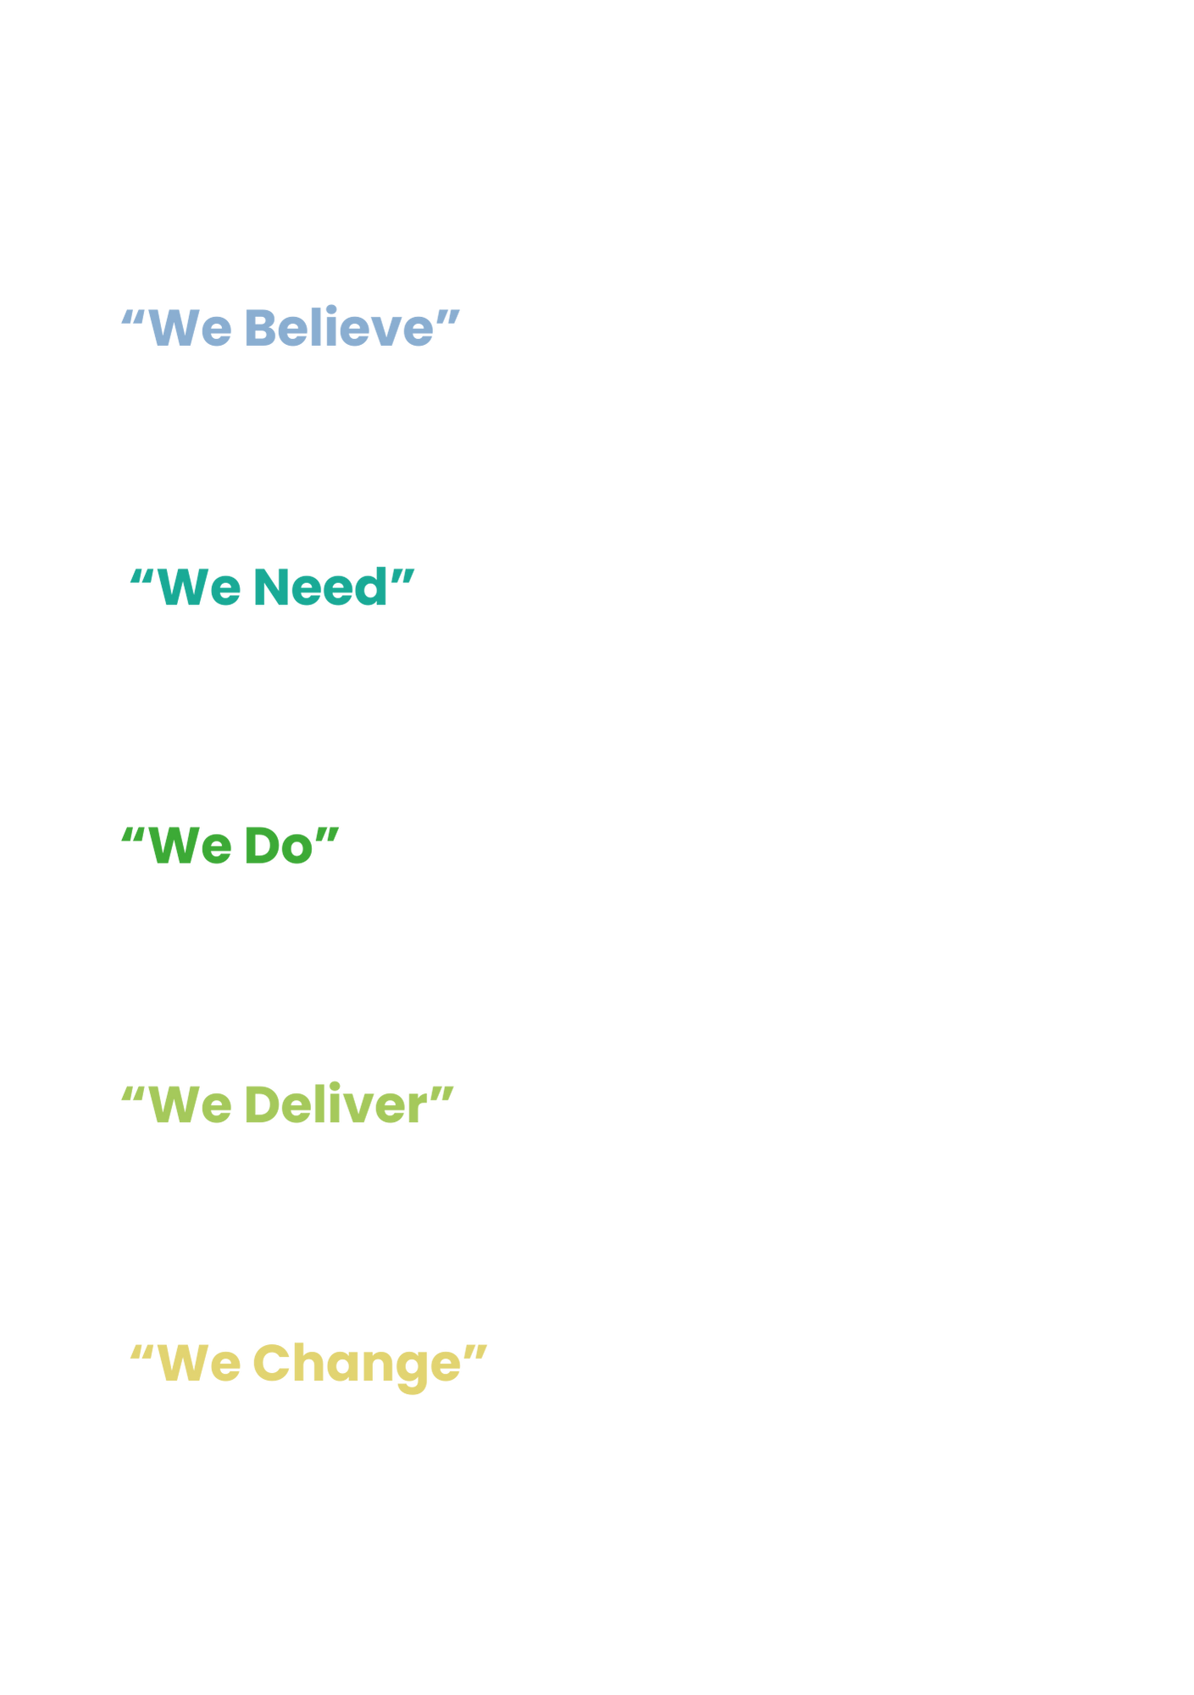
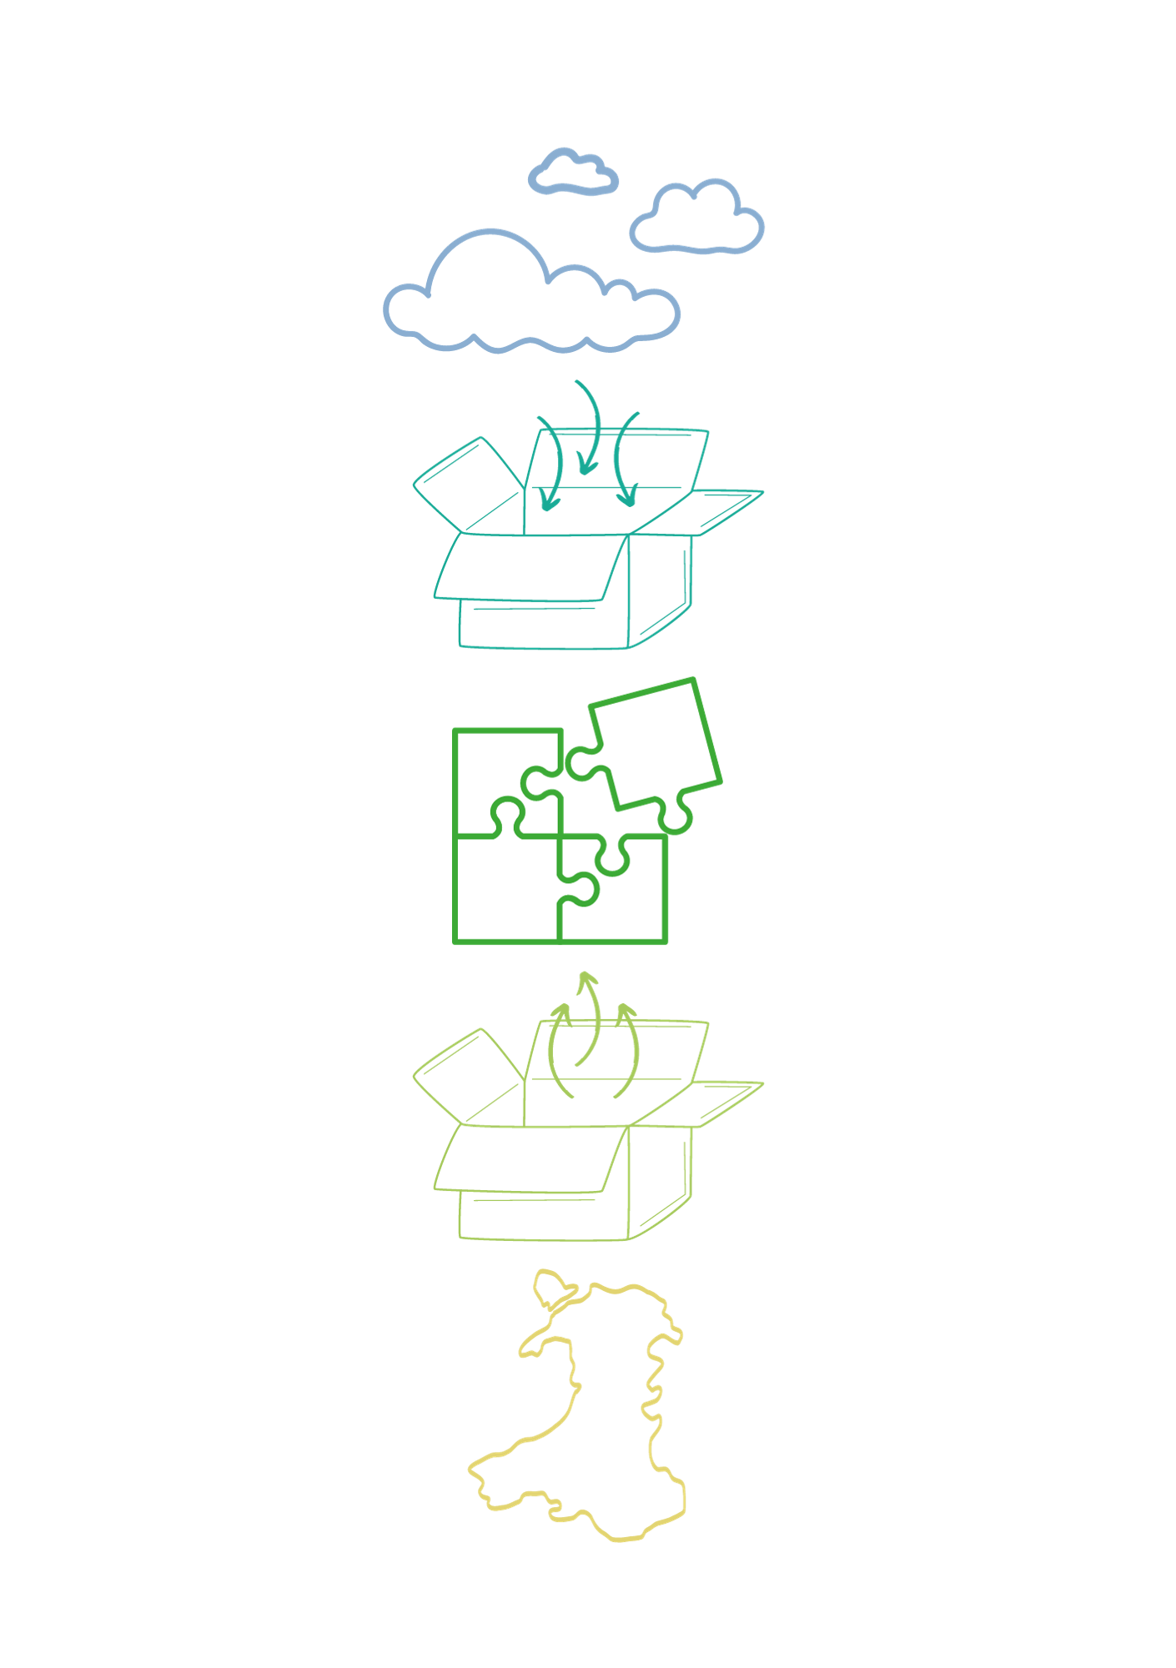


Where Next?

Slide 14
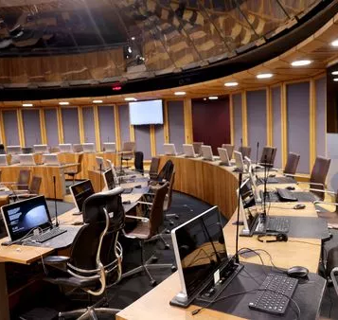
What Next?
Public Narrative
Trauma-informed NHS
Trauma-informed Social Care
Trauma-informed Education System

Slide 15
