Slide 1
Complex trauma and EMDR
Dr Annette Leponis
Consultant Clinical Psychologist and EMDR Consultant
Interim Lead Traumatic Stress Wales
Notes:
Area of interest
As time has passed, EMDR has changed and developed.
So whereas we started with a very nicely structured EMDR process for single case trauma, now we have to think about things from all sorts of perspectives. And it's this shift I'll be taking about today – how I and other people in the field of EMDR and complex trauma are using EMDR.
Who do we have in the room? Therapists/non-therapists? EMDR therapists specifically? Who works with trauma? Who knows what we mean in mental health world by trauma?

Slide 2
Definition of Trauma...
Any experience that is unpleasant and causes, or has the potential to cause, someone distress and /or anxiety
An experience or event outside human understanding
Emotional shock following a stressful event or a physical injury
An emotoinal response to a distressing event or situation that breaks a sense of security
Notes:
Just check in that everyone knows what we mean by 'trauma'.
The first definition is that used in the trauma-informed framework. It's not the only one and different definitions work better for different people.
My favourite is the second. I find it really helps people I'm working with therapeutically understand why I think they might be traumatised. It seems to encompass the third and fourth

Slide 3
C-PTSD: Who are we talking about?
Exposure to a major traumatic event
Commonly after prolonged exposure and/or exposure to multiple events
Traumatic responses:
  difficulty regulating emotion (massive shame)
  negative self-beliefs (I'm evil)
  relationship/attachment difficulties (abandonment, rejection, trust)
  Dissociation (Dissociative Identity Disorder, blanking)
  common PTSD features: nightmares, flashbacks, hypervigilance
Notes:
Who are we talking about when we're talking about complex trauma.
And even this isn't straight forward (because I'm a Psychologist and we don't like giving straight answers;))
We're talking about... for me, and who I'll be referencing today, those who have experienced prolonged childhood abuse
Common features: and for my people we'll ramp that up to paranoia, extreme hypervigilance (to level of setting traps at night)
*might be that these people don't display PTSD symptoms until a long way through the work because they are so well defended against the memories (dissociation). Once not dissociating (which we need to happen to process the trauma), then we're likely to see PTSD symptoms
Emotion: huge amounts of shame
Beliefs: huge amounts of worthlessness, bad, evil, deserving of bad things
Attachments: avoidant at best to disorganised as more standard – restricting relationships
Dissociation: DID, losing huge chunks of time (paralysed in the street for hours, no memories at all, different state ('identity') for months at a time

Slide 4
EMDR
Eye Movement Desensitisation and Reprocessing
Notes:
Included in NICE guidance for trauma (although only a small mention then, I imagine it'll get a much bigger mention when the guidance is reviewed)
Here is Wales, it mentioned in the MATRIX Cymru
Those who have heard of EMDR already will probably know it as the 'finger wagging therapy'. And you're not wrong, this is where the magic happens, but there is much more to it.
It can be used as a therapy 'technique' (that would be at a desensitisation level with a quicker run through the phases and more emphahsis on the finger wagging– e.g. phobia) but can also be used as a full psychotherapy, where emphasis is at a different point of the model. Let me explain. We'll funnel down from widest to the detail...

Slide 5

Adaptive Information Processing (AIP) model
Trauma is stored and stuck in the brain's neural network
Adaptive information processing is impaired, so experiences are inadequately processed
Information is maladaptively encoded and linked dysfunctionally within emotional, cognitive, somatosensory, and temporal systems
Memories become susceptible to dysfunctional recall with respect to time, place, and context and may be experienced in fragmented form
New information, positive experiences and affects, are unable to functionally connect with the disturbing memory
The goal is to add adaptive emotions to the neural network
Bilateral stimulation (BLS) is a process that has the ability to access memory neural pathways and develop new ones
Reprocessing of the trauma and a reduction of associated emotion, creates new associations with memories and increases adaptive behaviours
Notes:
I think this is information we all already know in one way or another
The important bit, is that trauma can INTERFERE with how the brain processes information and through EMDR we can undo the interference.
How?

Slide 6
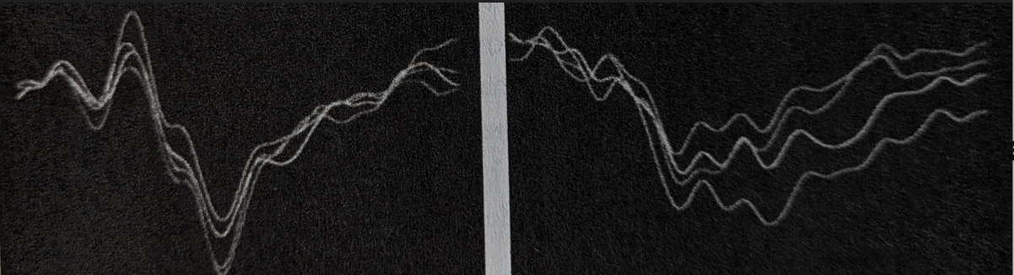
Notes:
First photo – none traumatised brain waves
Second photo – brain waves of traumatised person

Slide 7
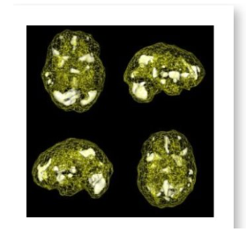
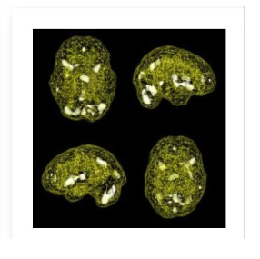
Lansing et al, 2005
Notes:
Before and after EMDR

Slide 8
History taking
Preparation
Assessment
De-sensitisation
Installation
Body Scan
Closure
Re-evaluation
The 8 phases
Notes:
This is the doing and although everyone refers to the 'finger wagging' or 'zapping' as I call it, in complex trauma in particular, we must take our time and make use of each phase best we can.
We know disclosure experience is extremely important. We know people who have experienced sexual abuse feel intense shame. Our best intervention to start with is compassion and containment, which we will the aim to develop as their own resource.

Slide 9
Standard protocol...
the target – the worst part (snapshot)
negative cognition
positive cognition
'how much do you believe it?' (1-7)
Level of distress (0-10)
body sensation
emotion
Notes:
We've talked about the model (AIP), we've talked about the whole therapeutic process (8 phases), we've talked about the re-processing bit (BLS) which particularly sets EMDR apart from other therapies
And now we talk about the therapy session...
SLOW, NO ENERGY
DON'T GET ANYWHERE,
FORGET YOUR PRIOR KNOWLEDGE

Slide 10
Bi-lateral Stimulation (BLS)
Alternate stimulation on either side of a person's body:
Movement – eyes / marching
Tapping / hand-held buzzers
Sounds through headphones
DAS: Dual Attention System
Notes:
The famous phase – desensitisation – the zapping

Slide 11
Perspective Shift
  Therapees
  Have access to an AIP system​
  Have access to internal resources​
  Can access memories​
  Need help creating space (too attached)​
  DON'T
  'Get in the way'
  Explore (without the structure of the protocol)
  Use yourself as a resource
  Leave the buzzers / light on
  DO
  Run the protocol in the exact order
  Start with the touchstone memory
  Only work with one negative cognition at a time
  Keep checking the SUDS
  Therapees
  Don't have access to an AIP system
  Don't have access to internal resources
  Can't access memories
  Need help creating space (too attached) Need help attaching
  DON'T
  'Get in the way'
  Explore (without the structure of the protocol)
  Use yourself as a resource
  Leave the buzzers / light on
  DON'T
  Necessarily run the protocol in the exact order
  Necessarily start with the touchstone memory
  Get hung up on negative and positive cognitions
  Keep checking the SUDS

Slide 12
From all-or-nothing perspective on trauma work to a process point of view
Tactical
Tailored
Tolerable
Temporal
Tackleable
EMDR
EMDr
EMD
Desensitising Dissociative States
Desensitising 'elements'
From reprocessing (not restricted) to contained desensitization (restricted)
Notes:
So fast forward a few years of my practice-based research and this is what I've learnt (which happens to be in line with the thinking of the top dogs in the field). People presenting with complex difficulties have so many things going on. So we're fighting a losing battle trying to fit their experiences into a neat form. Often these people will have trouble regulating emotions, they'll be dissociating, there'll be a lifetime of abuse that is unimaginable to us. However, this is learning that I use with people with and without complex presentations. Mainly, ragardless of diagnosis or how complex the difficulty, it helps us consider So we need to understand our intention conversations

Slide 13
To conclude
Open up conversations: realisations and recognitions
Create capacity for revision without force
Notes:
We do that by...

Slide 14
To conclude...
EMDR is the whole, BLS is the tool
Use the 8-phase framework to CREATE and help access to their AIP (not a linear process)
Most of the work will be history taking, preparation
The work needs to be tactical, tailored, tolerable, temporal, tackleable
Know when you're reprocessing and desensitising

Slide 15
Reflections and Questions

