Slide 1
Recovery College
Hywel Dda University Health Board
Jess Matthews
Notes:
Introduce self –
Jess – work in Hywel Dda University Health Board as the Recovery College and Lived Experience Lead – will tell you more about my role in a second.
I have lived experience of mental illness and accessing services.

Slide 2

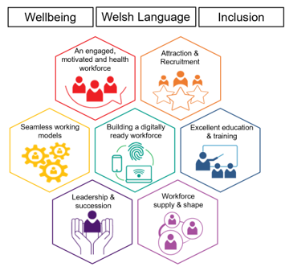


The Strategic Mental Health Workforce Plan
The ambition:
To have a motivated, engaged and valued Mental Health workforce with the capacity, competence and confidence to meet the needs of the people of Wales.
Notes:
The Recovery College project is a Wales-wide project – happening in each health board across Wales. It is currently being funded by Health Education Improvement Wales.
2 Key tasks include –
1. Undertaking a scoping exercise to consider having a Recovery College, identifying potential benefits etc and producing a business case
2. Supporting the implementation of the Strategic Mental Health Workforce Plan

Slide 3
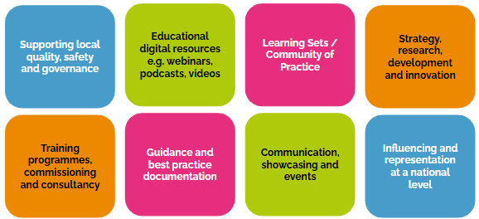
National Recovery College
Supporting the development of local Recovery Colleges, co-produced with health and social care, people with lived experience and their networks, local communities and voluntary sector organisations.
Funded Band 7 Peer Lead in each region (1 year)
Develop and implement plans for local RC based on National Model
Lived Experience Workforce and Peer Leaders Community of Practice
National Peer Network and support for regional leads to support local RC

Slide 4
What is a Recovery College?
A non-conventional educational approach to support individuals
Free educational courses on a range of topics focused on recovery, personal development and wellbeing
Open to everyone
Learning together and from each other
Operates on a self-referral system
Notes:
A Recovery College is an alternative option to the traditional medical models of mental health care that primarily focus on diagnosis and treatment. It can also sit alongside traditional mental health services. It offers free educational courses on a range of subjects including mental health, physical health and wellbeing topics. Taking a more holistic approach to encourage hope and motivation. All courses are accessible to all at any stage of recovery and are free to access.
Recovery Colleges are open to everyone; those receiving / previously received treatment from mental health services, carers, health professionals and members of the wider community. This means that all attendees learn together and from each other.
All courses are co-produced and co-delivered between those with lived experience (known as a Peer Trainer) and a practitioner. There is no hierarchy in a Recovery College – everyone attends as equals which contributes to a shared learning experience and enhances connection. Recovery College’s operate on a self-referral basis – so there is no waiting list and no discharge.

Slide 5
The National Recovery College
Fidelity Model
Peer led | A peer leads the local model
Co-produced | Peer trainers co-produce and co-deliver the courses with educators or practitioners
Community Focused | Service design and evaluation that focuses on what matters to the community not the system
Personal Recovery-Focused | Guided by the principles of hope, control and opportunity
Relationship-Centred Education | Mutual learning through conversations for staff, carers and service users
Wellbeing at every stage of recovery | Self-referral community and inpatient courses
Transformational | Services, cultures, paradigms
Notes:
Must be peer-led – lived experience is at the core of the recovery model with peers in leadership roles throughout the service, and courses are co-produced and delivered by peer trainers modelling that hope and ‘can do’ strength based focus.
Must be co-produced – service design, delivery and evaluation – co-production at every stage
Must be community-focused – so based on what the community wants, not what the system wants
Must be centred around personal recovery – fostering a sense of hope, control and opportunity – recovery looks different for everyone
Relationship-centred – building connection through learning, valuing all experience
Thinking about wellbeing at every stage – self-referral, free, accessible
Transformational – moving from a risk adverse culture to embedding person centred safety planning approaches

Slide 6
Recovery College Principles
Co-production: Collaboration, empowerment, mutual respect and shared decision making
Peer Support: Shared lived experience, empathy, non-judgemental, practical guidance, empowerment and hope, connection and sense of community.
Recovery and Hope: Personal journey, holistic approach, resilience building, belief in potential, empower by building on skills to lead a fulfilled life.
Notes:
A recovery college has 3 key principles – co-production, peer support and recovery and hope
Co-production -
Those with lived experience (service-users / carers) and professionals work together as equal partners to design, deliver and evaluate a service.
This collaborative process aims to create effective person-centred care by valuing the experiences of those with professional knowledge alongside those with lived-experiences.
Peer support –
Individuals with lived experience of mental health challenges / services offer guidance and understanding to others facing similar issues.
Peer support is rooted in the idea that those who have similar experiences can provide valuable insights to help others navigate their journey, and provide genuine empathy.
Recovery and hope –
Recovery is based on the idea individuals can 'recover' from mental health challenges - though this will mean something different to everyone and does not mean an absence of symptoms. Hope inspires the belief of this positive change even in the face of adversity.
Together, the principles of recovery and hope can create environments where individuals feel supported and encouraged to continue their journey.

Slide 7
Ensuring a Recovery College is Trauma-Informed – 5 Practice Principles
No harm approach
Person-centred
Relationship focused
Resilience and strengths focused
Inclusive
Notes:
These are the five practice principles that underpin the Wales Trauma-Informed approach, which we aim to embed within any Recovery College. These principles align with the National Recovery College Fidelity Model.

Slide 8
Embedding Trauma Informed Principles
Principle | How to Embed
No Harm Approach | Co-production, clear boundaries, training
Person-Centred | Flexibility, choices in engagement
Relationship-Focused | Safe, mutual, respectful connections
Strengths-Based | Highlight skills, agency and resilience
Inclusive | Anti-oppression focus, diverse lived experiences, accommodate for different learning needs and styles

Slide 9
Impact of Recovery Colleges
For an individual –
Improved wellbeing and personal growth
Increased hope, motivation and empowerment
Self-management and coping skills
Improved social inclusion and community integration
Notes:
There is only one existing Recovery College (that follows the National Fidelity Model) in Wales – which is in Cardiff. Recovery Colleges of the same model are also well established in pats of England. The evaluation of these services demonstrated that the positive impact of a Recovery College on those that use it include –
Improved wellbeing and personal growth
Increased hope, motivation and empowerment
Self-management and coping skills
Improved social inclusion and community integration

Slide 10
Impact of Recovery Colleges
For Wider Services –
Embedding co-productive practice
Shift in culture
Motivates staff and supports staff wellbeing
Improved relationships between professionals and service-users
Reduced dependency on acute/crisis services
Notes:
The evaluation of existing Recovery College services demonstrated that the positive impact exists for wider NHS and Health and Social Care services including –
Embedding co-productive practice
Shift in culture
Motivates staff and supports staff wellbeing
Improved relationships between professionals and service-users
Reduced dependency on acute/crisis services

Slide 11
Key questions
Break into smaller groups and discuss the following:
1. Further to the set Fidelity model, what additional principles or values should guide the Recovery College in West Wales / Hywel Dda?
2. What would attract and prevent you to access a Recovery College?
3. What would make it easier for you to access and utilise a Recovery College service?
Notes:
10-15 mins

Slide 12
Key questions
Break into smaller groups and discuss the following:
4. What would you hope to gain from accessing a Recovery College?
5. How can we ensure we value Lived Experience and work co-productively to set up and run a Recovery College?
6. What courses would you like to see offered from a Recovery College?
Notes:
10-15 mins

Slide 13
Opportunity to share
Would anyone like to share key points from their discussions with the wider group?

Slide 14

Survey
Please take some time to complete the survey.
You can complete via QR code, or via the paper copies on your tables.

Slide 15
What next?
Views and opinions shared today will help inform the business case
If you have further comments or questions, please contact Jessica.Matthews3@wales.nhs.uk

Slide 16
Thank you for listening and sharing your views

